Slide 1

Guided Reading

Slide 2
Complete the coloured work labelled on your pack.
If you want a challenge, or have some extra time, please feel free to try another group’s work ☺

Slide 3
Purple Group
Perfect picture!
Can you draw what the person in the picture has said ‘thank you’ for?
Sentence challenge!
Can you describe the act of kindness that resulted in someone writing this ‘thank you’ message?
Can you focus on using good descriptions of nouns you use, including the feelings involved with the kind gesture?

Slide 4
Blue Group
Sentence challenge!
Can you describe the act of kindness that resulted in someone writing this ‘thank you’ message?
Can you focus on using good descriptions of nouns you use, including the feelings involved with the kind gesture?
Sick sentences!
These sentences are ‘sick’ and need your help to get better. Can you help?
She gave him a present. It was wrapped up. He opened it. He was happy. He said thank you.

Slide 5
Green Group
Sick sentences!
These sentences are ‘sick’ and need your help to get better. Can you help?
She gave him a present. It was wrapped up. He opened it. He was happy. He said thank you.
Question time!
Who has written the message?
Why have they written the message?
Can you remember the last 5 times you said ‘thank you’ to someone?
Remember to write in full sentences.

Slide 6
Orange Group
Question time!
Who has written the message?
Why have they written the message?
Can you remember the last 5 times you said ‘thank you’ to someone?
What did you say thank you for?
What effect does being polite to people have?
Remember to write in full sentences.
Story starter!
“Thank you…” Two simple words, but such a powerful message...
Continue this story. What will be the reason the character in the story is thankful?

Slide 7
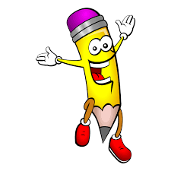
Handwriting
Complete page 25 in your handwriting book.

Slide 8
English
Today is a very important day. Today is V E Day and in English we are going to explore why this is such a special day.

Slide 14
Now answer the questions on your groups coloured slide.

Slide 15
Purple Group
What did VE Day mean?
What happened for VE Day to be announced?
How would people know that there was good news?
Who was Winston Churchill?
Remember to write in full sentences.

Slide 16
Blue Group
What did VE Day mean?
What happened for VE Day to be announced?
How would people know that there was good news?
Name two effects that the war in Europe had on British people?
Who was Winston Churchill?
Remember to write in full sentences.

Slide 17
Green Group
What did VE Day mean?
What happened for VE Day to be announced?
How would people know that there was good news?
Name two effects that the war in Europe had on British people?
Who was Winston Churchill?
Why did he announce that Tuesday would be a holiday?
What was the unusual think that the princesses did on that day?
Remember to write in full sentences.
Remember to write in full sentences.

Slide 18
Orange Group
What did VE Day mean?
What happened for VE Day to be announced?
How would people know that there was good news?
Name two effects that the war in Europe had on British people?
Who was Winston Churchill?
Why did he announce that Tuesday would be a holiday?
What was the unusual think that the princesses did on that day?
Why would some people have felt sad on VE Day?
Name on of the great powers?
How was it shown in London that people were happy?
Remember to write in full sentences.
Orange Group
What did VE Day mean?
What happened for VE Day to be announced?
How would people know that there was good news?
Name two effects that the war in Europe had on British people?
Who was Winston Churchill?
Why did he announce that Tuesday would be a holiday?
What was the unusual think that the princesses did on that day?
Why would some people have felt sad on VE Day?
Name on of the great powers?
How was it shown in London that people were happy?
Remember to write in full sentences.

Slide 19

Maths
Complete the coloured work you would normally do in class.
If you want a challenge (or have some extra time) there is a maths challenge link on the Year 3 page on the website linked to addition and subtraction.
Red Group follow this link https://nrich.maths.org/11012

Slide 20
Purple group
We are recapping our knowledge of time.
Write down the days of the week. How many days are there?
https://www.youtube.com/watch?v=HtQcnZ2JWsY
What day was it yesterday? What day will it be in 2 days time?
Now complete page 29 of your workbook

Slide 21
Blue group
Today we are recapping our knowledge of money.
See what coins you can find around your house. Talk about the coins with your adult – have you got them all? Are there any missing? Put the coins in two groups: worth less than 9p and worth more than 9p.
How many different combinations of coins can you add together to make 10p? Write as many as you can in your book.
Now complete page 32 of your workbook

Slide 22
WALT: count in tenths.
We are going to learn about fractions over the next few weeks.
Look at the yellow pages to help you, then complete the work
for your group.
Green group – green background
Orange group – orange background

Slide 23
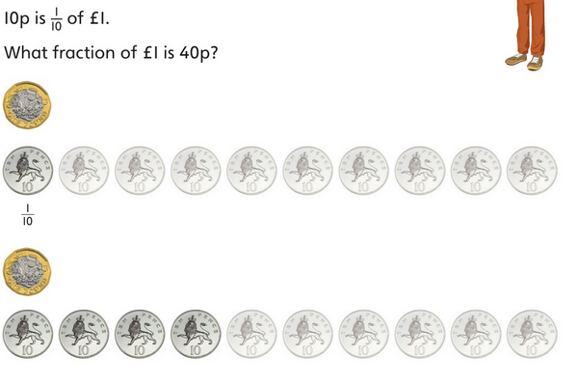

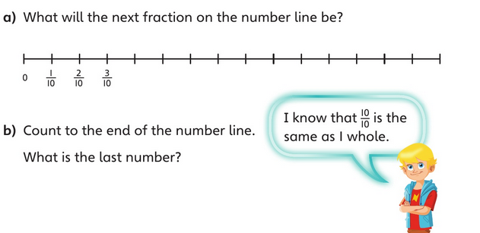
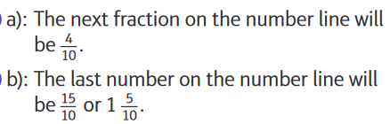
Wednesday’s answers:

Slide 24
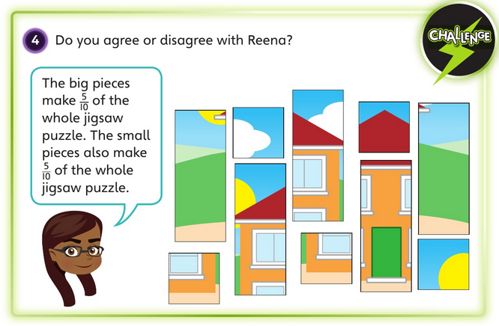

Wednesday’s answers:

Slide 25
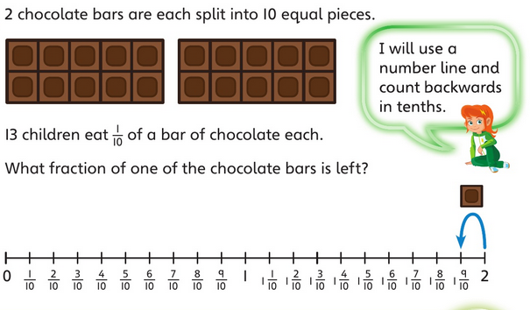
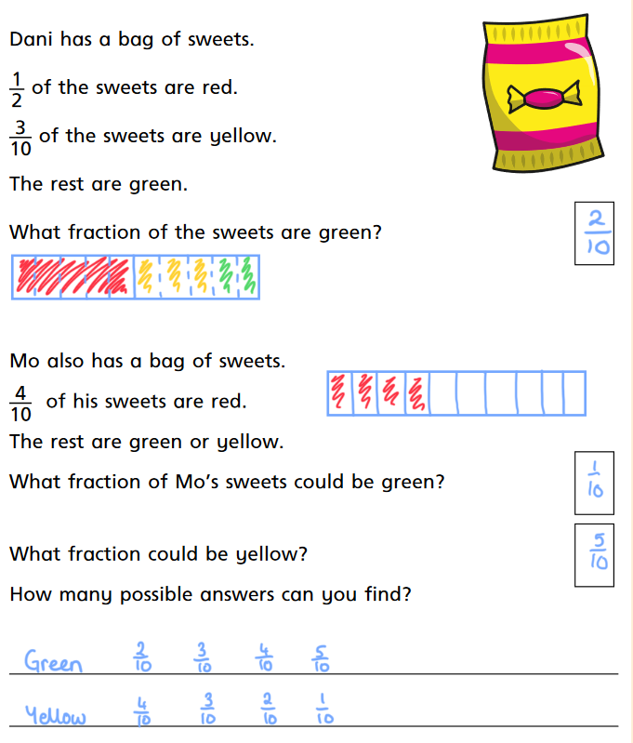

Wednesday’s answers:

Slide 26
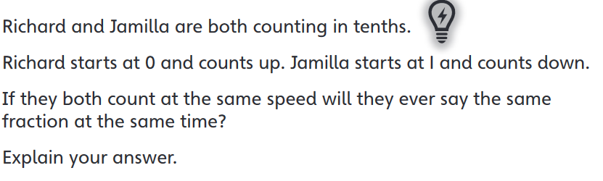

Wednesday’s answers:

Slide 27
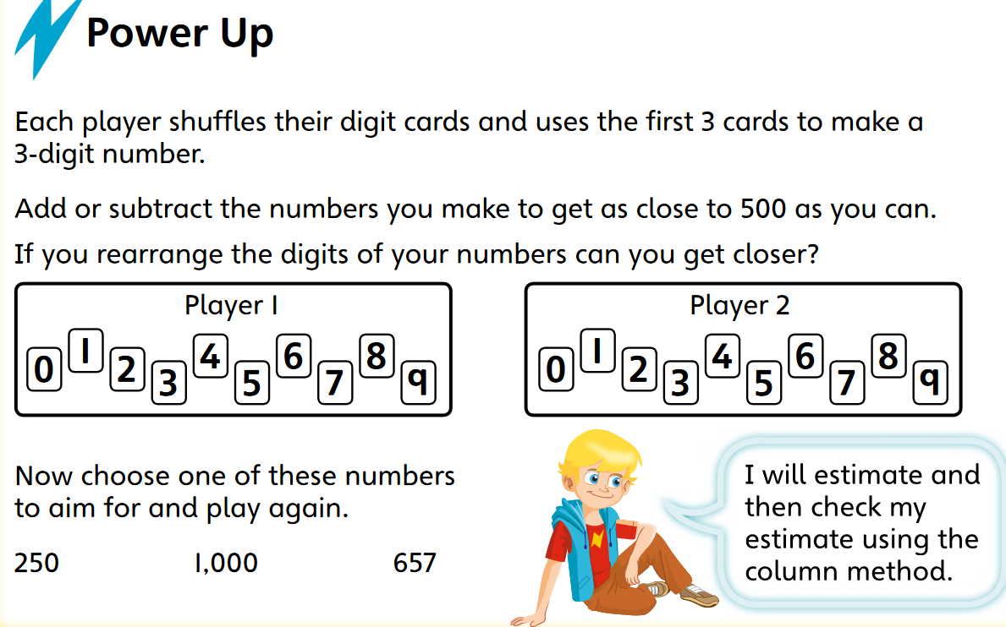
Green and orange warm-up

Slide 28
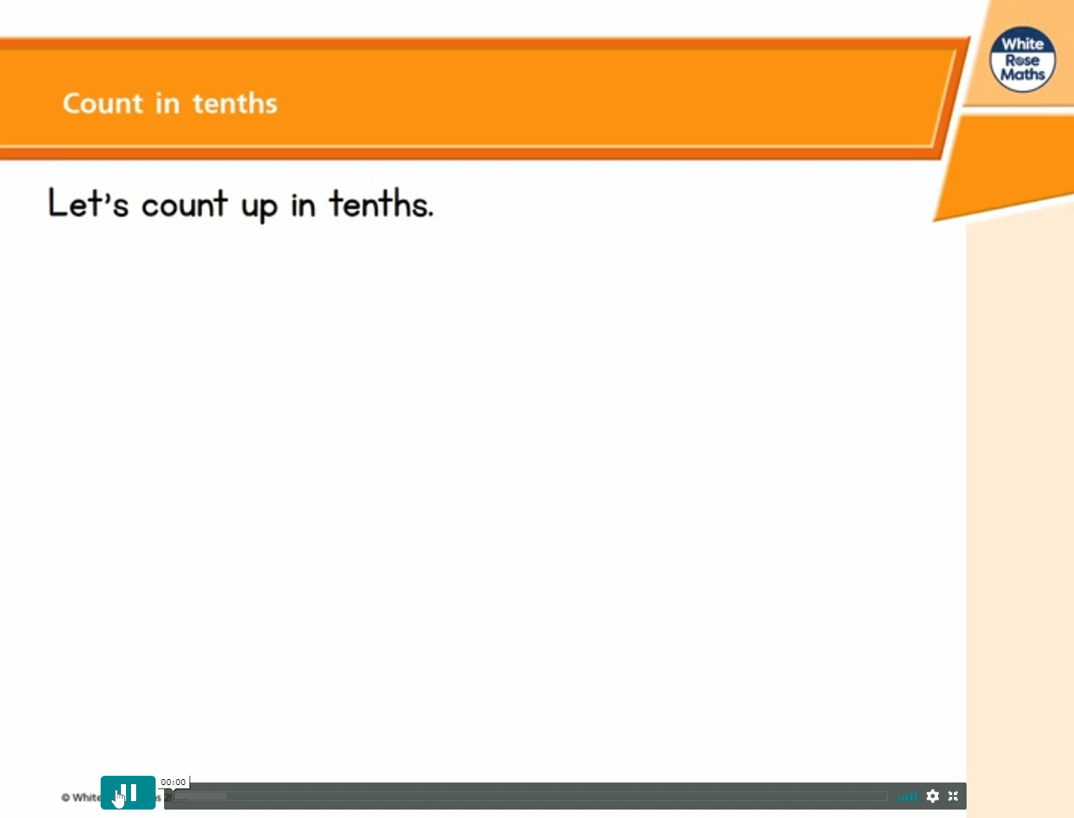
If the video doesn't play - click this link, go to week 1 and then lesson 4 – count in tenths

Slide 29

If the video doesn't play - click this link, go to week 1 and then lesson 4 – count in tenths

Slide 30
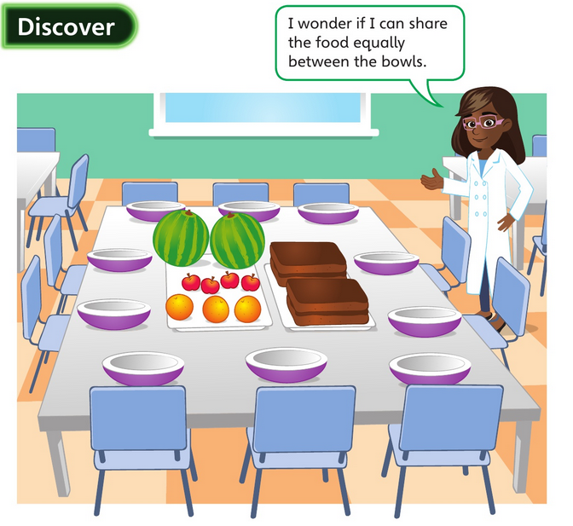
How much apple will each child get?

Slide 31
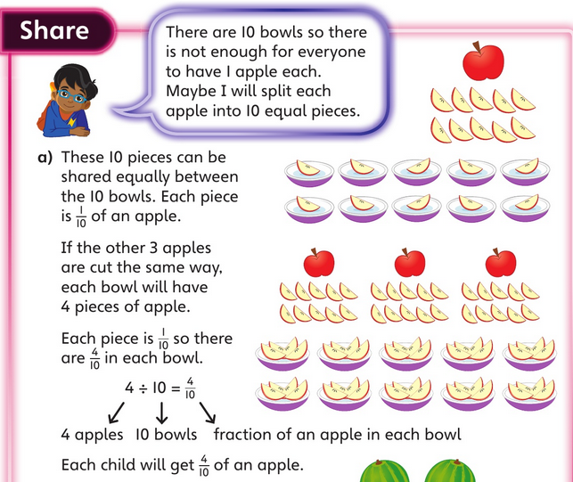
The answer:

Slide 32
How much melon will each child get?

Slide 33
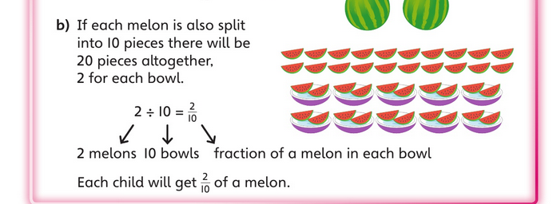
The answer:

Slide 34
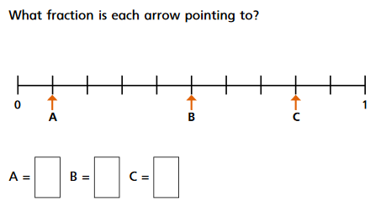

Slide 35
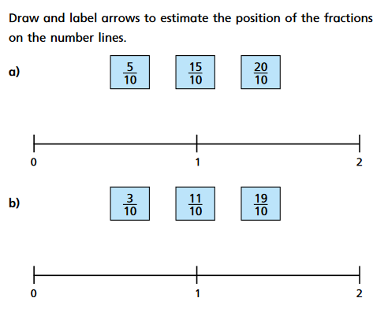

Slide 36
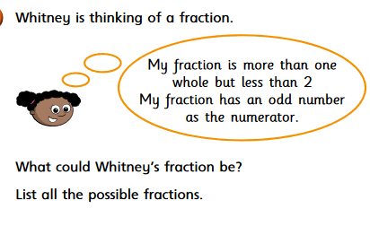

Slide 37
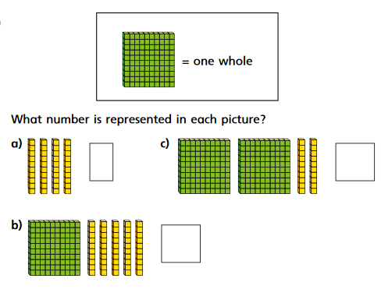

Slide 38
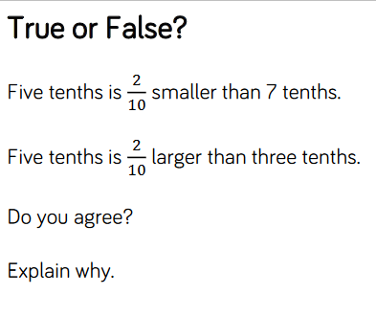

Slide 39
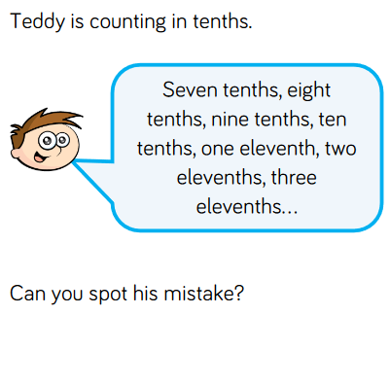

Slide 40
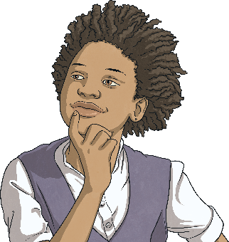

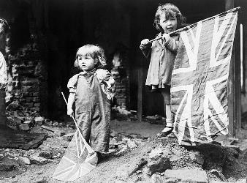
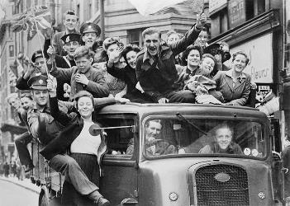
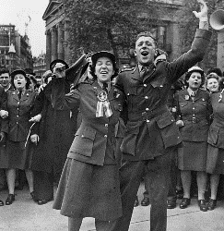
VE Day - 75 Years
The year 2020 marks 75 years since the original VE Day!
But what was VE day?
Here are some images of people
celebrating the first VE Day.
Does anyone have any ideas what VE Day might be?

Slide 41
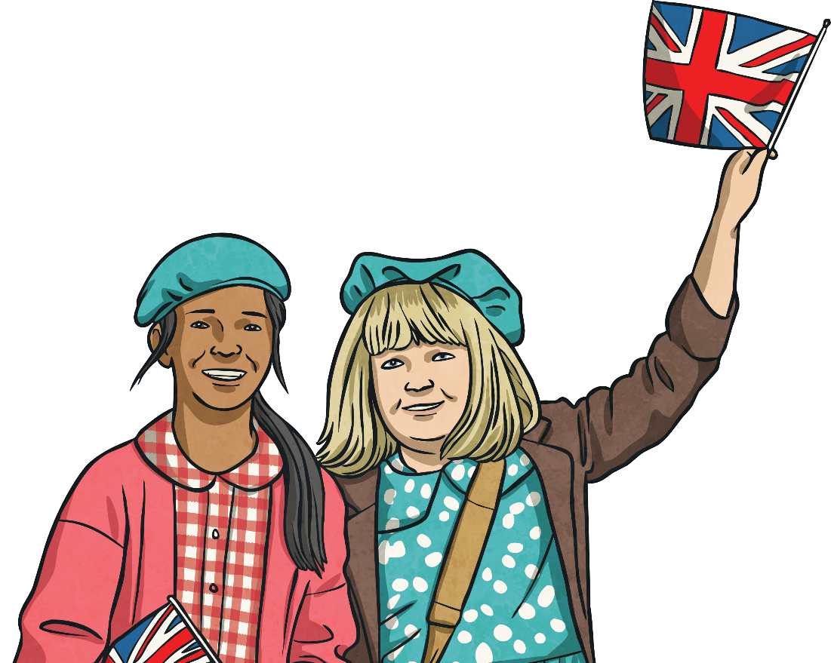
What is VE Day?
VE Day
Victory in Europe Day

Slide 42
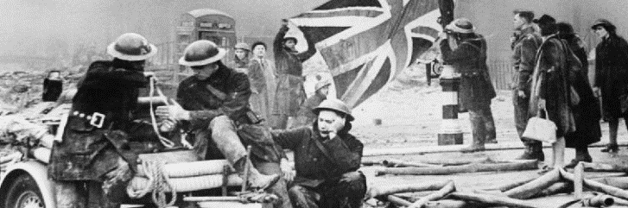
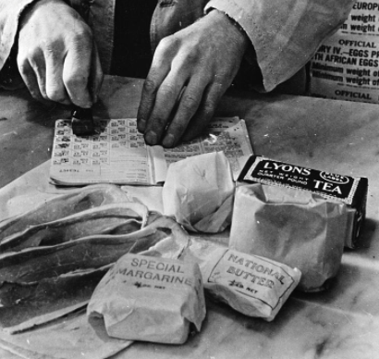
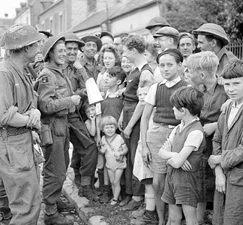
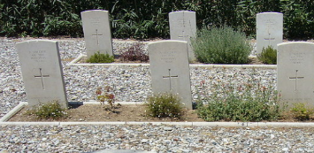
Second World War
Britain had been at war since September 1939.
The war had caused great hardships for the entire country.
Cities, such as Coventry, London and Plymouth were badly bombed and many were killed. Buildings were destroyed and people were left homeless.
Food was rationed; before the war, Britain imported lots of its food from abroad. With German submarines manning the seas, importing food was too risky.
It was usually impossible for soldiers to visit home due to the war.
384,000 British soldiers were killed and many more
were wounded.

Slide 43
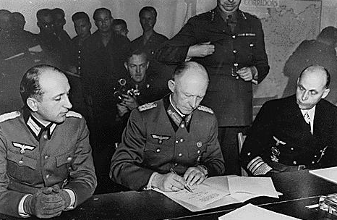
The End
By the end of April 1945, the leader of Italy, Benito Mussolini and the leader of Germany, Adolf Hitler, were dead. Germany was in ruins.
On 7th May, at 2.41 a.m., in Reims in France, Germany surrendered.
This meant that the war in Europe was over.

Slide 44
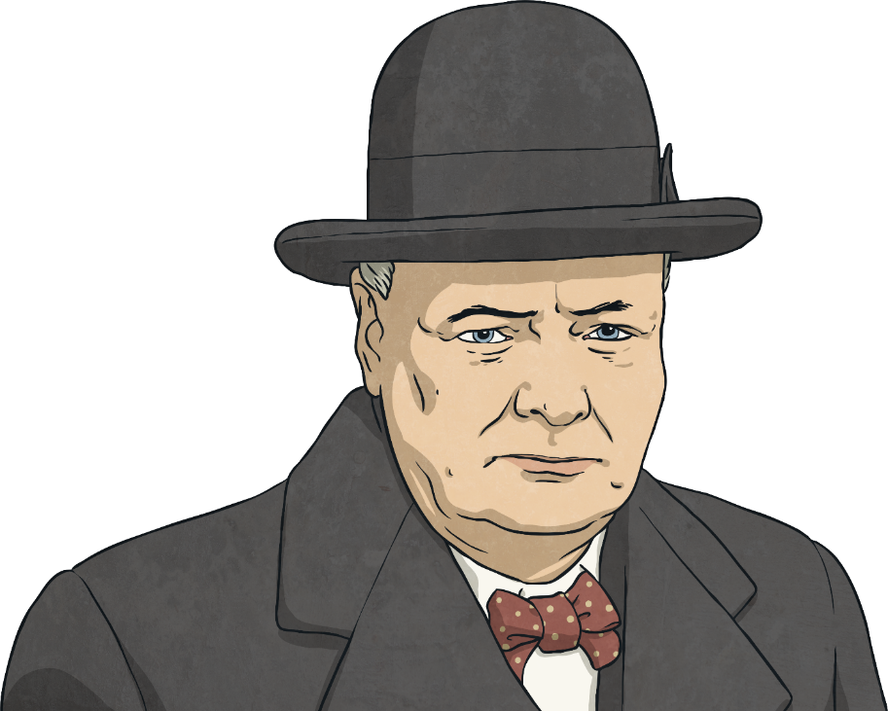
The News Spreads
Before long, the exciting news spread that the war in Europe was over. People ran out on the streets to celebrate and church bells were rung to spread the news.
In accordance with arrangements between the three great powers, tomorrow, Tuesday, will be treated as Victory in Europe Day and will be regarded as a holiday.

Slide 45
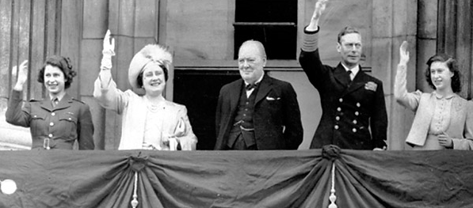
VE Day
The following day was one of great celebration. Churchill made a speech in which he said: ‘My dear friends, this is your hour. This is not victory of a party or of any class. It's a victory of the great British nation as a whole.’
Communities had street parties and churches held services of thanksgiving.

Slide 46



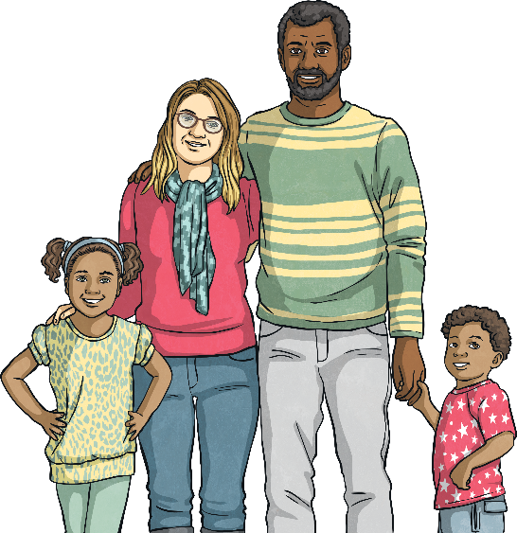

VE Day 2020
To celebrate 75 years since the original VE Day, the May Day Bank Holiday has been moved for the second time in history.
Although it's usually on a Monday, this year, the May Day Bank Holiday will be on Friday 8th May to coincide with the anniversary of VE Day.
The last time the May Day Bank Holiday was moved was also for VE Day - to celebrate its 50th Anniversary in 1995!

Slide 47
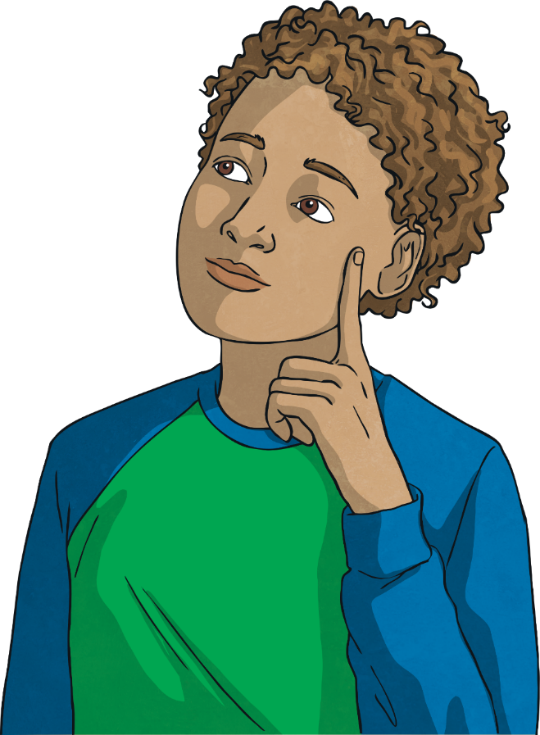
Time to Reflect
In his VE Day speech, Winston Churchill said,
How can you keep going when you face difficult or worrying times?
“Do not despair, do not yield to
violence and tyranny, march
straight forward.”

Slide 48
VE Day Creative Activities
We have put together some creatives ideas for you to mark this special day. We would like you to try at least one of the creative tasks but you can of course try as many as you would like as well as having a go at the word searches or even build your own spitfire plane.

Slide 50
We would like you to design your own VE Day teacup to celebrate the 75th Anniversary.
You could include
Flags
Bunting
Important figures like Winston Churchill
You should make it bright, colourful and eye catching. It should be a celebration of the day.

Slide 52
We would like you to design a VE Day Medal to give to the British soldiers who served in the Second World War.
You can design any shape or size medal but it should include:
The years of the war (1939-1945)
A symbol of victory
You should annotate your design explaining the choices you have made.

Slide 53
Bunting was used to decorate the sheets on VE Day as part of street parties.
Can you design some bunting to use in a street party celebration?
It should be:
Brightly coloured
Eye catching
It could also include flags in your design.

Slide 54
Here is a template of a spitfire plane.
If you can, print out the template and create your own spitfire by folding along the dotted lines.
If you can’t print out the template, then can you draw your own, adding the dotted lines to fold.

Slide 55
Here is a VE Day word search for a little bit of fun! See how many of the below words you can find.
Victory
Europe
Liberation
End
Surrender
Fighting
Party
Festival
Germany
Celebrate

Slide 56
Physical activity – minimum 30 minutes each day | Link to resource
5 a day User Name: FPS53 / Password: JFz4XqG7 | https://player.5-a-day.tv/
Joe Wicks – PE sessions | https://www.youtube.com/channel/UCAxW1XT0iEJo0TYlRfn6rYQ
Cosmic Kids Yoga | https://www.youtube.com/user/CosmicKidsYoga
PE Hub Parents Portal | https://pehubportal.co.uk/
Go Noodle | https://www.gonoodle.com/good-energy-at-home-kids-games-and-videos/
Go for a walk/run. You must go with an adult from your home and make sure you stay 2 metres away from other people.

