Slide 1

Guided Reading

Slide 2
Complete the coloured work labelled on your pack.
If you want a challenge, or have some extra time, please feel free to try another group’s work ☺
We are going to continue to look at cause and effect. This will help you to think deeper about what you are reading and start to make links.
Can you remember what cause and effect meant?
Why will this help you when you are reading?

Slide 3
Now it is you turn. Have a go at mind mapping the cause and effect for the statements for your group.

Slide 4
Purple Group

Slide 5
Blue Group

Slide 6
Green Group

Slide 7
Orange Group

Slide 8
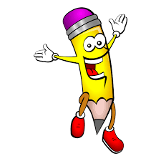
Handwriting
Complete page 24 in your handwriting book.

Slide 9
English
This week we are going to continue exploring Journey by Aaron Becker

Slide 10
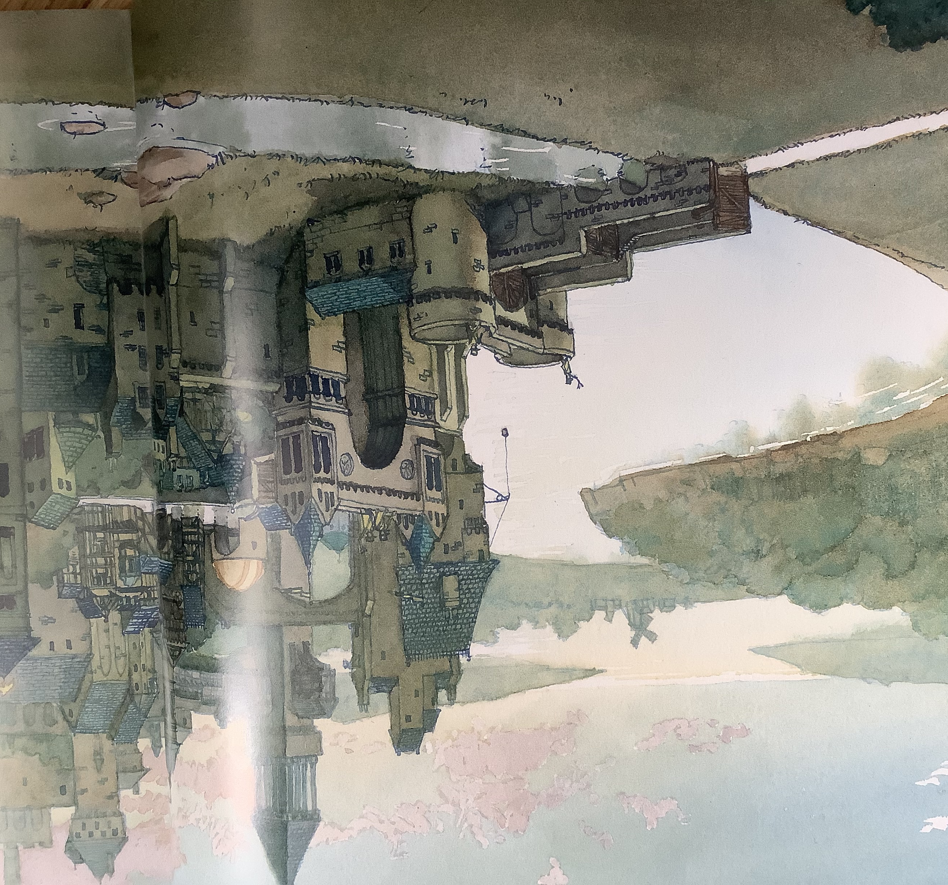
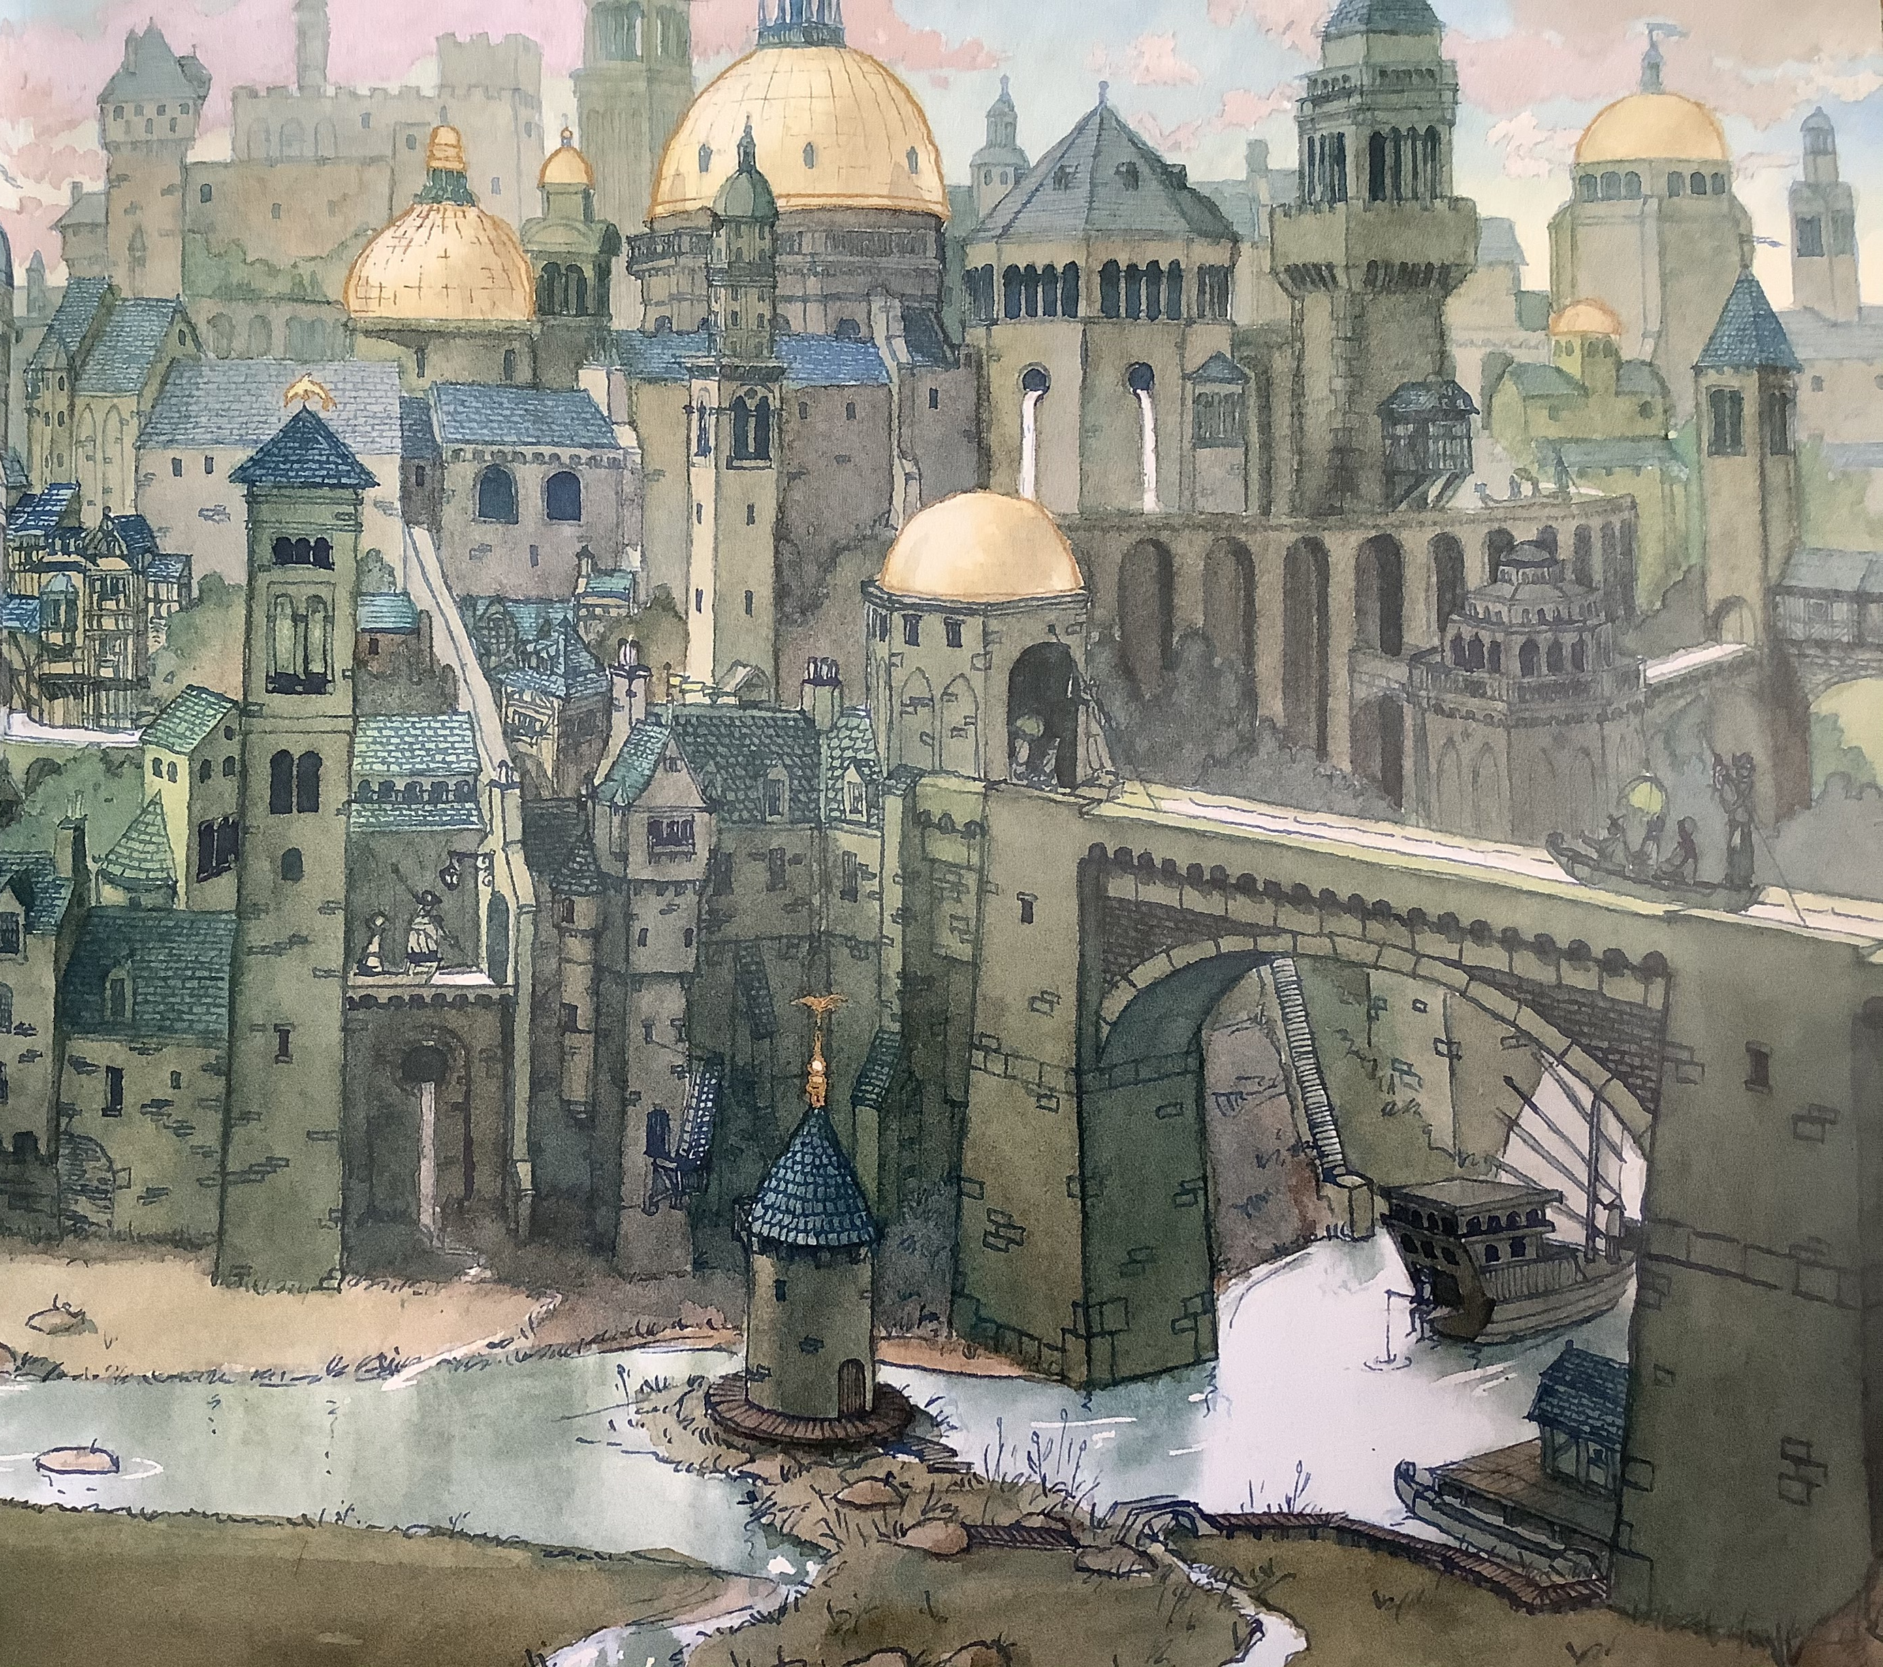
This is where the boat took our character.
Is this what you predicted?

Slide 11
Toolkit for creating a setting.
Show not tell how the character reacts to the setting.
Interesting adjectives
Show the setting through the character’s eyes.
Use your senses to describe it.
Sight
Smell
Sound
Taste
Touch
Prepositions
Below
Near
On top
Using our tool kit create a mind map for the castle to help you write a setting description.
Describe the time of day and weather to create an effect.

Slide 12
Here is mine. What can you see that I have included?
The water flowed slowly around each of the bends, carrying the little boat carefully as it travelled. Katie sat perfectly still in the boat, watching everything go by. Where would she end up?
The trees began to clear, the light became less green, perhaps she was leaving the forest?
As the boat carried Katie out of the forest, in front of her stood the most magnificent building she had ever seen. It was more than a building, was it a village? No bigger. Was it a town? No bigger. This was an entire hidden city surrounded by the magic forest and the water that had carried Katie there.
There were turrets and towers, flags and drawbridges, domes dusted with gold like icing sugar.
In that moment, Katie heard it. The music. It sounded so grand, it must have been for somebody important she thought.

Slide 13
Can you continue the story?
What will happen next?
Why is our character there?
Will she encounter a problem she needs to solve?
How will she get home?

Slide 14
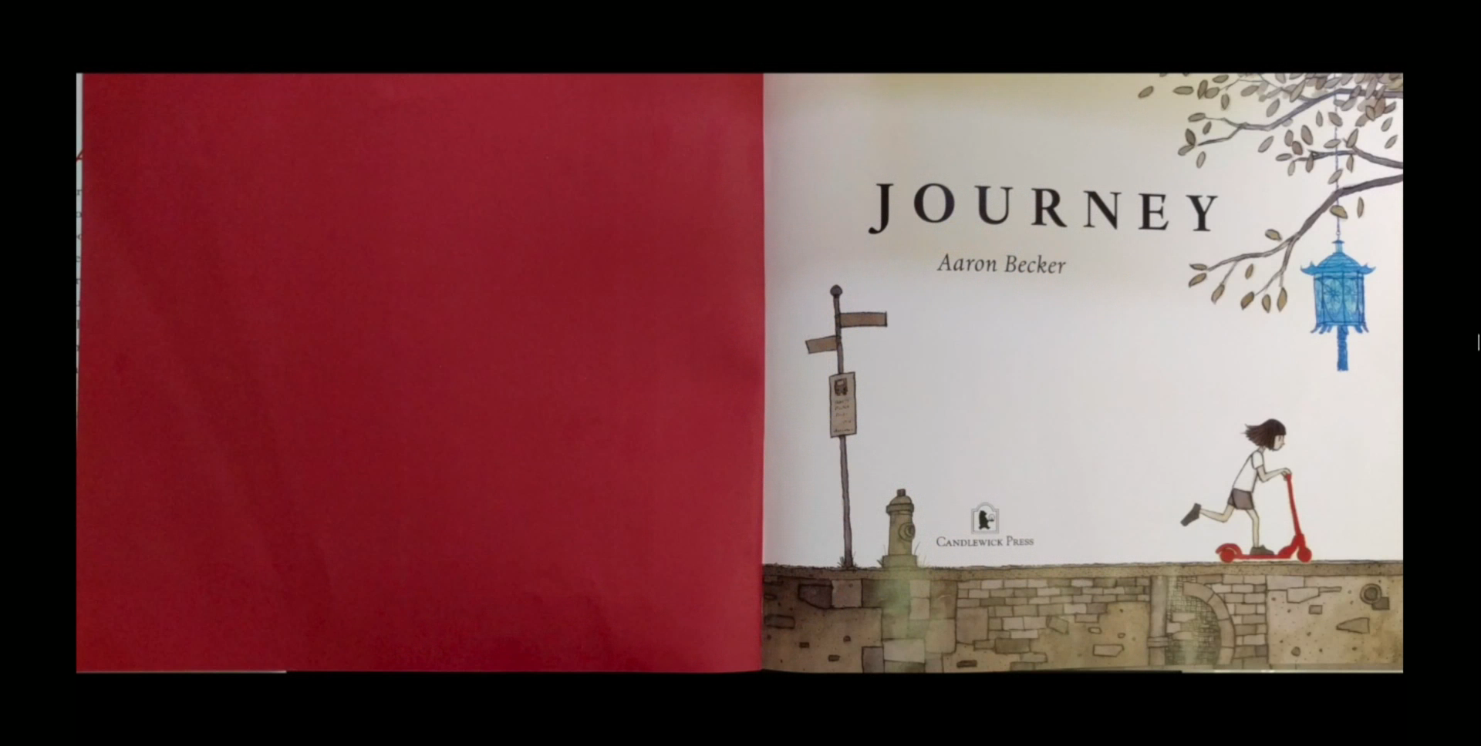
Here is a video to show you how the author thought the story would end.

Slide 15

Maths
Complete the coloured work you would normally do in class.
If you want a challenge (or have some extra time) there is a maths challenge link on the Year 3 page on the website linked to addition and subtraction.
Red Group follow this link https://VEEIGOX.exampro.net

Slide 16
Purple group
We are recapping our knowledge of money.
Find as many coins as you can around your house. Sort them from which coin is worth the least to the most. Record what coins you have found. Are there any coins you are missing?
Check you have thought of all the coins:
https://www.youtube.com/watch?v=vs8F_g3MGtM
Now complete page 28 of your workbook

Slide 17
Blue group
Today we are recapping our knowledge of measuring.
Order everyone in your family from shortest to tallest.
Now order them from youngest to oldest.
Is the order the same?
Pick up 10 objects from around your house. Sort them into two groups based on something you can measure. Examples you might use are:
Length, weight, age, capacity
Record what you have sorted in your book.
Now complete page 31 of your workbook

Slide 18
WALT: identify tenths.
We are going to learn about fractions over the next few weeks.
Look at the yellow pages to help you, then complete the work
for your group.
Green group – green background
Orange group – orange background

Slide 19
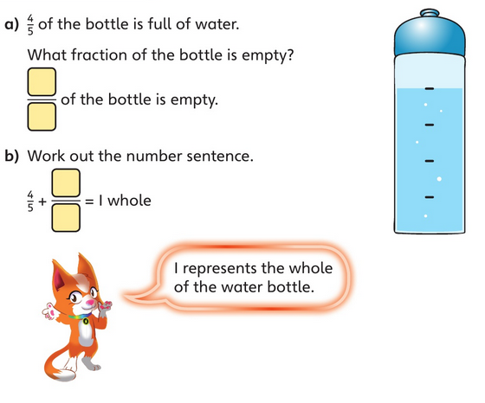
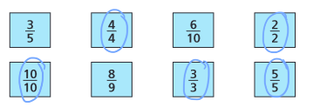
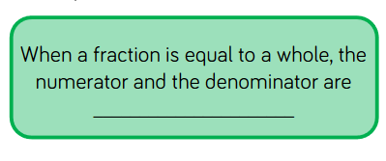
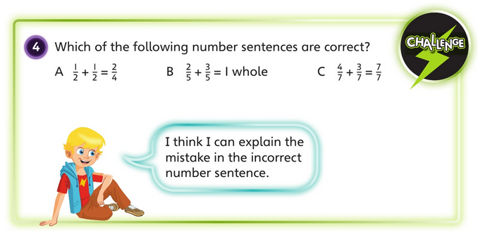

Tuesday’s answers:
equal
B and C are both correct.
A is wrong because ½ + ½ = 1
2/4 is the same as ½.

Slide 20
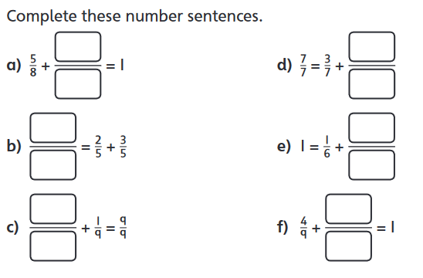
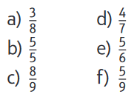
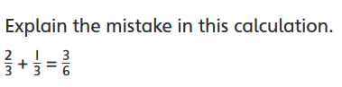
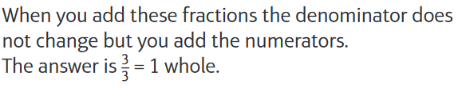
Tuesday’s answers:

Slide 21
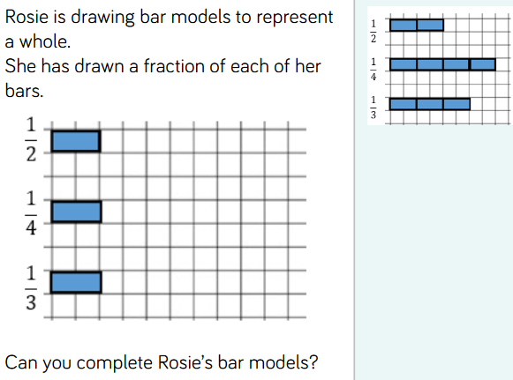
Tuesday’s answers:

Slide 22
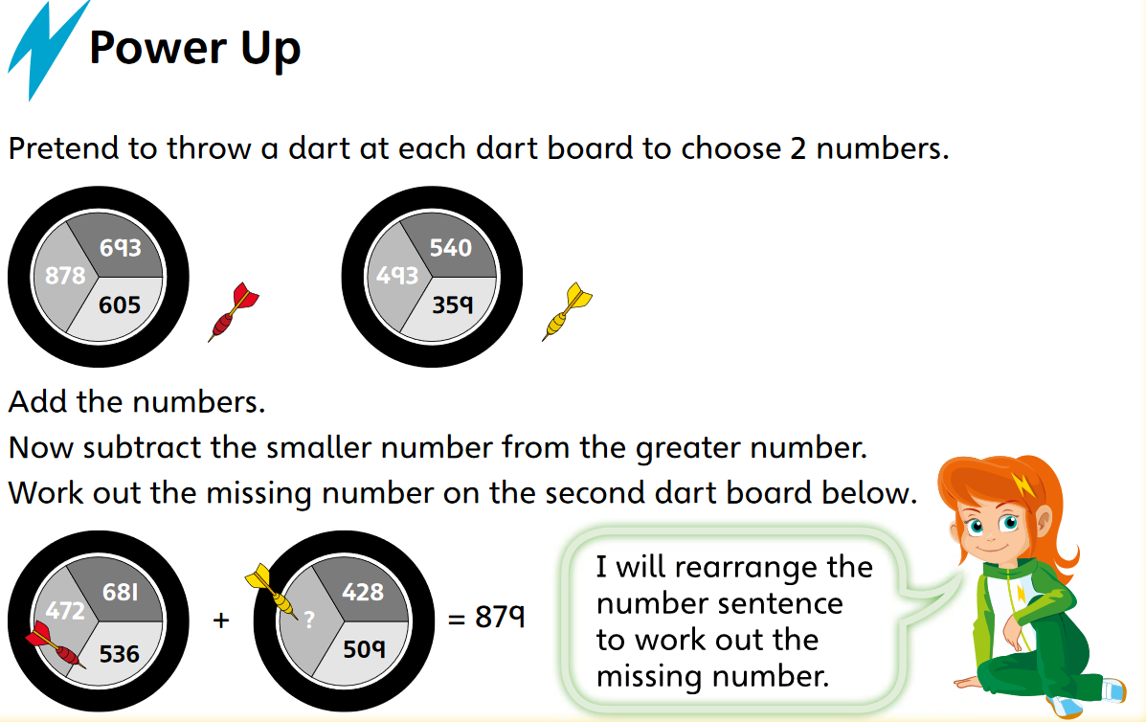
Green and orange warm-up

Slide 23
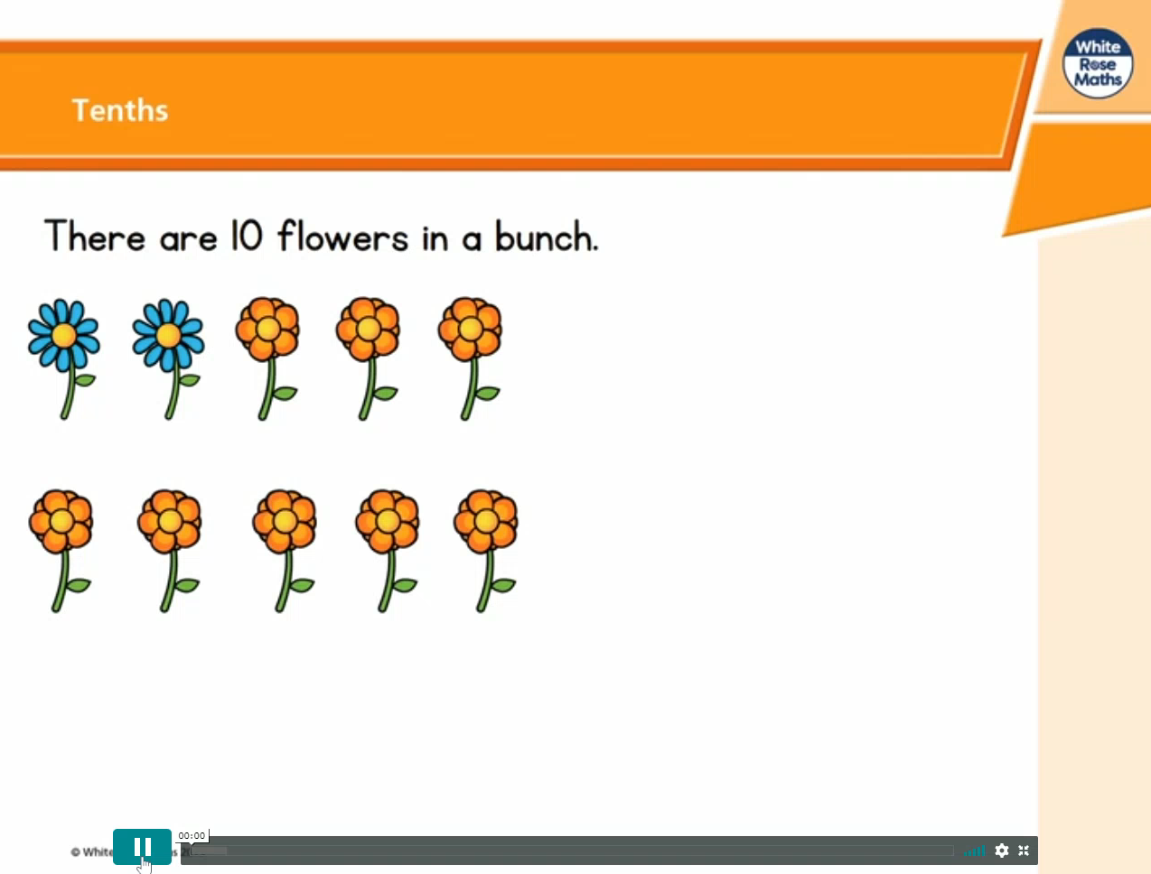
If the video doesn't play - click this link, go to week 1 and then lesson 3 – tenths

Slide 24
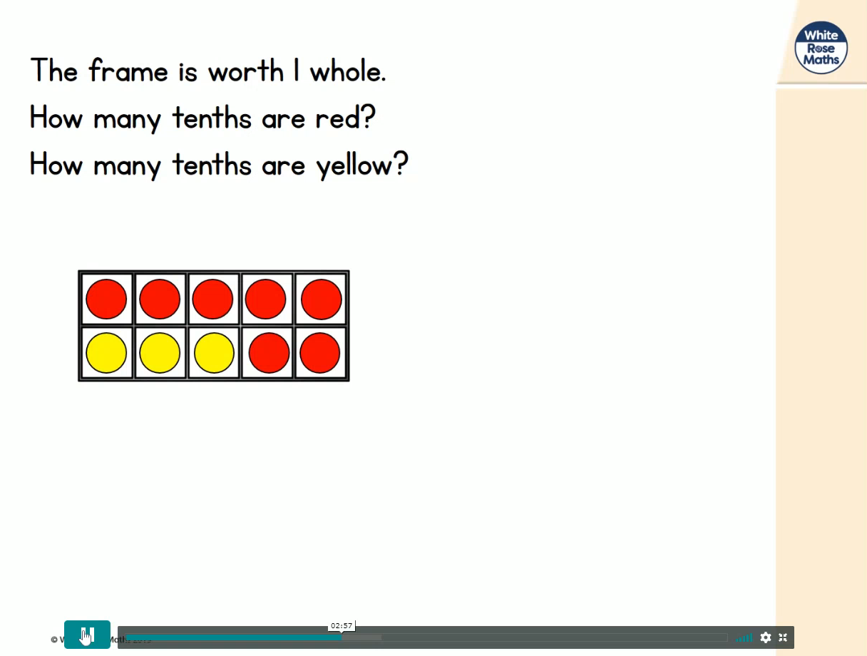
If the video doesn't play - click this link, go to week 1 and then lesson 3 – tenths

Slide 25
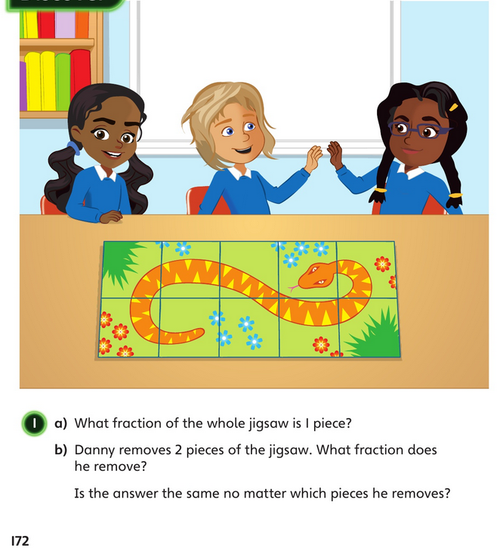
What fraction of the whole jigsaw is one piece?

Slide 26
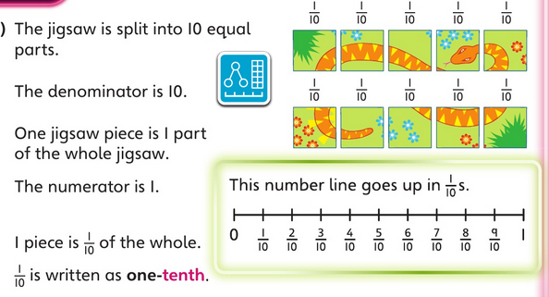
The answer:

Slide 27
Danny removes 2 pieces of the jigsaw. What fraction does he remove?
Is the answer the same no matter which pieces he removes?

Slide 28
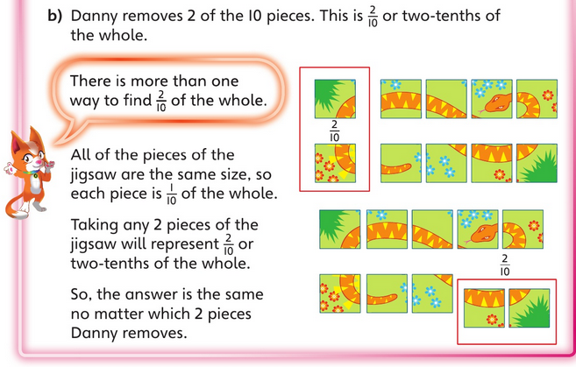
Possible way to show the answer:

Slide 29
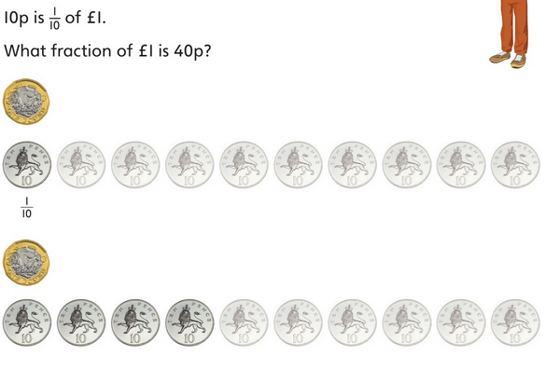

Slide 30
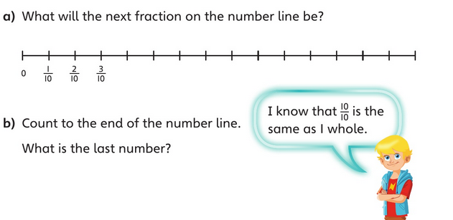

Slide 31
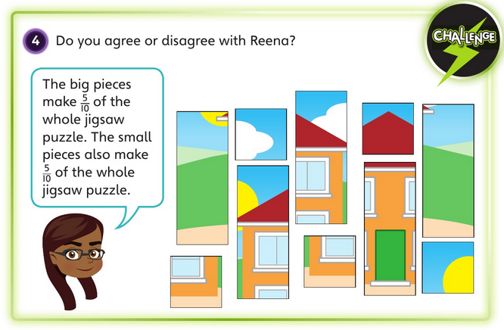

Slide 32
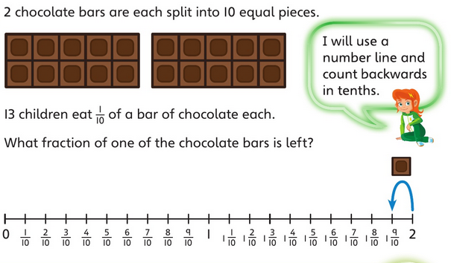

Slide 33
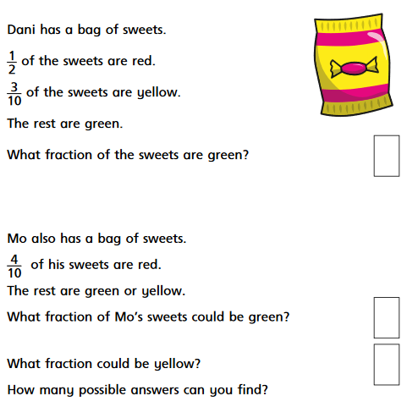
How many tenths is ½ equivalent to?

Slide 34
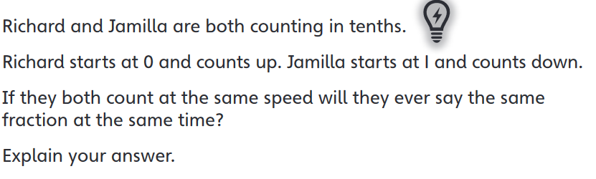

Slide 35

Computing
Use the code for life website, follow this link to login, this also works on devices/tablets:
https://www.codeforlife.education/login_form
Complete levels 13-16 ☺
Phoenix Class (Mrs Roberts):
Login with your first name as the Name (Oliver, also use your initial with no space after your name e.g. OliverL or OliverP)
Class access code: XE569
Password: Farnborough1
Pegasus Class (Mrs Cheeseman):
Login with your first name as the Name
(James, also use your initial with no space after your name e.g. JamesB, JamesR, JamesW)
Class access code: LG594
Password: Farnborough1

Slide 36
Physical activity – minimum 30 minutes each day | Link to resource
5 a day User Name: FPS53 / Password: JFz4XqG7 | https://player.5-a-day.tv/
Joe Wicks – PE sessions | https://www.youtube.com/channel/UCAxW1XT0iEJo0TYlRfn6rYQ
Cosmic Kids Yoga | https://www.youtube.com/user/CosmicKidsYoga
PE Hub Parents Portal | https://pehubportal.co.uk/
Go Noodle | https://www.gonoodle.com/good-energy-at-home-kids-games-and-videos/
Go for a walk/run. You must go with an adult from your home and make sure you stay 2 metres away from other people.

