Slide 1
Good Morning Elves!
You’ve been amazing!

Slide 2
Green group
Tuesday’s
Maths Answers
Challenge 1
35 petals.
Challenge 2
2. 10 wheels
3. 20 spots
Challenge 3
3. Ben has equal groups. He has 4 groups of 2.
Gina has unequal groups as 1 group has 3 doughnuts and 3 groups have 2 doughnuts.

Slide 3
Yellow group
Tuesday’s
Maths Answers
Challenge 1
Yes I can share 8 counters into 2 equal groups.
Challenge 2
2 4 6 8 or 10
Challenge 3
1. 1 3 5 7 or 9

Slide 4
It’s Wednesday!
Wednesday 6th May 2020
Here’s your work for today…
.

Slide 5
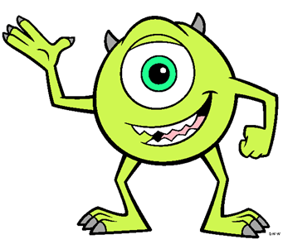
Reading online
I’m so impressed with your reading Elves.
You should be very proud of yourselves!
Please log on to Bug Club
Read for at least 15 minutes.
Please read the key words inside the front cover first.
When you find the bug questions, click and complete them.
Please note down the books you’ve read in your reading
record book.
Your personal login details are on the inside of your reading record book.

Slide 6
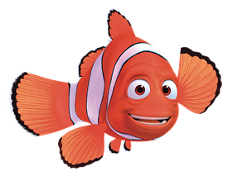
Maths
Today we are learning to add equal groups

Slide 7
Maths
Re-read this words today to remind yourselves of these words. Which word do you think you will spot today?

Slide 8
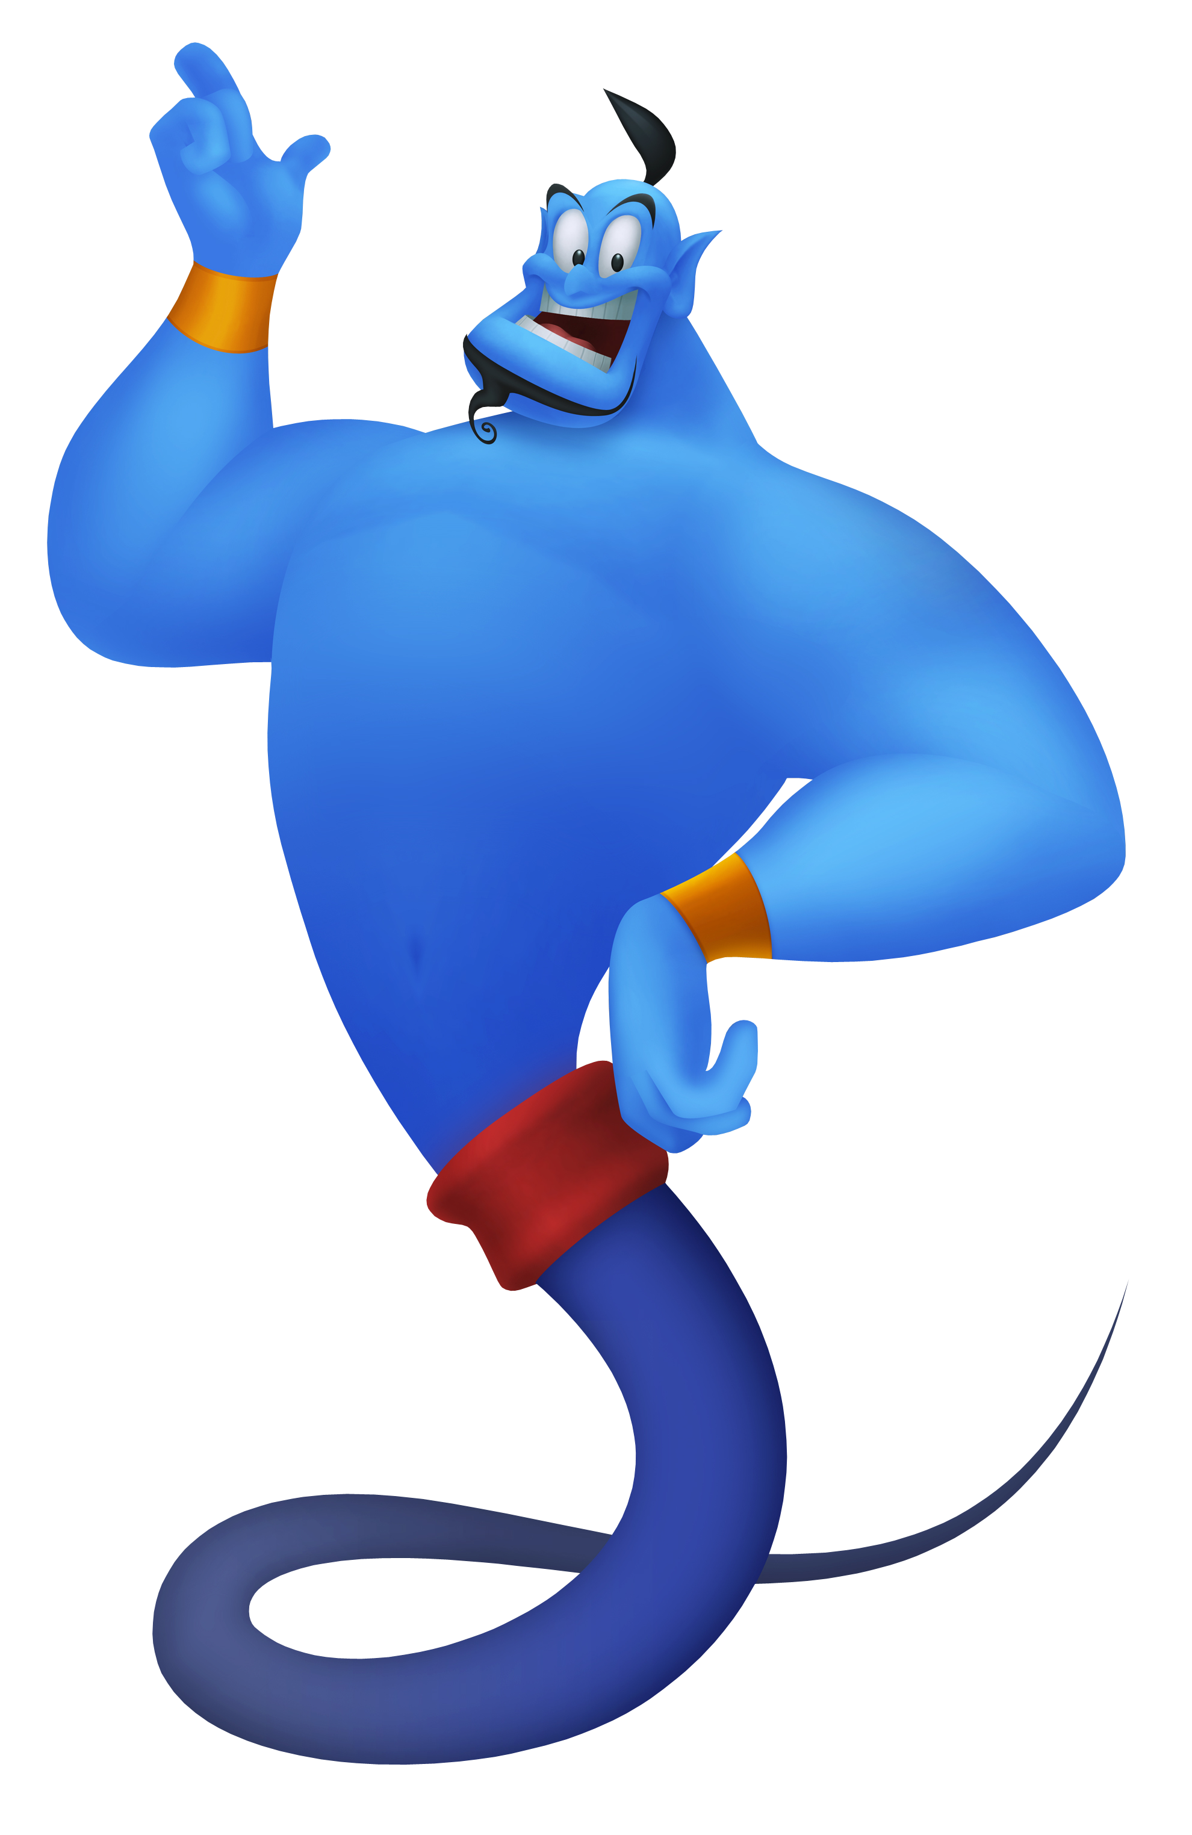
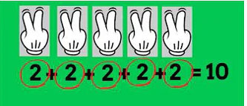
Green group
Maths
Let’s remind ourselves about adding equal groups.
You Tube Adding equal groups
https://www.youtube.com/watch?v=A8trPHq1rx8

Slide 9
Green group
Maths
How many groups are there?
How many in each group?
The answer is on the next page.

Slide 10
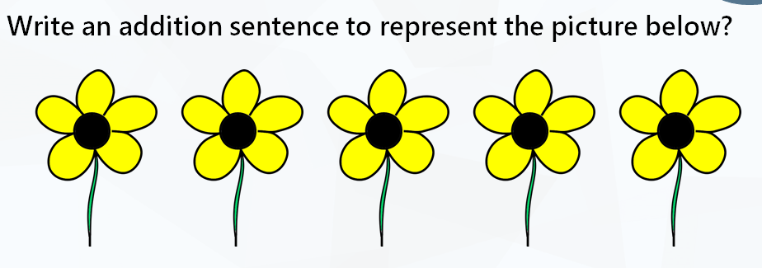
Green group
Maths
Yes brilliant it is ……
The answer is on the next page.

Slide 11
Green group
Maths
Yes fantastic it is….
Draw lines to match the number sentence to the picture groups

Slide 12
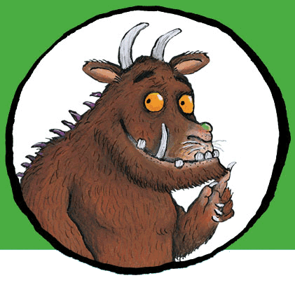
For today’s work, complete the slides which follow in your blue books. .
If you would like to try Gruffalo work, complete challenge 1 on the next page.
If you would like to try Horrid Henry work, complete challenges 1 and 2
If you would like to try James and the Giant Peach work, complete challenges pages 1,2 and 3.

Slide 13
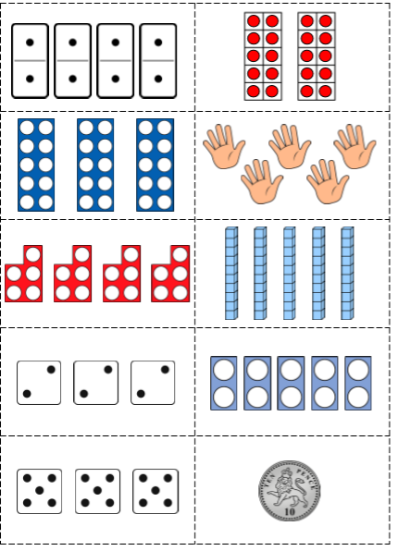
Green group
Maths
Challenge 1
If possible, can you print of the next two pages. If not, you can complete the activity on the screen and use both pages.
Can you match the addition
Sentences on the following
page with these pictures?

Slide 14
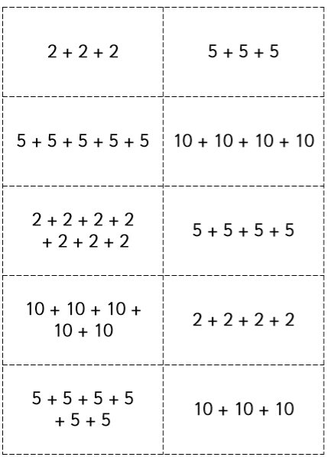
Green group
Maths
Challenge
2

Slide 15
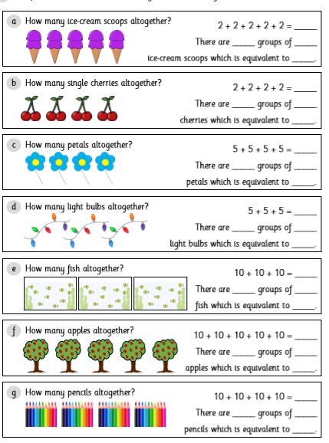
Complete these questions. Try and use a number line to show a repeated addition sentence also. Print of a blank number line found in the Maths section of the Year 1 page.
Green group
Maths
Challenge
2
Can you spot
a new word on
the task?
Yes, its
equivalent.
Equivalent means the same
as equals.

Slide 16
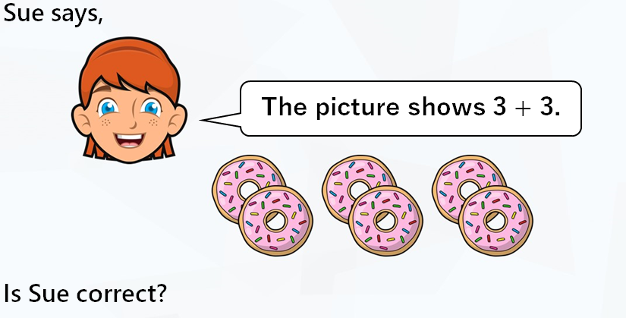
Green group
Maths
Challenge 3
Reply yes or no and explain why. Try and use the word because in your sentence.

Slide 17
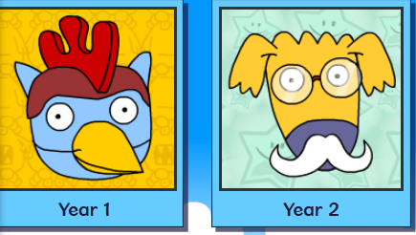
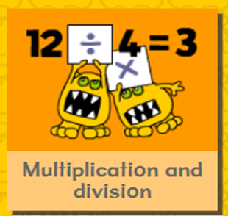
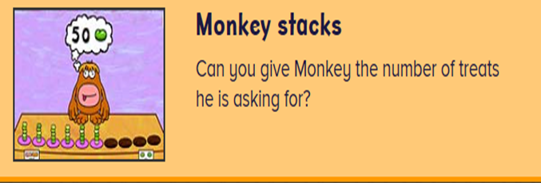
.
.
.
.
Logon on to Busy Things.
Can you score more points today? Are you faster?
Play this game to practise your repeated addition skills.

Slide 18
If you’ve completed your maths quickly, go to the Maths Challenge
Powerpoint on the learning page for
this week and complete one or more challenges. There are challenges linked to this lesson ‘Adding equal groups’.

Slide 19
Yellow group
Maths
Maths
Today we are learning to find odd and even numbers

Slide 20
Yellow group
Maths
Use objects from home (lego pieces, bricks, cars,pens) to practise counting on as shown above.

Slide 21
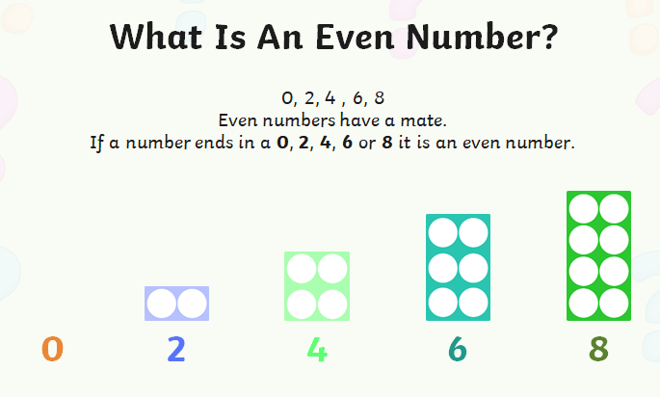
Yellow group
Maths
Use objects from home (lego pieces, bricks, cars,pens) to practise counting on as shown above.

Slide 22
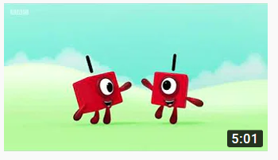
Yellow group
Maths
Follow the link to find out about odd and even numbers.
You Tube odd and even numbers song
https://www.youtube.com/watch?v=0wzyD3qrWUc

Slide 23
Yellow group
Maths
Complete the challenge questions in your blue book.
If you would like to try Gruffalo work, complete page challenge 1
If you would like to try Horrid Henry work, complete pages challenge 1 and 2
If you would like to try James and the Giant Peach work, complete challenge 1, 2 and 3

Slide 24
Yellow group
Maths
Challenge 1
Use objects from home (lego pieces, bricks, cars,pens) to practise the above.

Slide 25
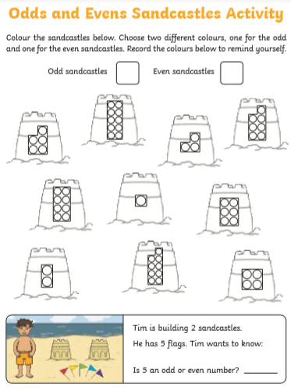
Yellow group
Maths Challenge
2
Use objects from home (lego pieces, bricks, cars,pens) to practise counting on as shown above.

Slide 26
Yellow group
Maths Challenge
3
Use objects from home (lego pieces, bricks, cars,pens) to practise counting on as shown above.

Slide 27
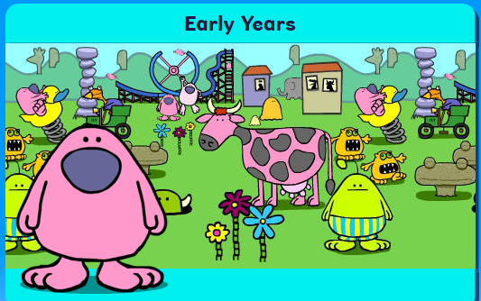
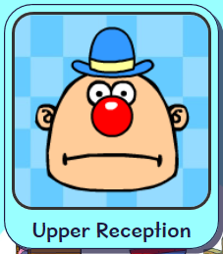
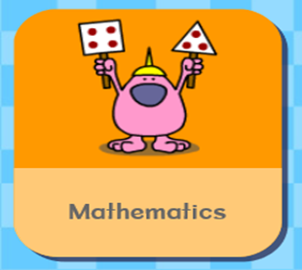
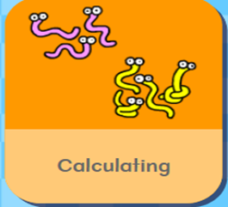
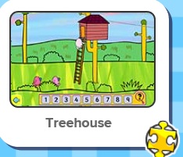
.
Logon on to Busy Things. How did you get on with the games
yesterday.. Play the following game to practise your counting skills.

Slide 28
Handwriting
.

Slide 29
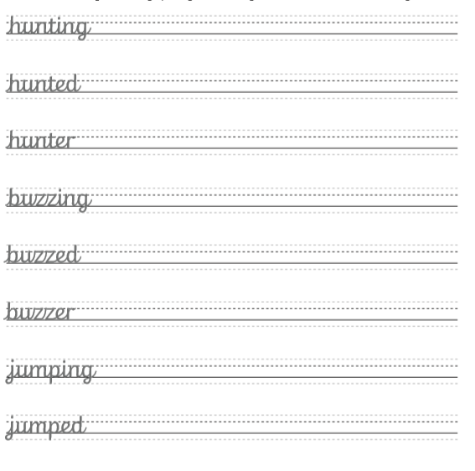
Handwriting
.

Slide 30
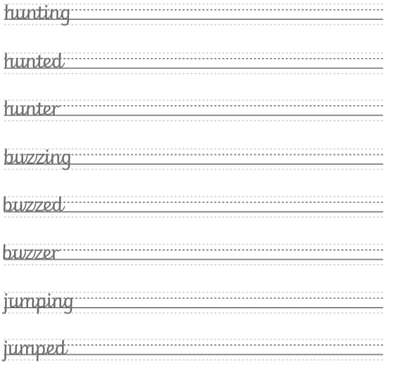
Handwriting
.

Slide 31
English
We are learning to answer
questions about a story.

Slide 32
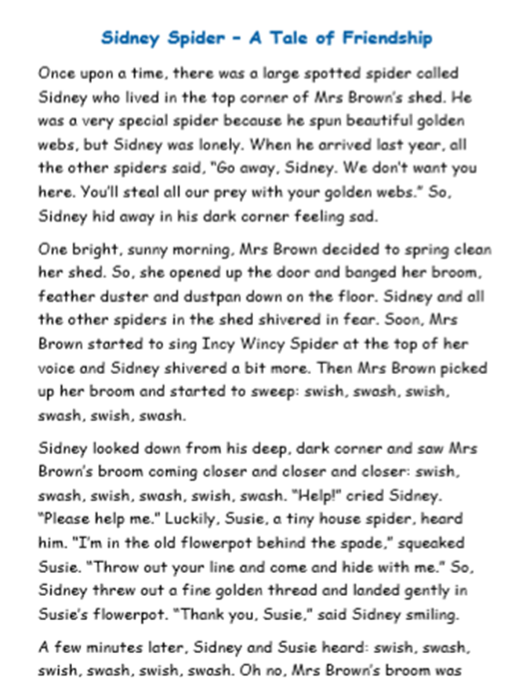
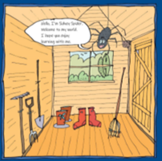
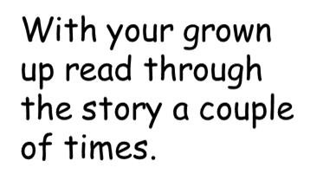
English

Slide 33
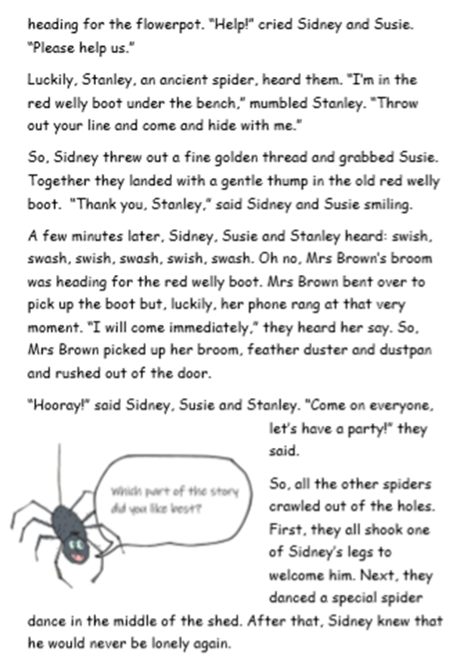
English

Slide 34
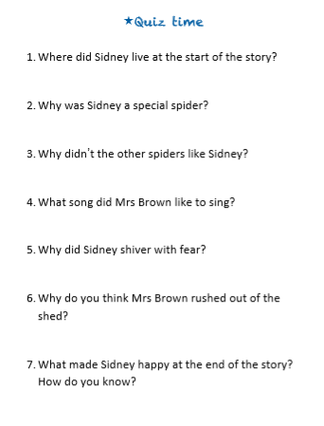
English
When you write these sentences out in your books, remember
to write in your neatest handwriting and full sentences.

Slide 35
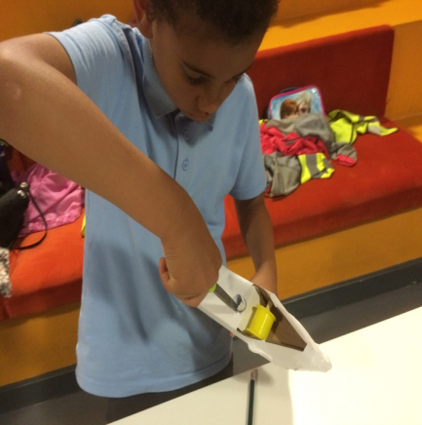
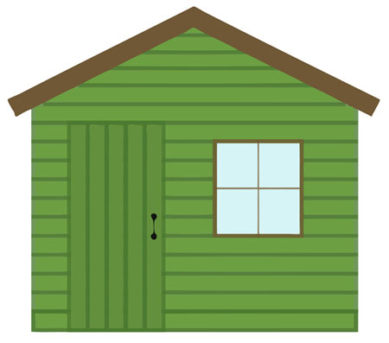
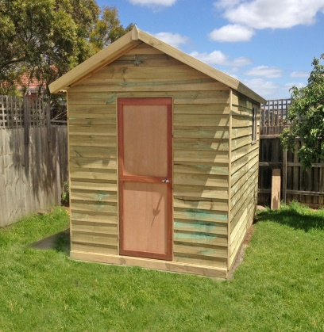
English
Can you plan and make Mrs Brown’s shed out of materials you have at home for Sidney and his friends.
Or draw and label Mrs Brown’s shed with Sidney and his friends.

Slide 36
Phonics
Green group
Phonics
Today you are learning the alternative i sound.
Complete pages 4 and 5 in your CGP phonics booklet.
Follow the orange link to phonics play to practise the alternative i sound. The web address is in red in case you are unable to access the link.
Click on the existing version. Login for Phonicsplay: Username: march 20 password: home Phase 5
Cheeky Chimps Game Phase 5 alternative i sound
https://www.phonicsplay.co.uk/member-only/CheekyChimps.html

Slide 37
Phonics
Yellow group
Phonics
I would like you to work through pages 18 and 19 in your Phonics booklet 2.
Follow the orange link to phonics play to practise blending single
sounds. The web address is in red in case you are unable to access
the link. Click on the existing version. Login for Phonicsplay:
Username: march 20 password: home
Phase 2
Make a match game Phase 2 Wk1-3
https://www.phonicsplay.co.uk/member-only/MatchingPh2Wk13.html

Slide 38
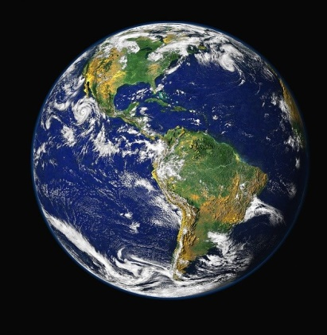
Google Earth
https://www.google.co.uk/intl/en_uk/earth/
Explore Google Earth .
Can you find:
The United Kingdom and its countries.
London.
Bromley
Farnborough.
School and your home.
What else can you find?

Slide 39
Active Learning

Slide 40
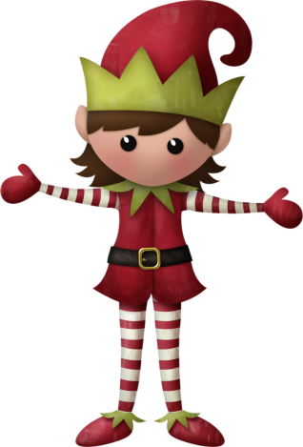
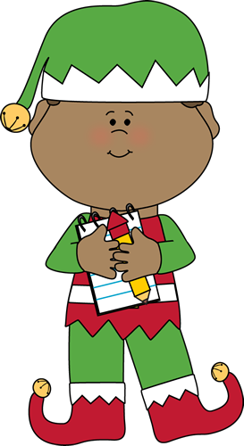
Well done for
your brilliant work today!
If you have any questions or just to let me know what you have been up to email me on admin@farnborough.bromley. sch.uk

