Slide 1
Good Morning Elves!
You’ve been amazing!

Slide 4
Green group
Tuesday’s
Maths Answers
Challenge 2
2 + 2 + 2 + 2
Challenge 3
1.a. 2
5
10
b.3
5
15
c.4
5
20
Challenge 3
2.a. 3
2
6
b. 4
2
8
c. 5
2
10

Slide 5
It’s Wednesday!
Wednesday 13th May 2020
Here’s your work for today…
.

Slide 6
Reading online
I’m so impressed with your reading Elves.
You should be very proud of yourselves!
Please log on to Bug Club
Read for at least 15 minutes.
Please read the key words inside the front cover first.
When you find the bug questions, click and complete them.
Please note down the books you’ve read in your reading
record book.
Your personal login details are on the inside of your reading record book.

Slide 7
Maths
Today we are learning to
make arrays

Slide 8
Maths
Re-read this words today to remind yourselves of these words. Which word do you think you will spot today?

Slide 9
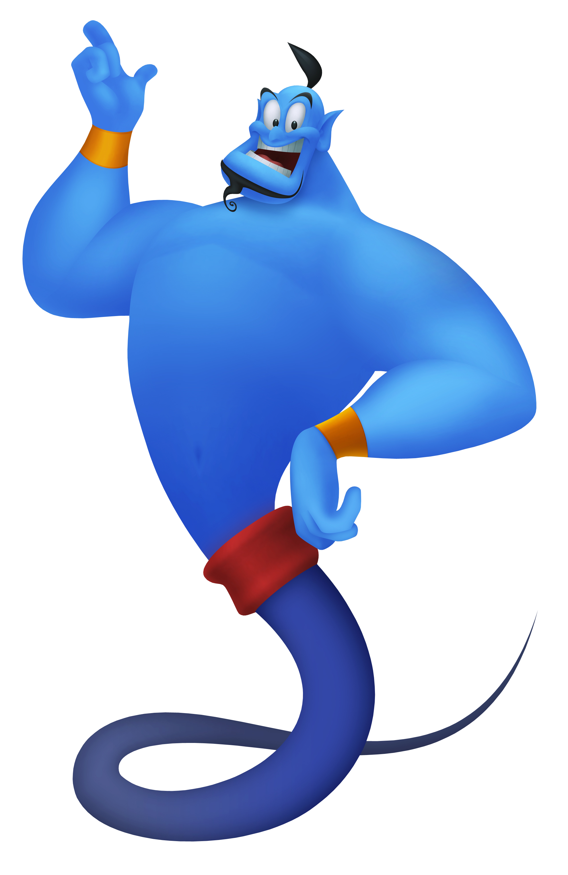
Green group
Maths
Let’s play a game to remind ourselves of what we have learnt so far….
Karate Cats Maths Multiplication and Division Bronze Stage
https://www.bbc.co.uk/games/embed/karate-cats-2?exitGameUrl=http%3A%2F%2Fbbc.com%2Fbitesize%2Farticles%2Fzf4sscw

Slide 10
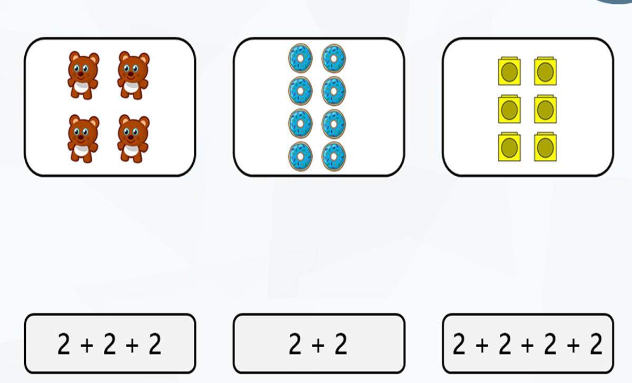
Match the repeated addition sentence to the correct array
Green group
Maths
The answer is on the next page.

Slide 11
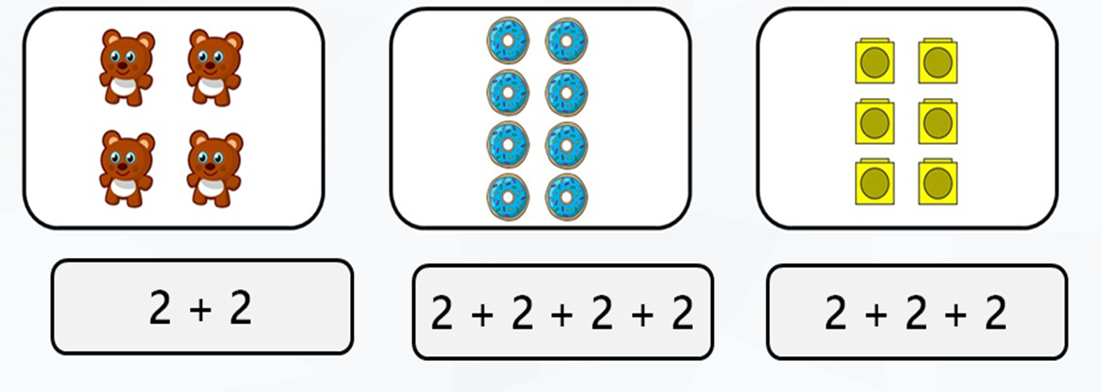
Green group
Maths
Yes brilliant it is ……

Slide 12
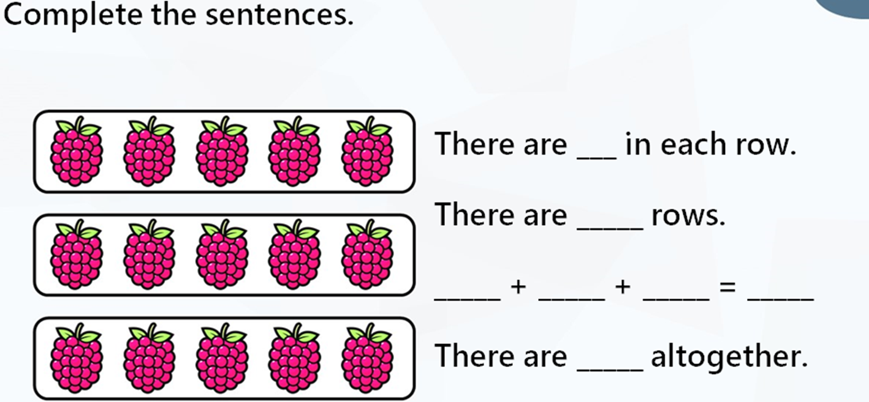
Green group
Maths

Slide 13
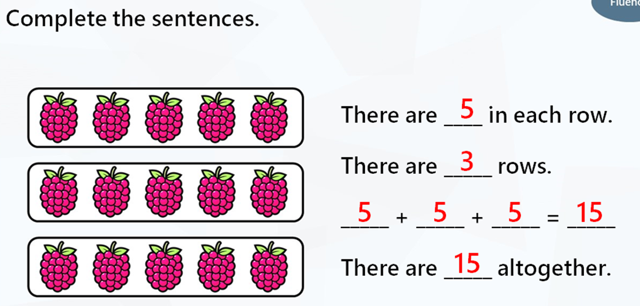
Green group
Maths
Yes fantastic it is….

Slide 14
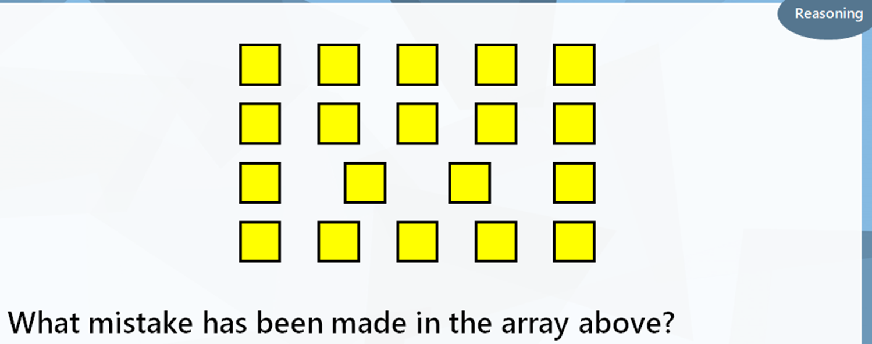
Green group
Maths
The answer is on the next page

Slide 15
Green group
Maths

Slide 16
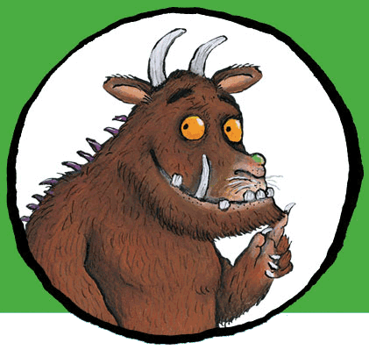
. .
If you would like to try Gruffalo work, complete challenge 1 on the next page.
If you would like to try Horrid Henry work, complete challenges 1 and 2
If you would like to try James and the Giant Peach work, complete challenges pages 1,2 and 3.

Slide 17
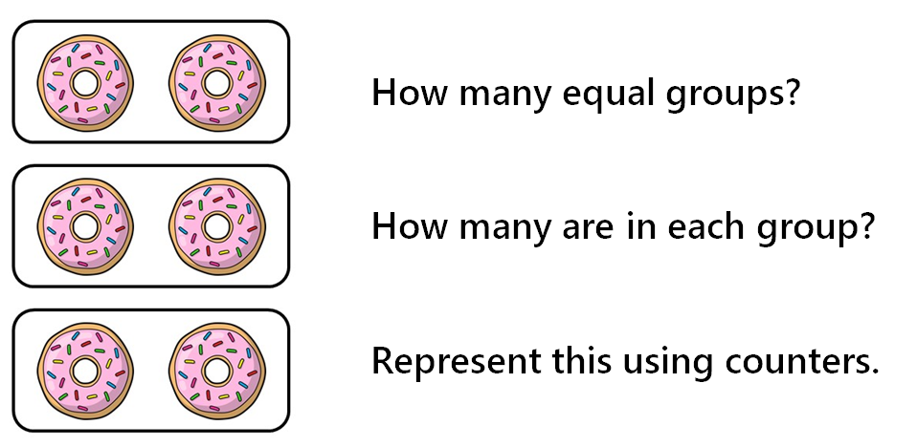
Green group
Maths
Challenge
1

Slide 18
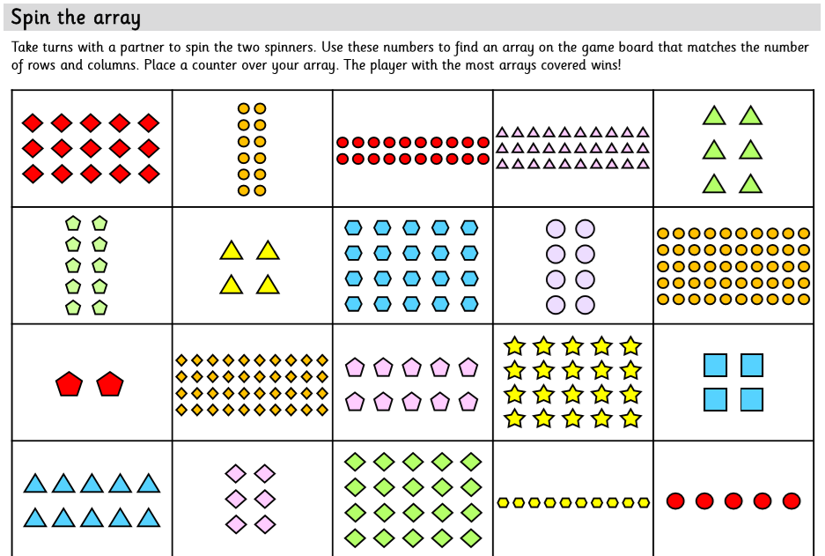
Green group
Maths
Challenge
2

Slide 19
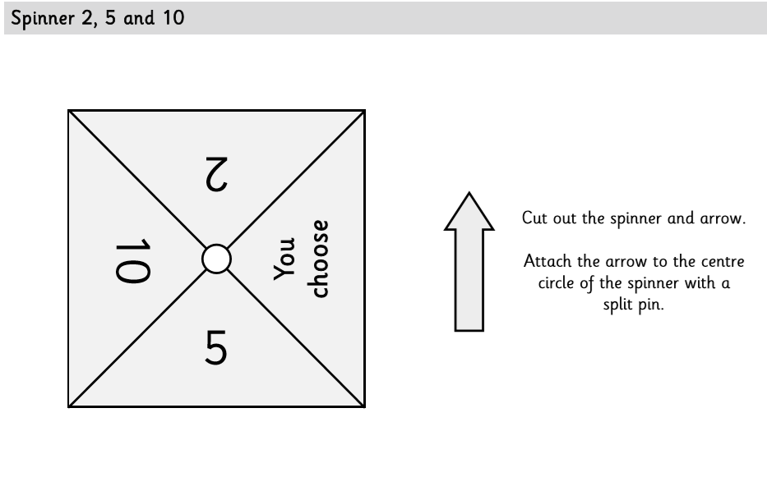
Green group
Maths
Challenge
2
Or use a dice. Roll a 1 or 2 to find 2 rows or columns on the array.
Roll a 3 or a 5 to find 5 rows or columns on the array
Roll a 4 or a 6 to find 10 rows or columns on the array.

Slide 20
Green group
Maths
Challenge 3

Slide 21
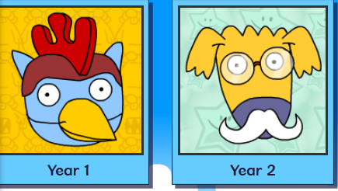
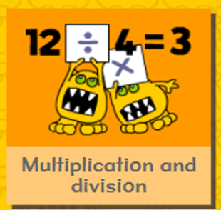
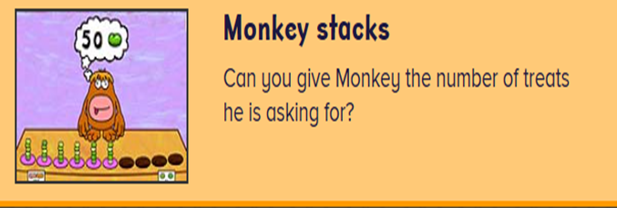
.
.
.
.
Logon on to Busy Things.
Can you score more points today? Are you faster?
Play this game to practise your repeated addition skills.

Slide 22
If you’ve completed your maths quickly, go to the Maths Challenge
Powerpoint on the learning page for
this week and complete one or more challenges.

Slide 23
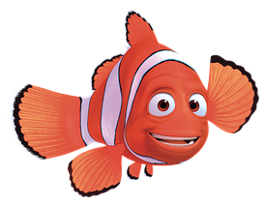
Yellow group
Maths
Maths
Today we are learning to
find numbers.

Slide 24
Yellow group
Maths
How many challenges can you complete? Follow the next few slides and see.
If you would like to try Gruffalo work, complete page challenge 1
If you would like to try Horrid Henry work, complete pages challenge 1 and 2
If you would like to try James and the Giant Peach work, complete challenge 1, 2 and 3

Slide 25
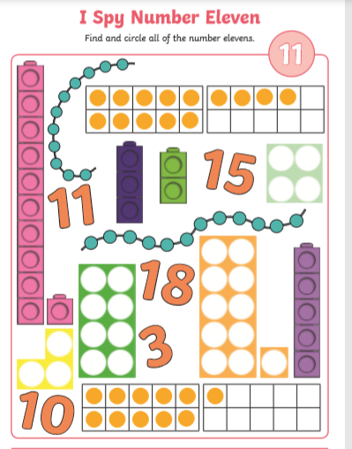
Yellow group
Maths
Challenge 1
Can you make number 11 with Numicon?

Slide 26
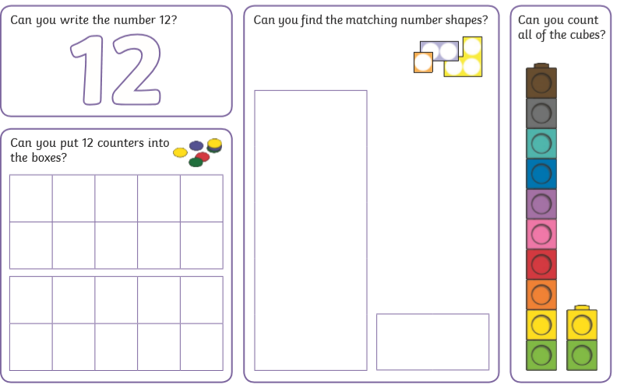
Yellow group
Maths
Challenge 2
Use objects from home (lego pieces, bricks, cars,pens) to practise finding this number.

Slide 27
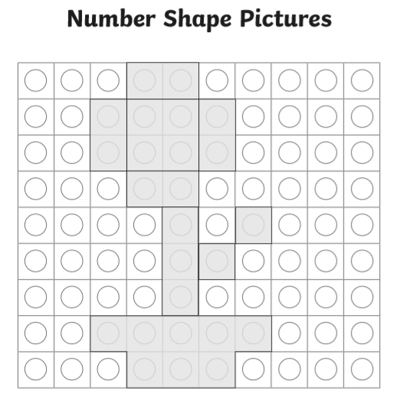
Yellow group
Maths
Challenge 3
Can you make this picture using Numicon?

Slide 28
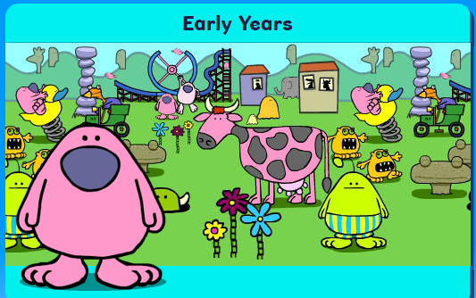
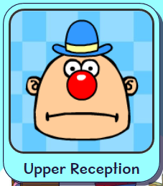
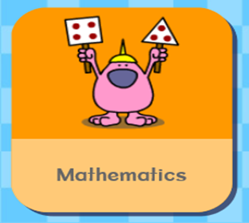
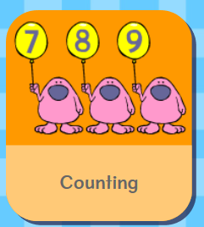
Logon on to Busy Things. How did you get on with the games
yesterday.. Play the following game to practise your counting skills.
.

Slide 29
Handwriting
.

Slide 30
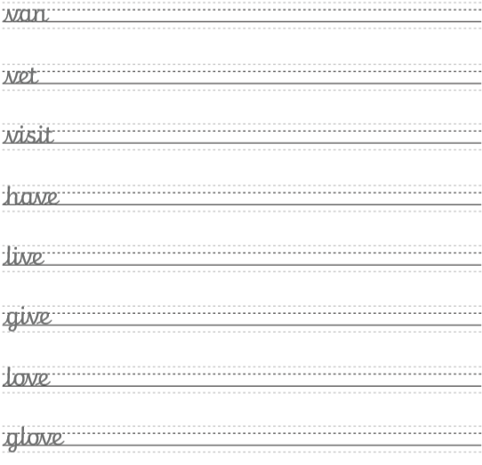
Handwriting
.

Slide 31
Handwriting
.

Slide 32
English
We are learning to use and in our sentences.

Slide 33
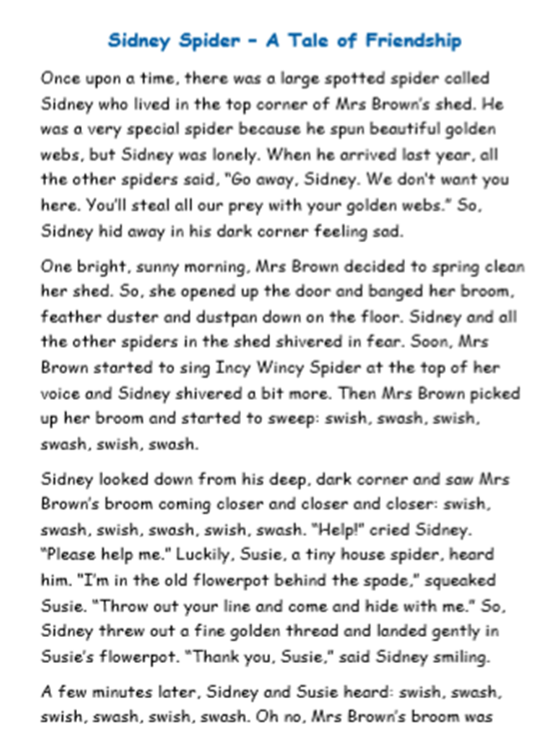
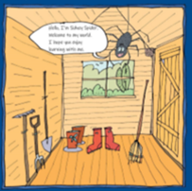
English
Read through the story, using actions too.
Can you say some of the story out loud?
Once upon a time ….

Slide 34
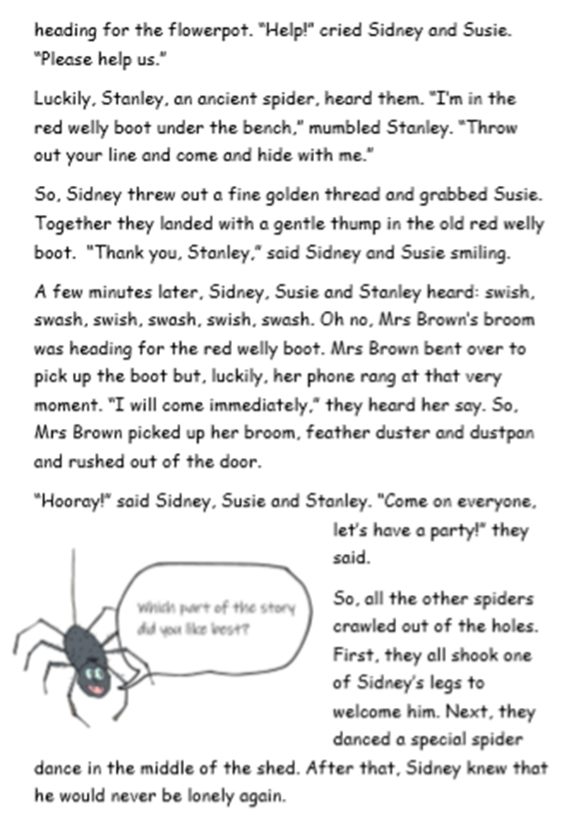
English

Slide 35
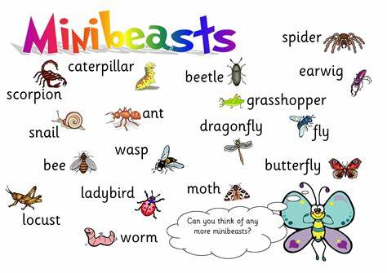
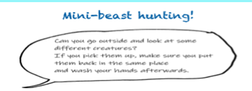
English
.
Follow this link to see if you can spot other mini beasts.
Home learning with BBC Bitesize - KS1 Primary English for Year 1 - BBC Bitesize Minibeast facts
https://www.bbc.co.uk/bitesize/articles/zrk492p
Write short sentences to list the minibeasts you saw. Write as many as you can like this:
I saw a spider.
I saw a snail.

Slide 36
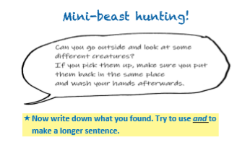
English
.
Once you have written as many sentences as you can, try using
the word ‘and’ to join sentences together. For example:
I saw a snail and a spider.
If you are writing these sentences quickly, add adjectives (describing words).
I saw a soft, slimy snail and a furry, dark brown spider.
Go to the next page

Slide 37
Phonics
Green group
Phonics
Today we are learning to read tricky words 1.
Complete pages 10 and 11 in your CGP phonics booklet.
Follow the link to practise tricky words.
Tricky Word Trucks Game Phase 5b
https://www.phonicsplay.co.uk/member-only/TrickyWordTrucks.html

Slide 38
Phonics
Yellow group
Phonics
I would like you to work through pages 24 and 25 in your Phonics booklet 2 to learn the ‘r’ sound.
Follow the orange link to phonics play to practise blending single
sounds.
Login for Phonicsplay:
Username: march 20 password: home
Phase 2
Dragons den blending game Phase 2 r sound
https://www.phonicsplay.co.uk/member-only/DragonsDen.html

Slide 39
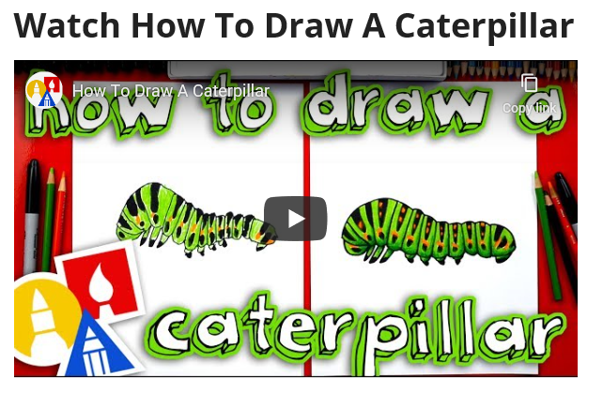
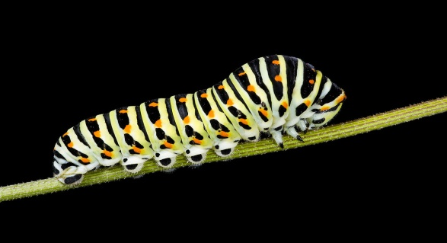
Follow this link to draw caterpillar.
How To Draw A Caterpillar - Art For Kids Hub –
https://www.artforkidshub.com/how-to-draw-caterpillar/

Slide 40
Active Learning

Slide 41
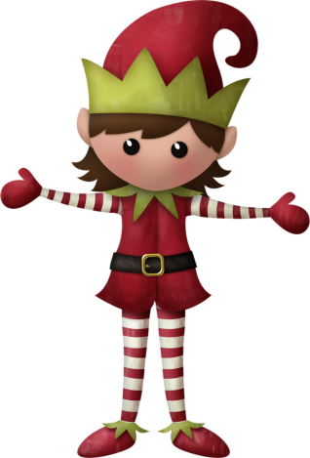
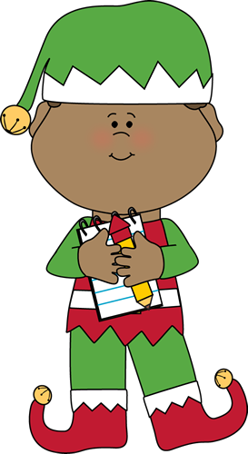
Well done for
your brilliant work today!
If you have any questions or just to let me know what you have been up to email me on admin@farnborough.bromley. sch.uk

