Slide 1
Welcome back Elves!
.
Let’s get busy Elves.

Slide 2
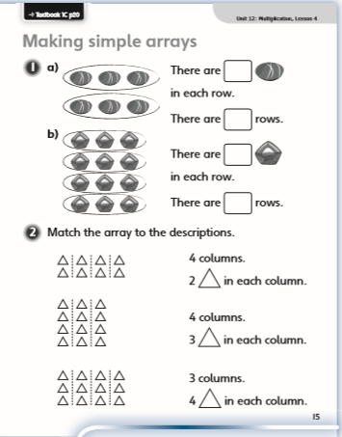
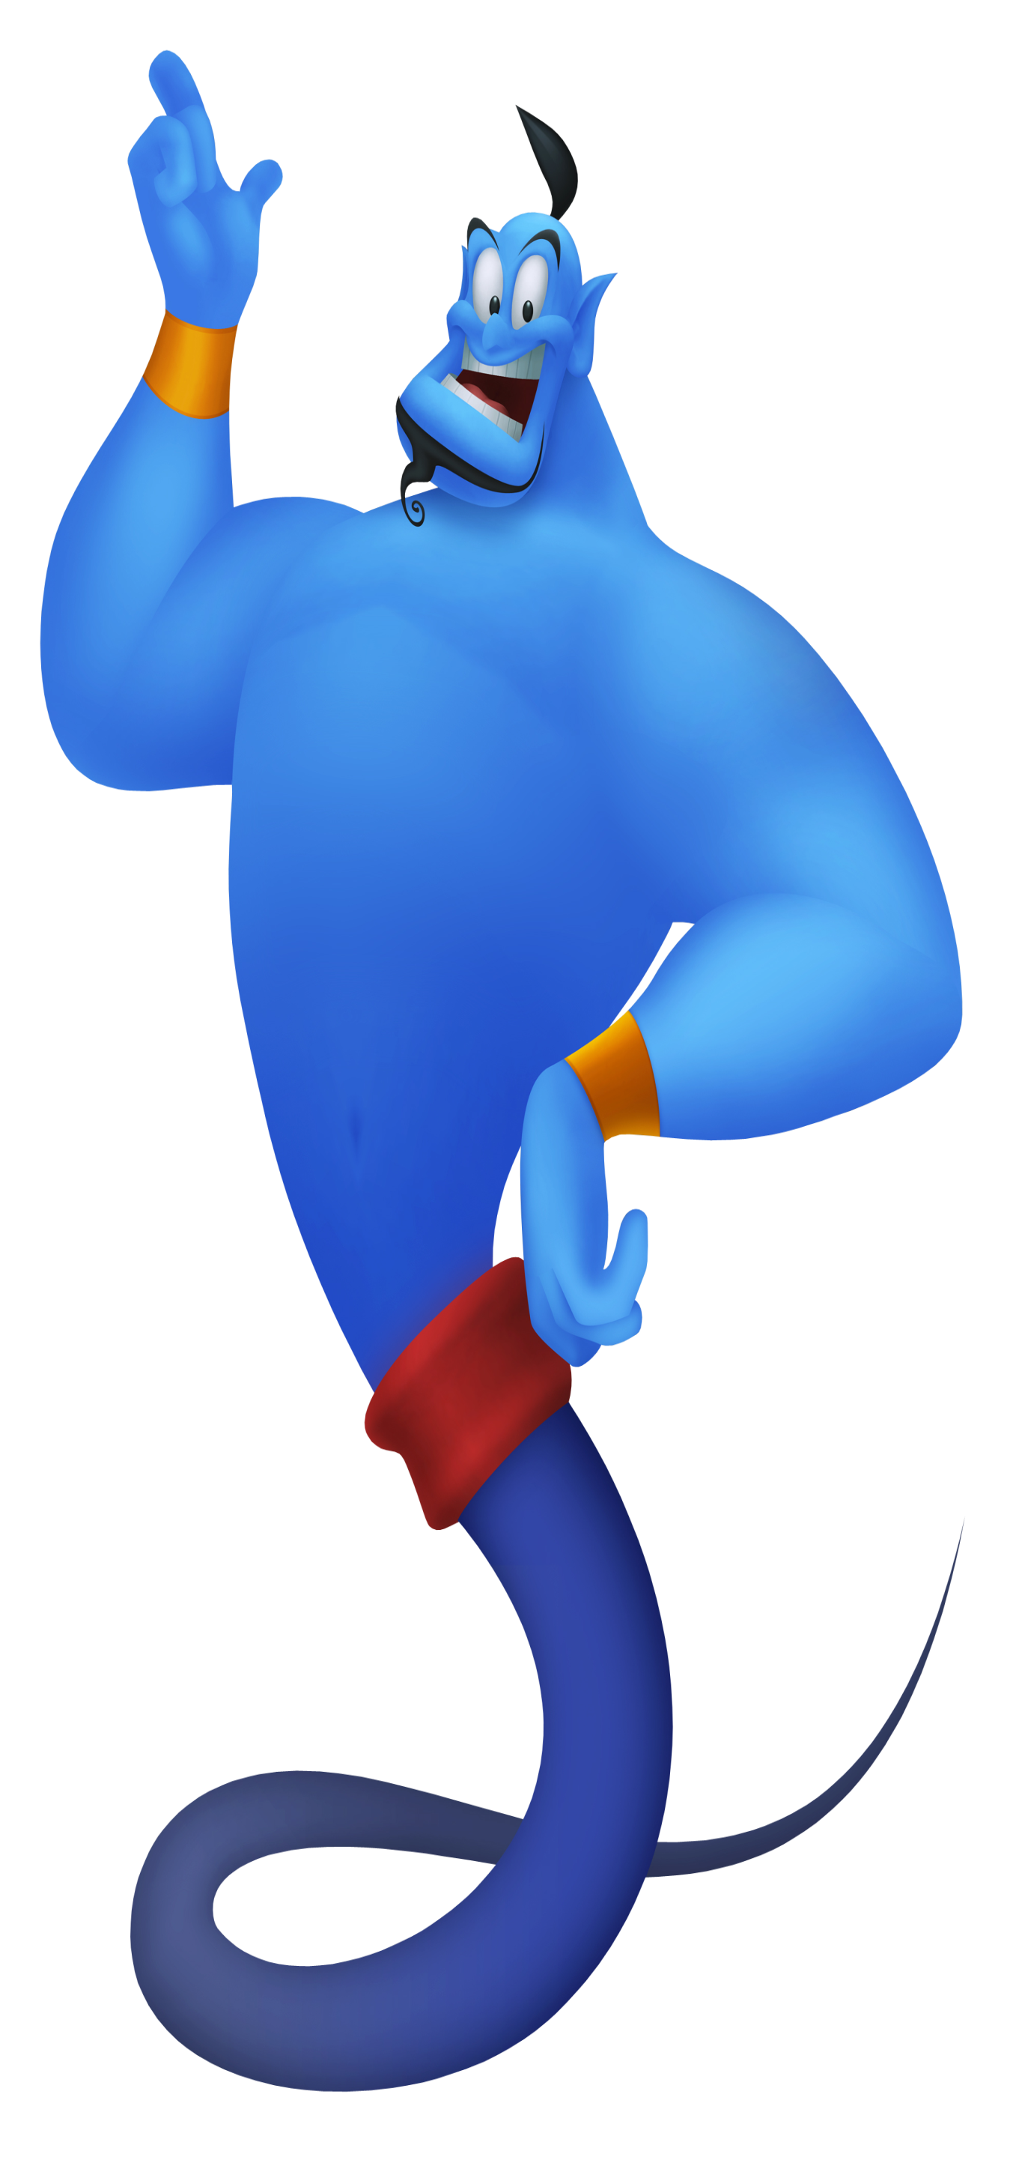
Green group
Monday’s
Maths Answers
Challenge 1
1 a) 3
2
b)3
4
2a) 4 columns 2
in each column.
3 columns 4
in each column.
4 columns 3 in each column.

Slide 3
Green group
Monday’s
Maths Answers
Challenge 2
5 + 5 + 5 = 15
15 stars
10 15
Challenge 3
Tim has made a mistake because his rows or his columns are not equal.

Slide 4
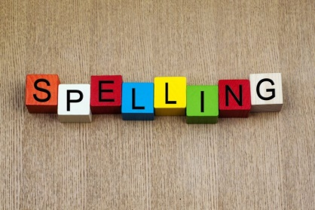
Spellings
This weeks spellings are posted on the
Year 1 Learning page to learn.
Your grown up can carry out the spelling test on Friday!
Happy Spelling

Slide 5
It’s Tuesday!
Tuesday 12th May 2020
Here’s your work for today…
.

Slide 6
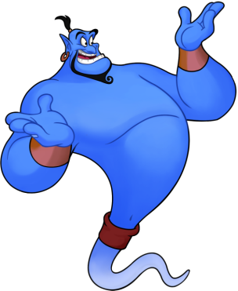
Reading online
I’m so impressed with your reading Elves.
You should be very proud of yourselves!
Please log on to Bug Club
Read for at least 15 minutes.
Please read the key words inside the front cover first.
When you find the bug questions, click and complete them.
Please note down the books you’ve read in your reading
record book.
Your personal login details are on the inside of your reading record book.

Slide 7
Maths
Today we are learning to
make arrays

Slide 8
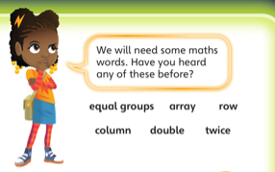
Green group
Maths
Which new words did you come across yesterday?

Slide 9
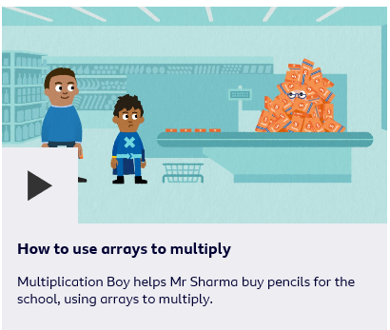
Green group
Maths
Follow this link to learn about arrays.
Maths KS1 / KS2: How to use arrays to multiply - BBC Teach
https://www.bbc.co.uk/teach/class-clips-video/maths-ks1--ks2-how-to-use-arrays-to-multiply/zrks382

Slide 10
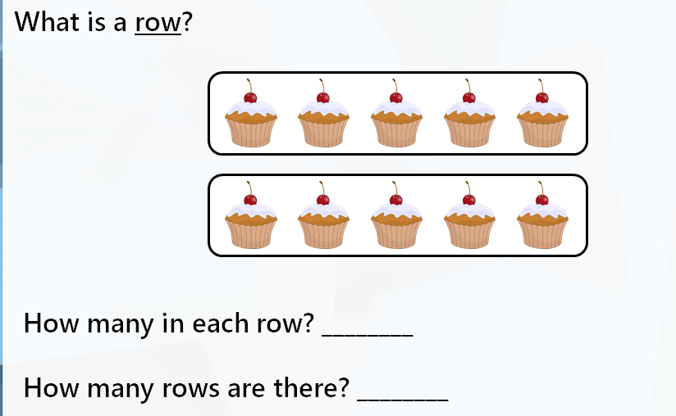
Green group
Maths
Answers on the next page

Slide 11
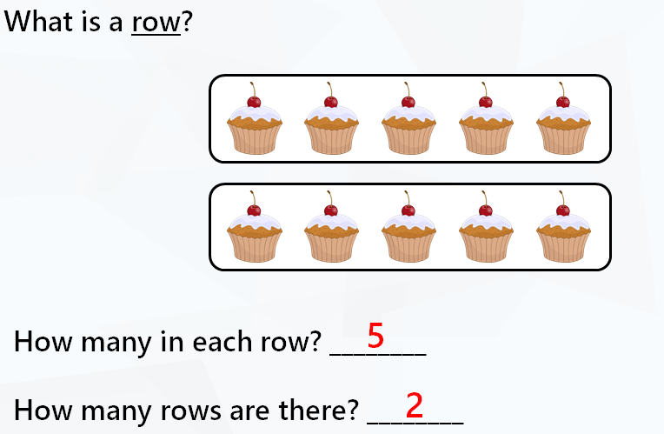
Green group
Maths

Slide 12
Green group
Maths
Answers on the next page

Slide 13
Green group
Maths
Can you answer these questions? Let’s look at the next page to find out the answers and how you could have worked them out.

Slide 14
Green group
Maths
Answers on the next page

Slide 15
Green group
Maths

Slide 16
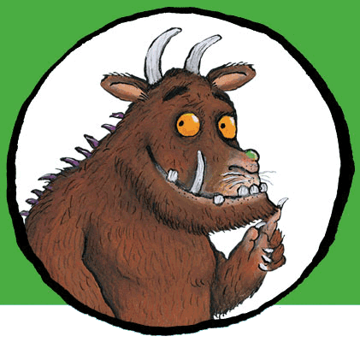
Please can you complete the challenge questions which follow this slide. I will supply you with the answers for the challenge questions on tomorrow’s slide
If you would like to try Gruffalo work, complete challenge question 1
If you would like to try Horrid Henry work, complete challenge question 1 and 2
If you would like to try James and the Giant Peach work, complete challenge question 1, 2 and 3.

Slide 17
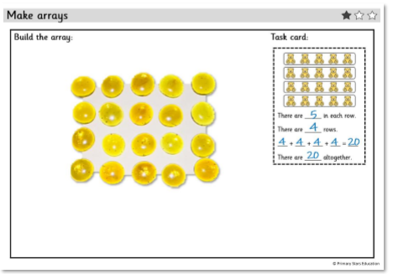
Green group
Maths
Challenge 1
Go to next page

Slide 18
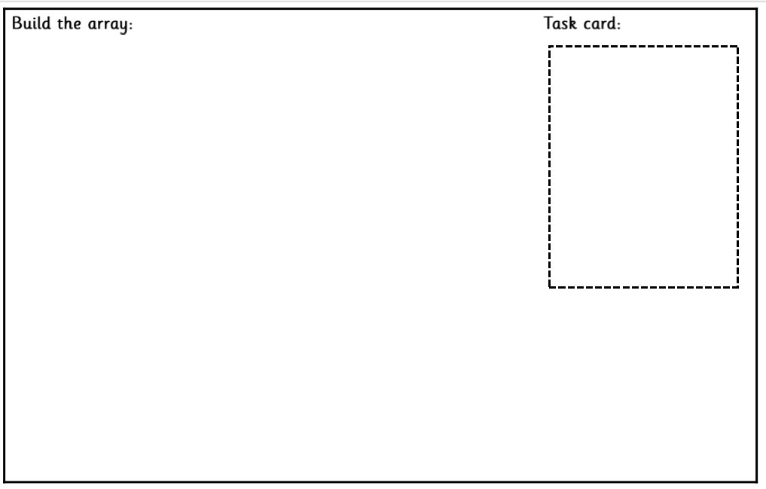
Green group
Maths
Challenge 1
Go to next page

Slide 19
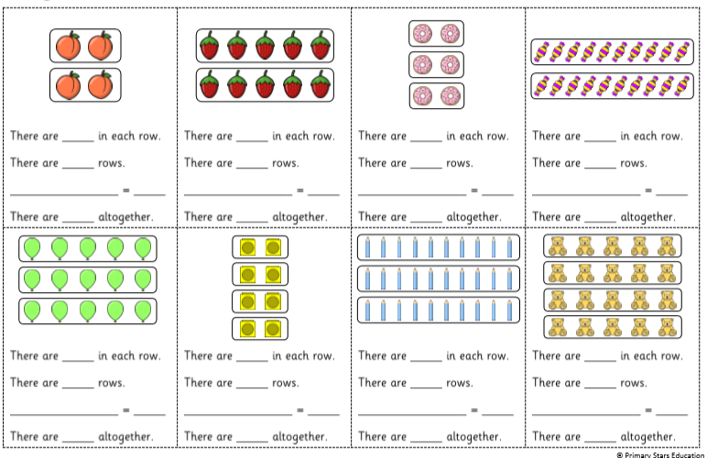
Green group
Maths
Challenge 1
Cut out the task cards to make the arrays as shown on the previous slide.

Slide 20
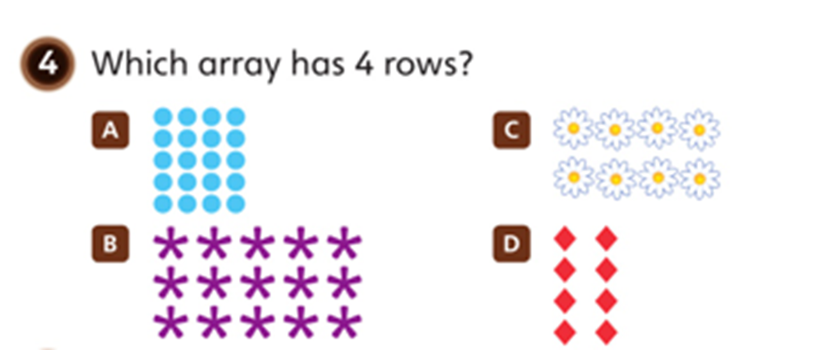
Green group
Maths
Challenge 3
.
Can you write the repeated addition sentence for the each array?

Slide 21
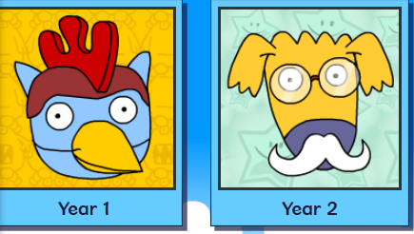
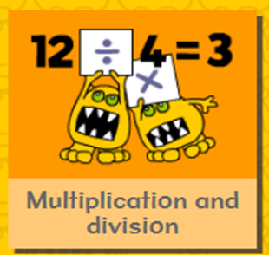
.
.
.
.
Logon on to Busy Things.
On your marks, get set, go. Play this game to mutlitplication skills.

Slide 22
If you’ve completed your maths quickly, go to the Maths Challenge
Powerpoint on the Year 1 learning page for this week and complete one or more challenges.

Slide 23
Today we are learning to make numbers.
Yellow group
Maths

Slide 24
How many challenges can you complete? Follow the next few slides and see.
Yellow group
Maths
If you would like to try Gruffalo work, complete Challenge 1
If you would like to try Horrid Henry work, complete Challenge 1 and 2
If you would like to try James and the Giant Peach work, complete Challenge 1, 2 and 3

Slide 25
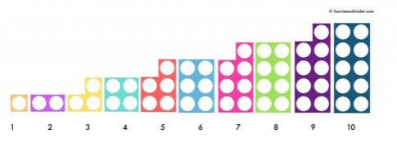
Yellow group
Maths
Challenge 1
Using the Numicon shapes, make the numbers along the Numicon number line.

Slide 26
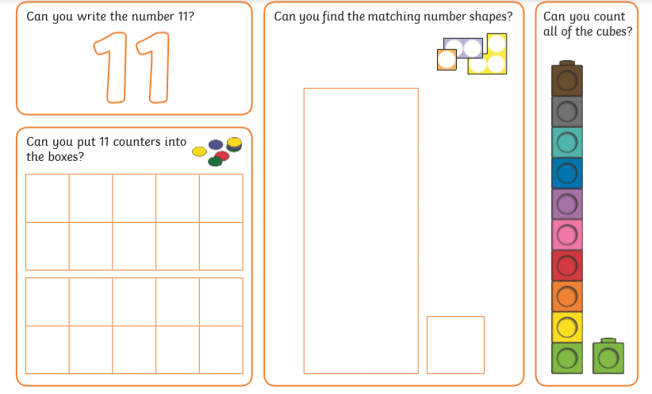
Yellow group
Maths
Challenge 2
What are these numbers?
Using Numicon

Slide 27
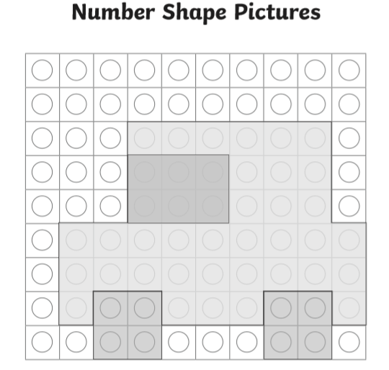
Yellow group
Maths
Challenge 3
Can you make this picture using Numicon?

Slide 28
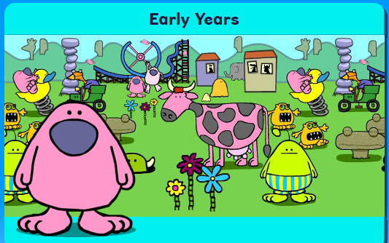
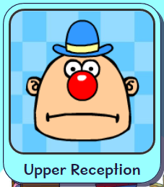
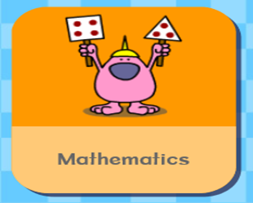
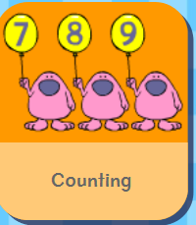
.
Logon on to Busy Things. On your marks, get set and go. Play following game to practise your counting skills.

Slide 29
Handwriting
.

Slide 30
Handwriting
.

Slide 31
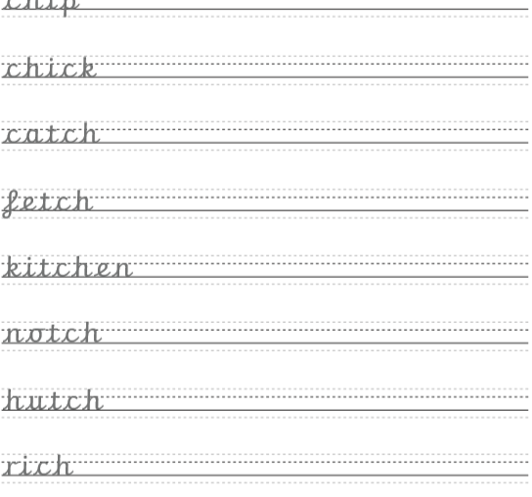
Handwriting
.

Slide 32
English
We are learning to include full stops in our sentences.

Slide 33
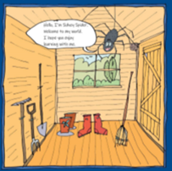
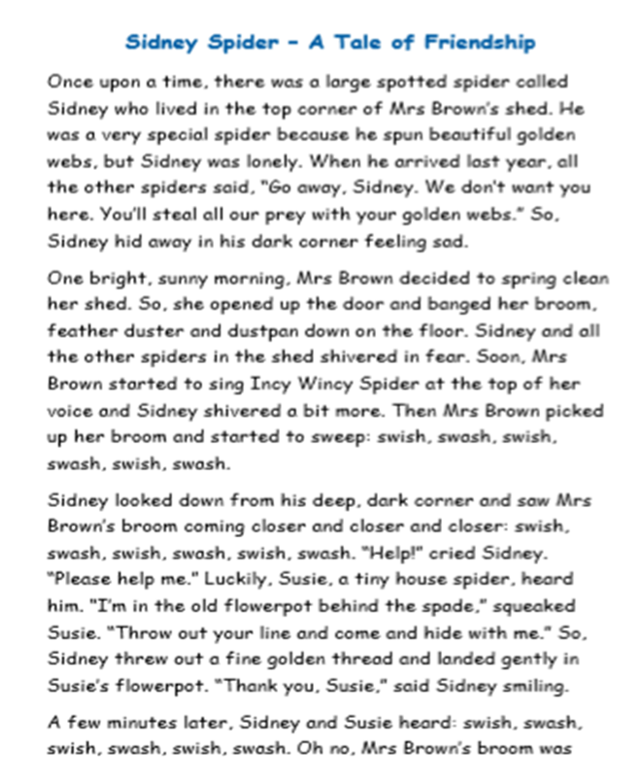
English
Can you spot the full stops to show the end of the sentences.

Slide 34
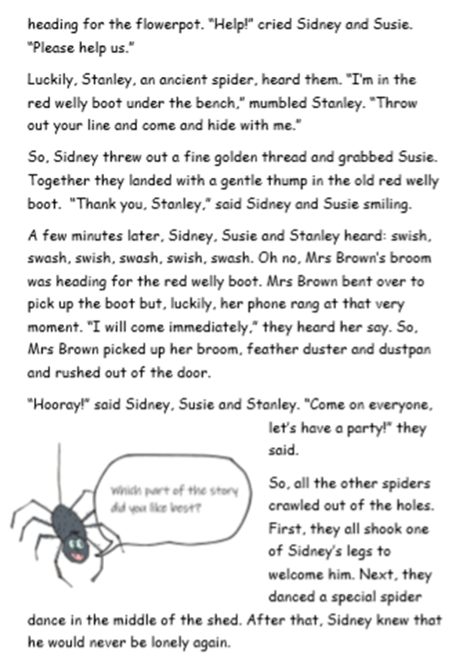
English

Slide 35
English
Follow this link to find out about writing in full sentences.
Play Small Town Superheroes | KS1 Literacy | English | BBC Bitesize Full Stops and Capital letters
https://www.bbc.co.uk/bitesize/topics/zd63xyc/articles/zncgvk7

Slide 36
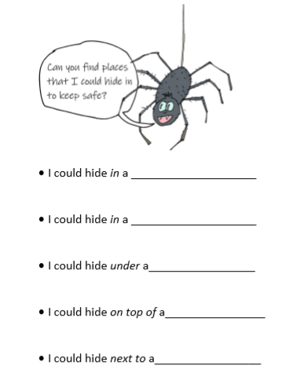
English
Remember to include
capital letters and full
stops to write in full
sentences.
Can you write in full sentences like the one below.
I could hide in a cardboard box.

Slide 37
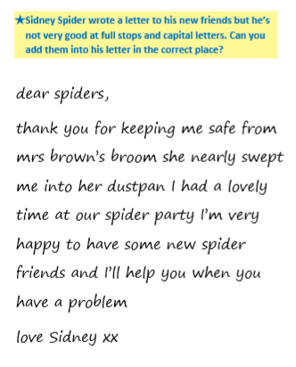
English

Slide 38
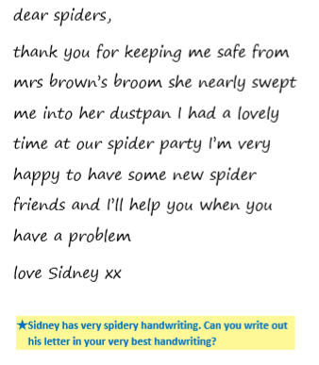
English
Remember to include
capital letters and full stops to write in full
sentences.
Challenge: Write your own letter starting with:
Dear Spiders,
Thank you for ….
I had/did/liked ………
love Sidney.

Slide 39
Phonics
Green group
Phonics
Complete pages 8 and 9 in Phonics booklet 2
to learn the alternative ‘e’
Login for Phonicsplay: Username: march 20 password: home Phase 5
Cheeky Chimps Game Phase 5 alternative e sound
https://www.phonicsplay.co.uk/member-only/CheekyChimps.html

Slide 40
Phonics
Yellow group
Phonics
I would like you to work through pages 22 and 23 in your Phonics booklet 2 to practise Tricky Words.
Tricky Word Trucks Game Phase 2
https://www.phonicsplay.co.uk/member-only/TrickyWordTrucks.html

Slide 41
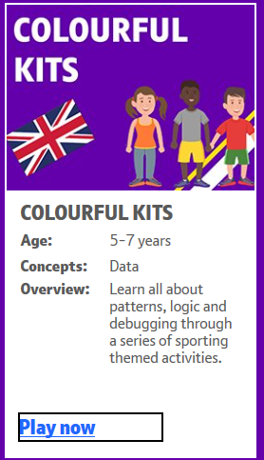
The following is a link to barefoot computing which gives children an introduction to computational thinking skills , for example, debugging, logic and patterns. Just one click, there is no need for a login.
Visit www.barefootcomputing.org/homelearning to find out more.
Click on this link to play
‘Colourful Kits’
Visit www.barefootcomputing.org/homelearning Colourful Kits
https://barefootgames.org/colourful-kits?ref=https://www.barefootcomputing.org/homelearning

Slide 42
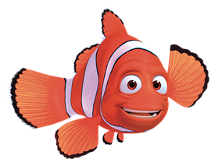
Active Learning

Slide 43
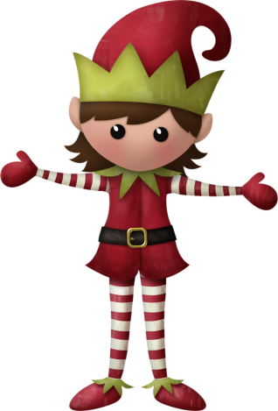
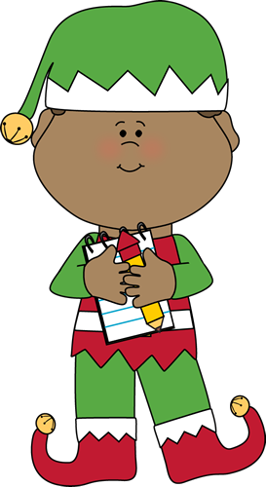
Well done for
your super work today!
Let me know how you are getting on!
admin@farnborough.bromley. sch.uk

