Slide 1
Good Morning Unicorns!
Here’s your work for today:
Tuesday 12th May

Slide 2
Reading Comprehension
Today you are going to read a text and answer questions about it. You can write your answers in your exercise book.

Slide 4
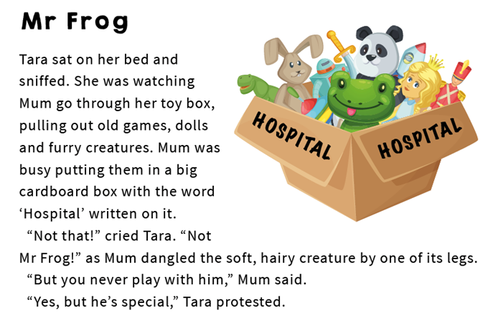

Slide 6
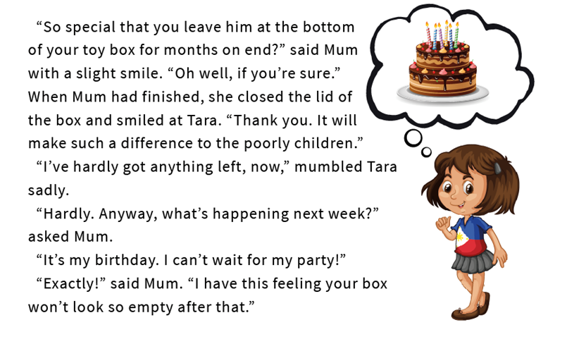

Slide 7
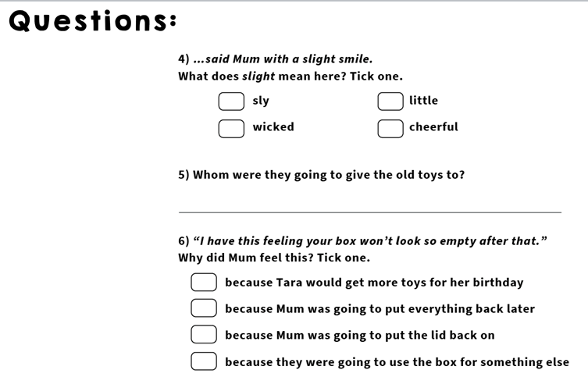

Slide 8
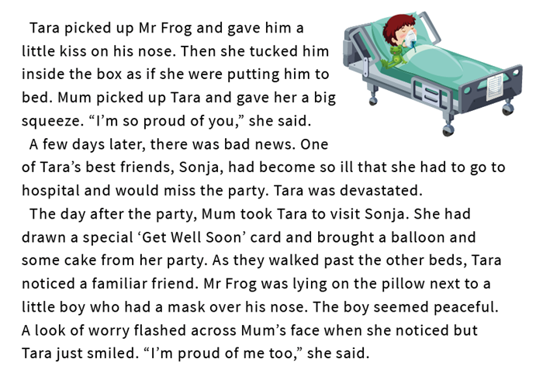

Slide 10
Handwriting
Please look at the high frequency words on the next slide and copy them into your exercise book.

Slide 11
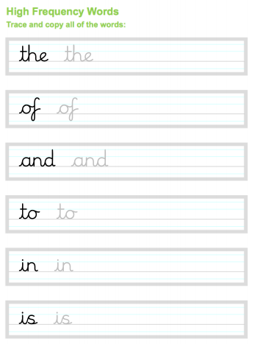

Slide 12
Independent Learning Have fun practising saying this tongue twister. How quickly can you say it?

Slide 13
Maths answers from yesterday:
a) 8 b) 4 c) Children should have drawn an object which is between 4 and 8 cm long according to the ruler on the page.
2. a) 4 b) 11 c) 11 cm is greater than 4 cm
Check the lines children have drawn for accuracy.
Children could have found many different objects to complete the table.

Slide 14
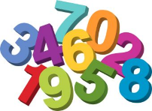
Maths
Today we are going to be measuring in metres.

Slide 15
Click on this link:
https://www.youtube.com/watch?v=HT_c0AQu1I8

Slide 16
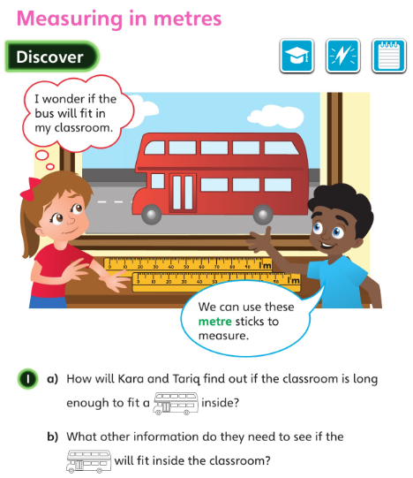
How would you use the metre sticks to answer the question?
Do you need to measure the length of the bus or the classroom or both?
Let’s look at the answers and how you could have worked them out on the next slide…

Slide 17
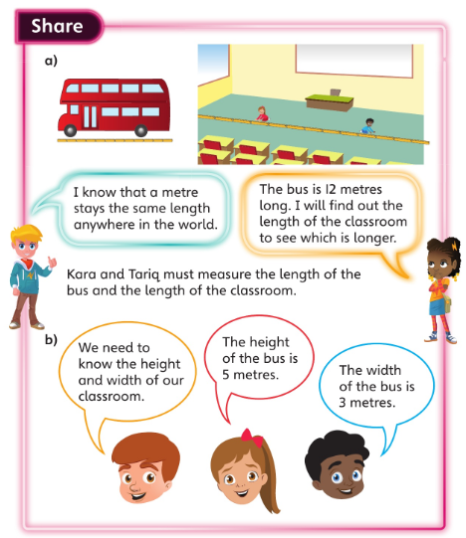
The children in the picture used metre sticks to measure their classroom. Would the bus fit there?

Slide 18
a): 2 metres < 20 metres
b): 9 metres > 9 centimetres
c): 100 centimetres = 1 metre

Slide 19
Now I would like you to have a go at completing the questions on the next slides. You can write your answers in your exercise books.
If you would like to try Gruffalo work, complete questions 1 and 2.
If you would like to try Horrid Henry work, complete questions 1, 2, 3 and 4
If you would like to try James and the Giant Peach work, complete questions 1, 2, 3 ,4 and the Challenge question on the following slide.

Slide 20
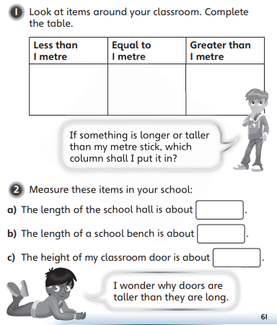
You will need to use items in your house to replace the items in the classroom.

Slide 21
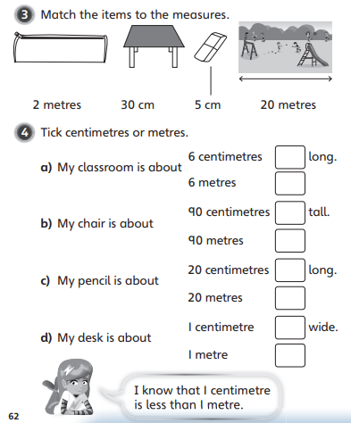

Slide 22
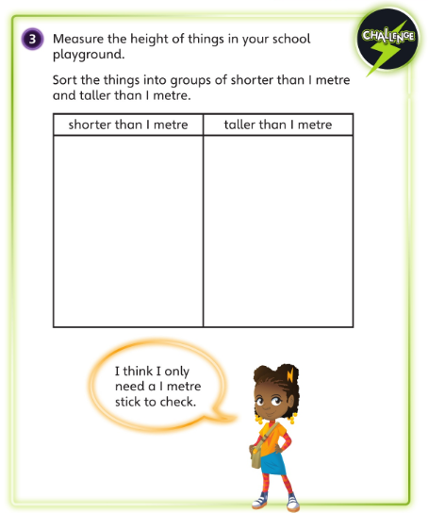
You will need to use items in your garden or when you are out for your daily exercise.

Slide 23
If you’d like an extra challenge, (or have some spare time) I have created a Maths Challenge PowerPoint which has an extra challenge for every day. You can have a go at that now.

Slide 24
English
Today you are going to be working towards writing a setting description of the underwater world inside the washing machine.
First, re-watch the film to remind yourself what happened:
https://vimeo.com/24962214

Slide 25
You are going to be gathering vocabulary and phrases about the underwater world.
First, we are going to focus on the seaweed.
What is it made from? Can you think of an adjective to describe it?
Can you think of an expanded noun phrase to describe it? (Remember, an expounded noun phrase is a phrase made up of a noun and at least one adjective)
For example:
Tall, metal seaweed made from tokens.

Slide 26
Still focusing on the seaweed can you think of a verb (the action) which effectively describes what it is doing and put that into a sentence?
For example:
Growing towards the light on the surface.
Now try with other objects/creatures from the film. If you want to, you can use my sheet on the next slide.

Slide 27
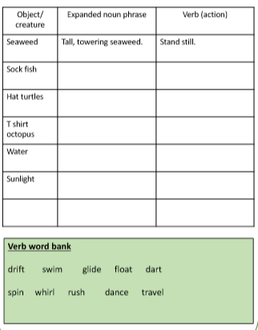

Slide 28
I might write stripy, colourful sock fish as my expanded noun phrase and dart as my verb.
For hat turtles I could write small, woolly hat turtles as my expanded noun phrase and swim for my verb.

Slide 29
We are going to start a new topic where we are looking at:
Inspirational People
(These are people that have made a difference to the lives of others)
Today is the 200th anniversary of Florence Nightingale’s birthday so I thought that we should begin by finding out all about her…

Slide 30
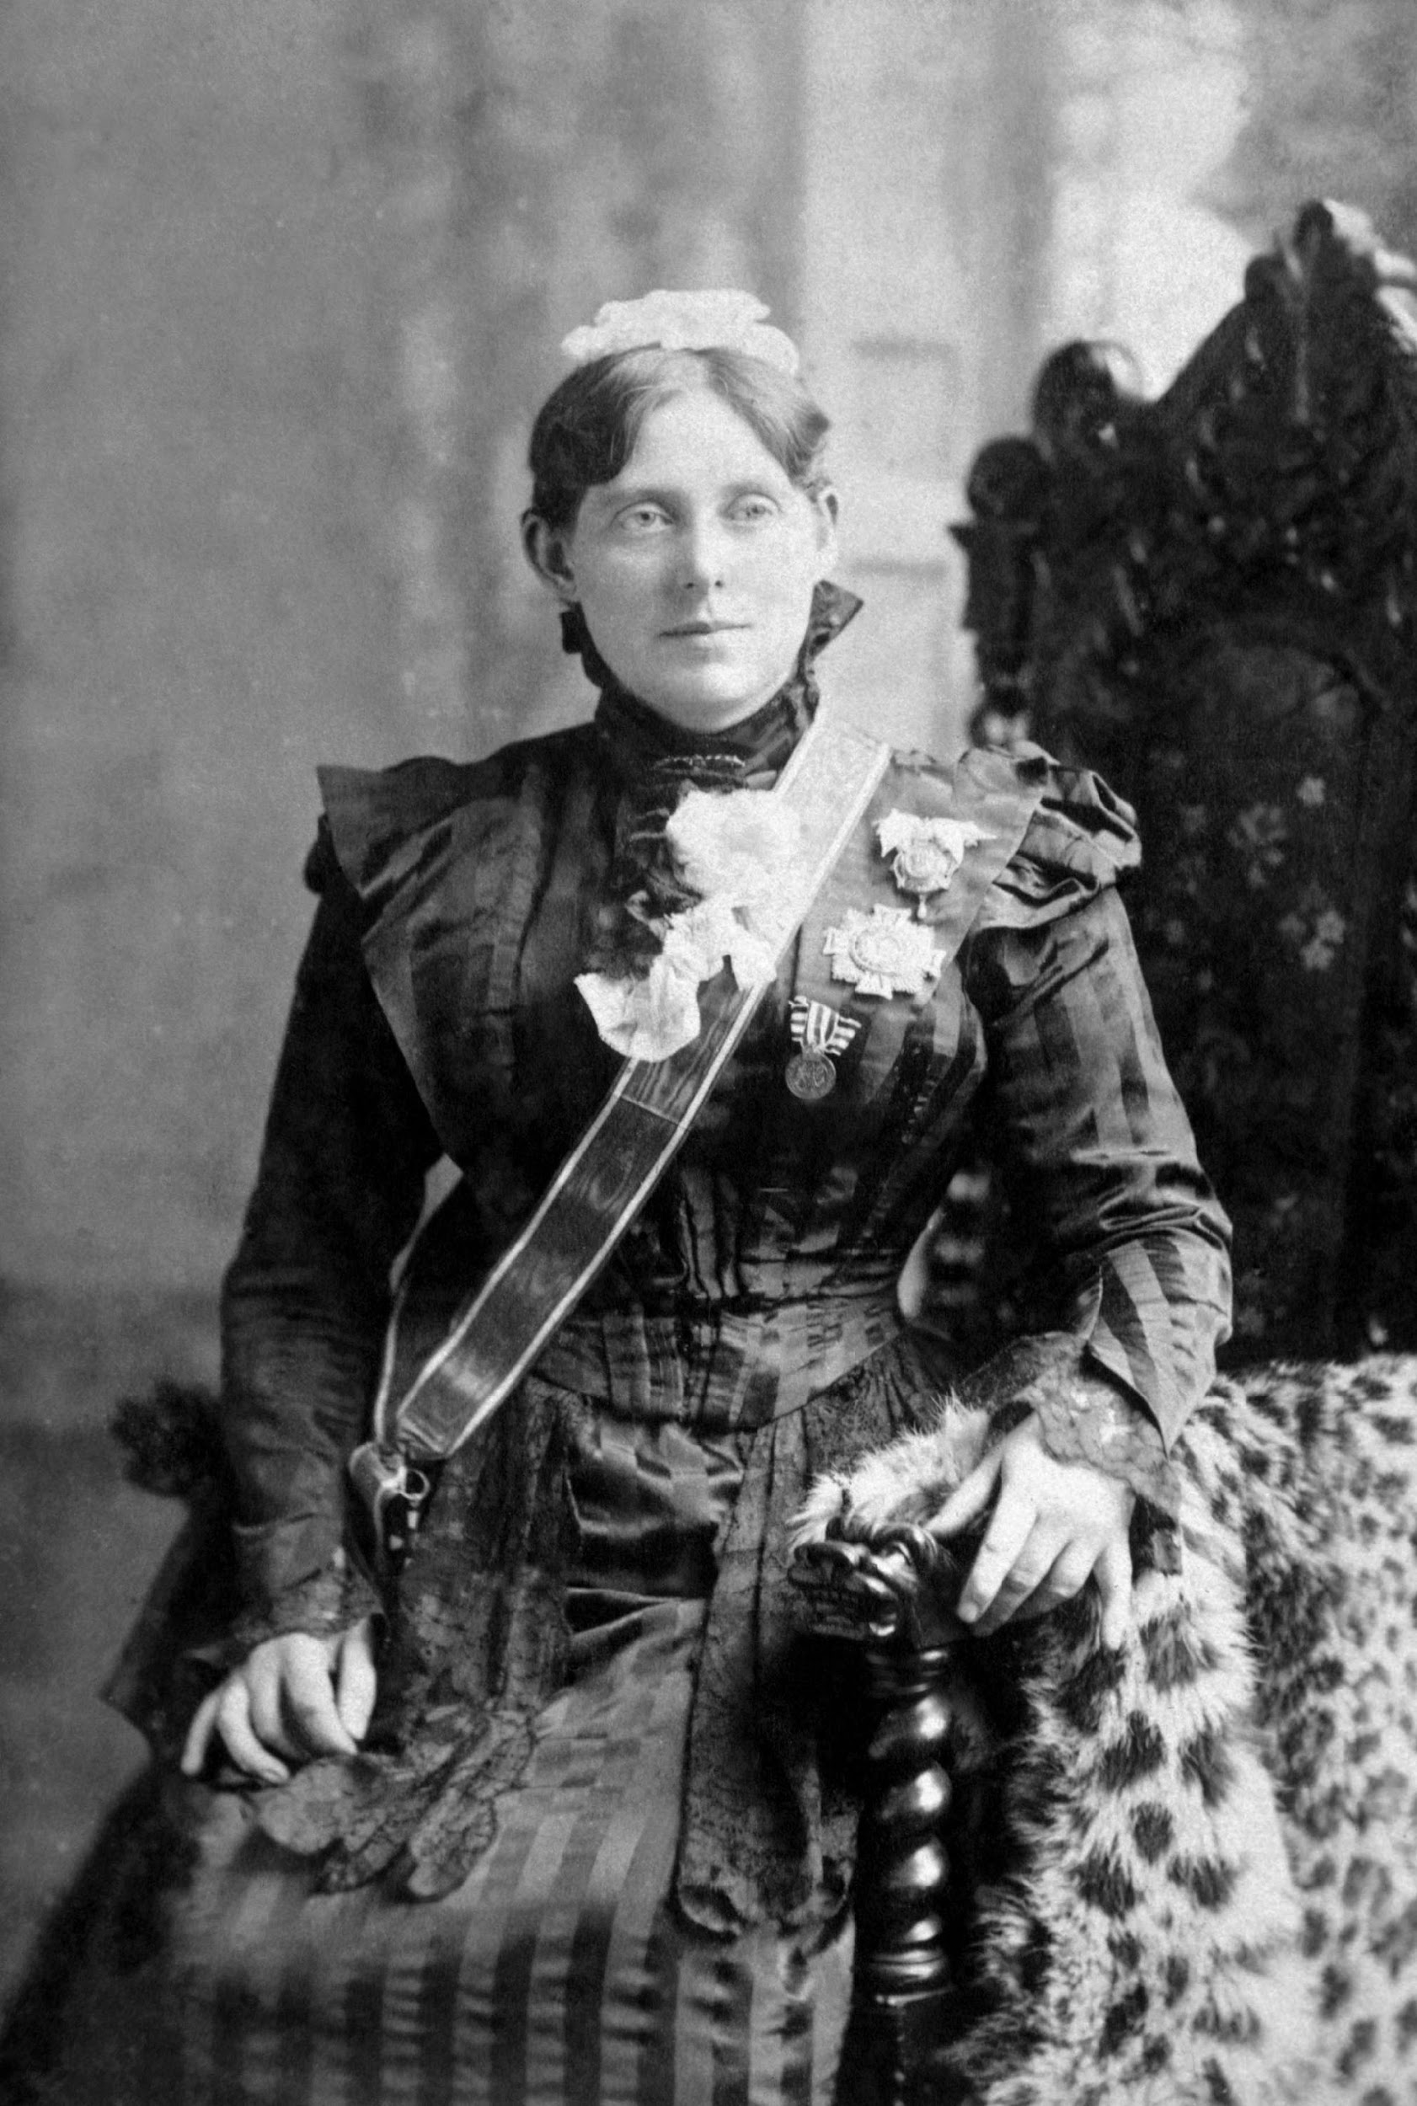
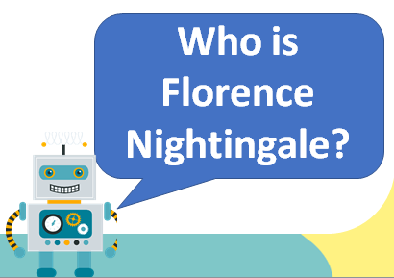
Have you ever heard of her? Do you know why she is inspirational?

Slide 31
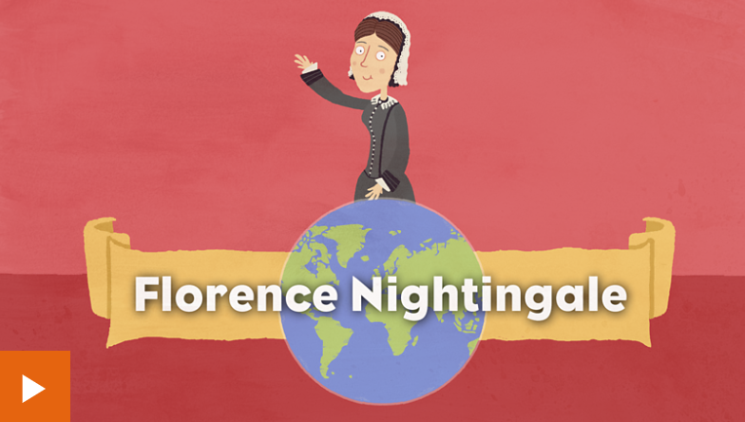
Please click on this link to learn more about Florence Nightingale:
https://www.bbc.co.uk/bitesize/topics/zns9nrd/articles/znsct39
First, watch the video.

Slide 32
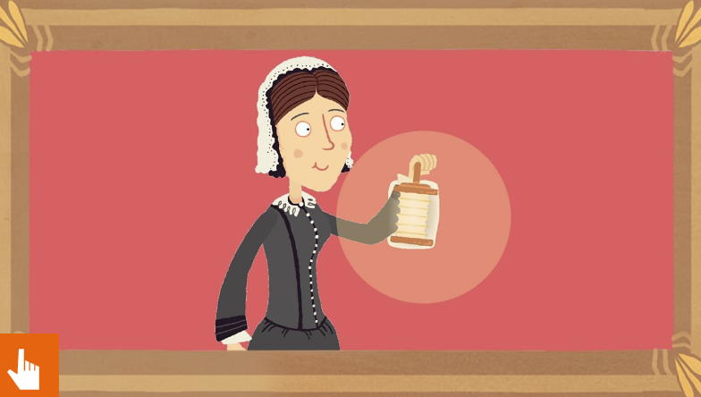
Now try the online activity to see how much you remembered.
When you have finished, write down three reasons why you think that Florence Nightingale is inspirational.

Slide 33
Have fun, Unicorns!

