Slide 1
Writing - Days Two and Three
You have today and tomorrow’s session to write the log that you have drafted into a written piece with full sentences.
Use the guidance on the next slide to help you.

Slide 3
Maths Investigation – 20.05.20
The Horse Race Game
Pupils select a horse and put their counter on the number.
Roll two dice and add the scores.
Move the horse on that number forward one square.
Play the game until a horse reaches the finishing line.
Is the game fair?
If not can you make it fair?
You could change .... the course .... the rules.... the dice

Slide 4
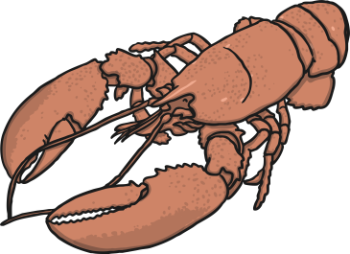
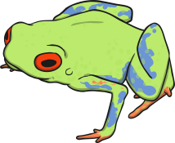
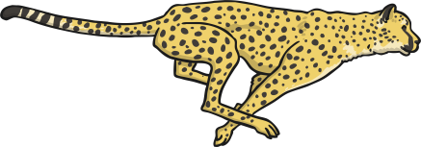
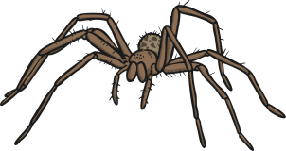
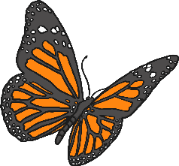
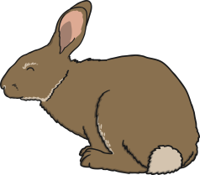
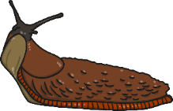
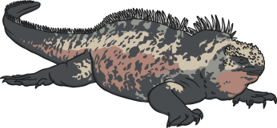
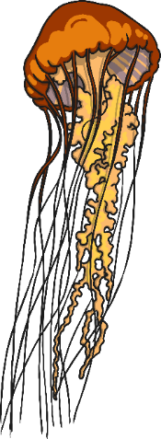
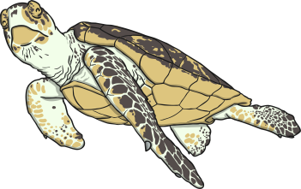
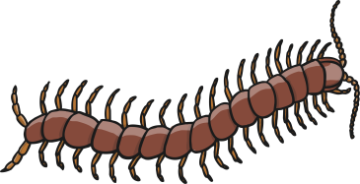
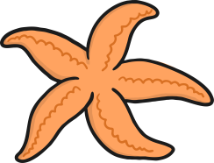
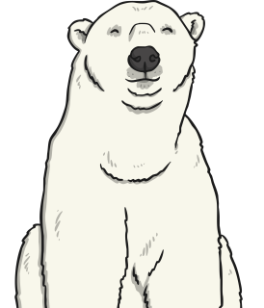
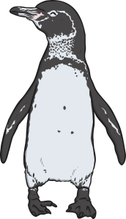
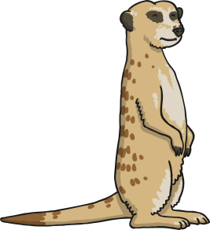
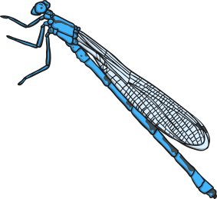
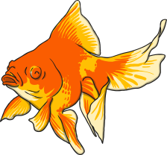
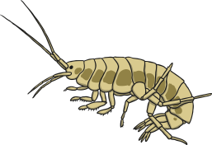
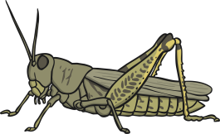
Classifying Invertebrates
vertebrates
invertebrates
When looking at animals, scientists usually split them into two groups: vertebrates (animals with a backbone) and invertebrates (animals without a backbone).

Slide 5
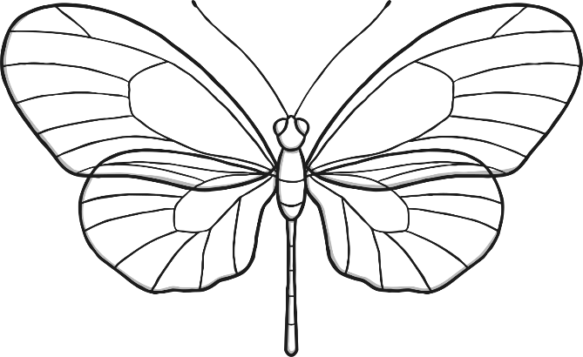
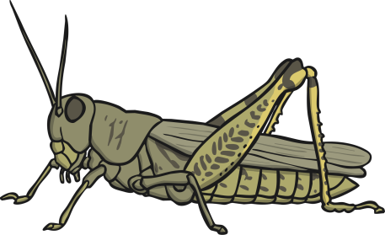
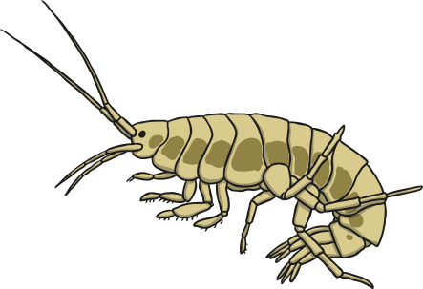
Classifying Invertebrates
Invertebrates do not have a backbone, or a skeleton made of bones. Many have a hard shell outside their bodies to protect them. Others have soft, flexible bodies.

Slide 6
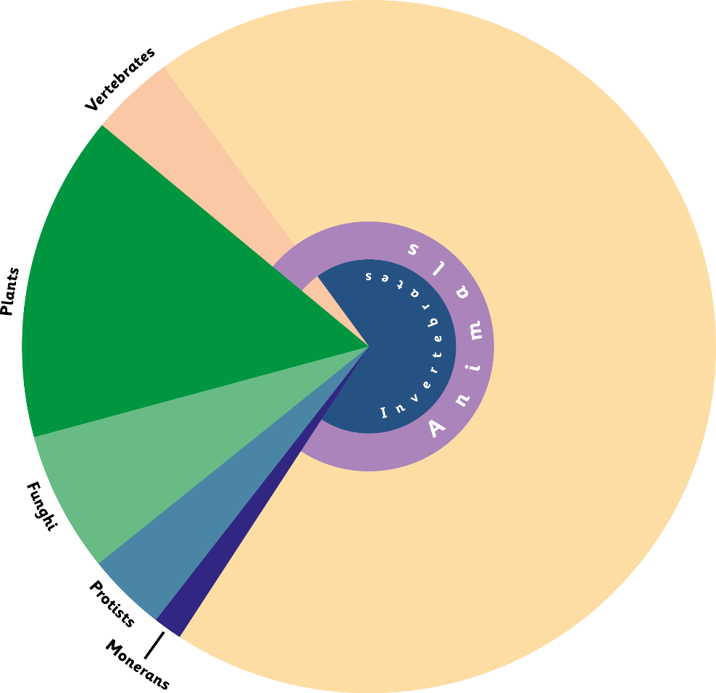
Classification See https://www.bbc.co.uk/bitesize/topics/zn22pv4/articles/z8mbqhv
More than 80% of living things on the planet, and 98% of animals, are invertebrates.
Invertebrates
Watch https://www.bbc.co.uk/bitesize/clips/zmj8q6f

Slide 7
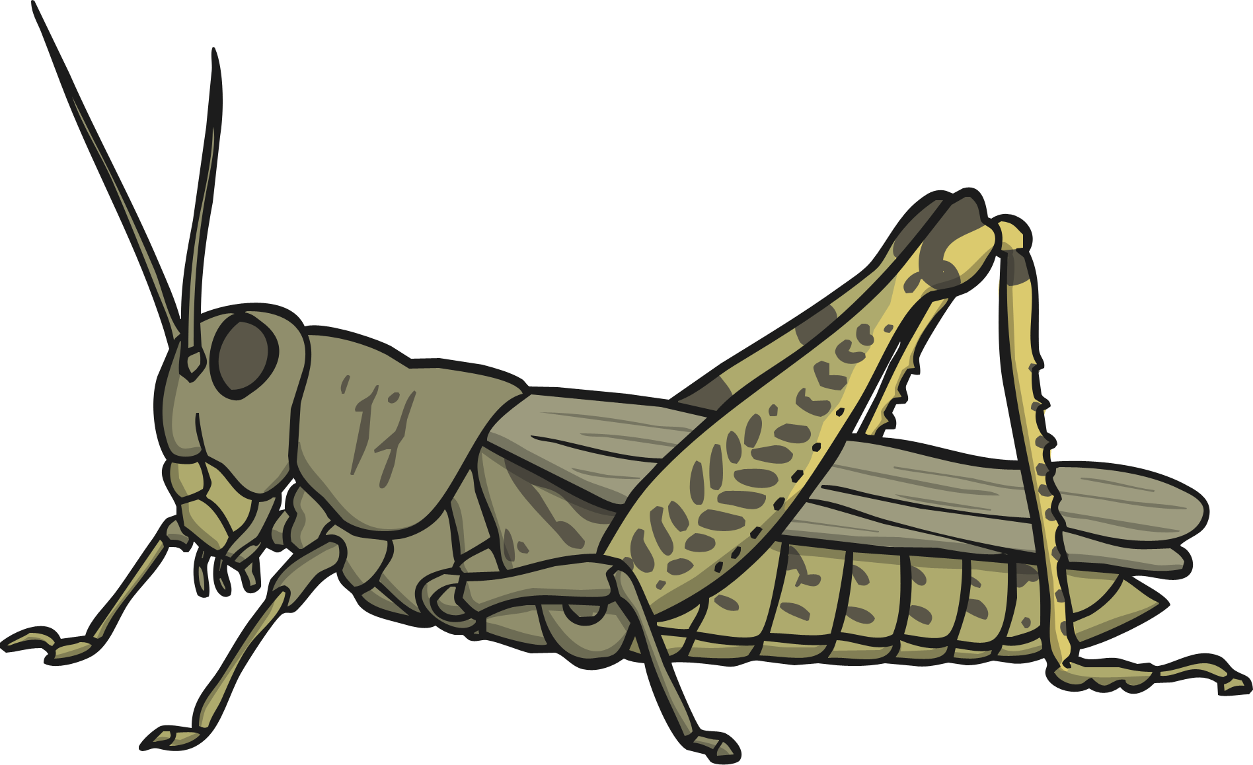
Classifying Invertebrates
Insects
There are over 800 000 different types of insects.
They have an exoskeleton covering their body.
The body consists of 3 parts: the head, thorax and abdomen.
They must shed their exoskeleton in order to grow.
They have a pair of antennae on their head.

Slide 8
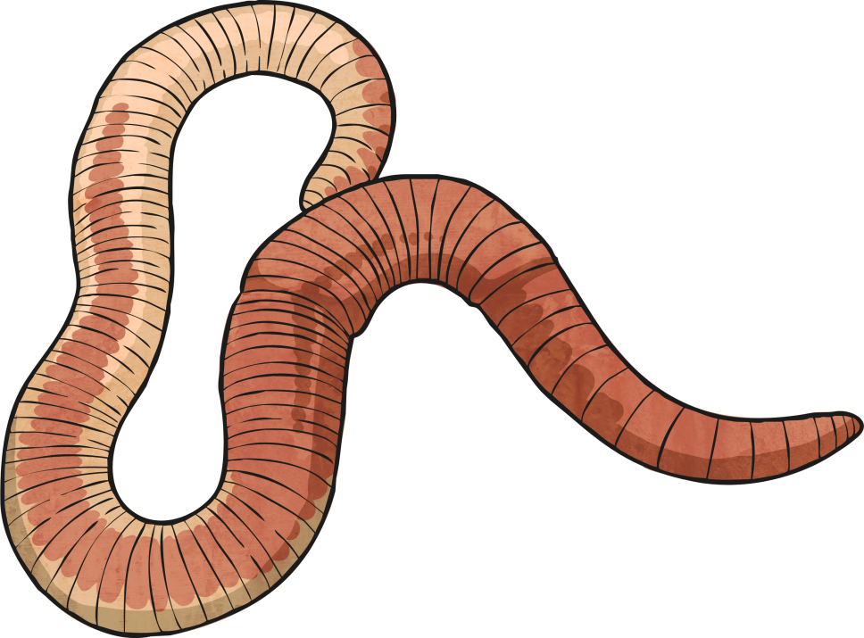
Classifying Invertebrates
Annelids
They have existed for over 120 million years.
There are over 9,000 species, including worms and leeches.
They have bodies divided into segments.
They don't have any limbs.
Some have long bristles; others have shorter bristles and seem smooth.

Slide 9
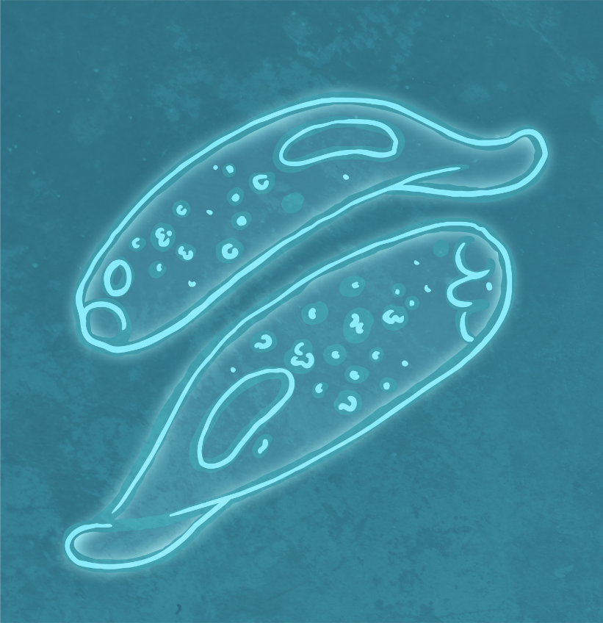
Classifying Invertebrates
Protozoa
They eat tiny algae and bacteria.
They can only be seen under a microscope.
They are simple, single-celled animals.
They are a source of food for fish and other animals.
They reproduce by splitting in half.

Slide 10
Classifying Invertebrates
Crustaceans
Most common crustaceans are the crab, lobster and barnacle. Woodlice are also crustaceans.
They have a hard, external shell which protects their body.
They live mostly in the ocean or other waters.
They have a head and abdomen.
Many have claws that help with crawling and eating.

Slide 11
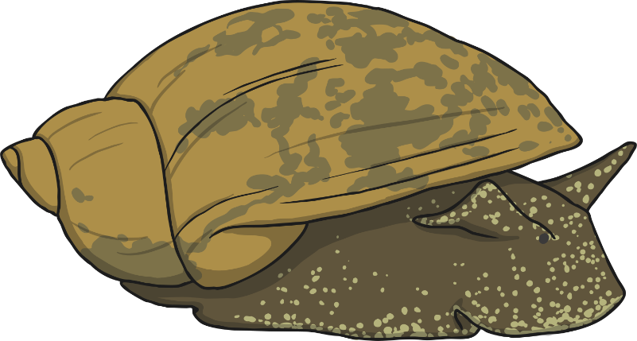
Classifying Invertebrates
Molluscs
They were among the first inhabitants of the Earth.
They live on land or in water.
Most have a soft, skin-like organ covered with a hard outside shell.
Land molluscs move slowly on a flat sole called a foot.
Ocean molluscs attach themselves to rocks or other surfaces, and can't move.

Slide 12
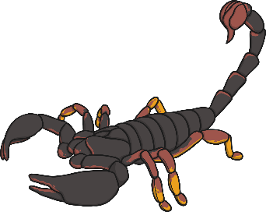
Classifying Invertebrates
Arachnids
Most arachnids have 4 pairs of legs.
The first pair of legs may be used for holding their prey and feeding.
Common arachnids are spiders, scorpions, ticks and mites.
They have a hard exoskeleton and jointed legs for walking.
Arachnids do not have antennae.

Slide 13
Classifying Invertebrates
Echinoderms
They are marine animals that live in the ocean.
Common echinoderms include the sea star, sea urchin, sand dollar and sea cucumber.
They have arms or spines that radiate from the centre of their body.
The central body contains their organs, and their mouth for feeding.
The mouth is underneath, to eat other sea life.

Slide 14
Invertebrates in the Local Environment
A specimen is a particular plant or animal that scientists study to find out about its species.
We are going to look for specimens of invertebrates in the local environment.
What kinds of invertebrate do you expect to find?
Are there any invertebrates that won’t appear in the local habitat?

Slide 15
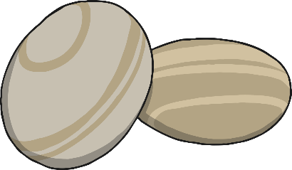
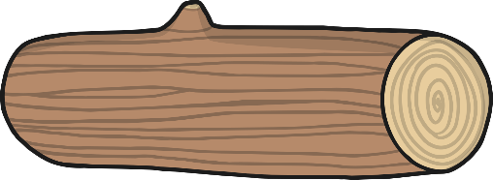
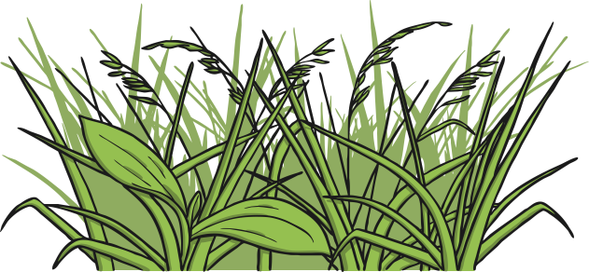
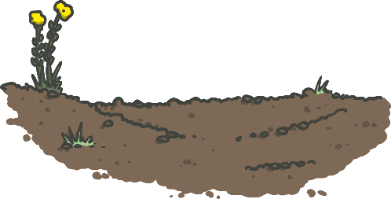
Invertebrates in the Local Environment
Invertebrates often inhabit small homes called microhabitats.
Here are some different microhabitats you might find.
In short grass
Under stones and rocks
Inside or under rotting wood
In and on soil
Under fallen leaves
In tall flowers and grasses
Can you think of any more?

Slide 16
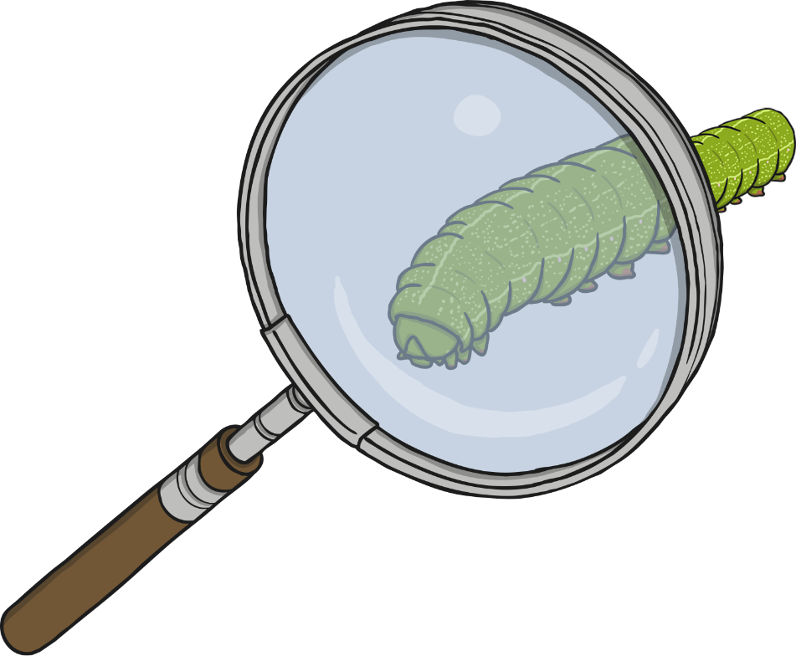
Classification
Because invertebrates are so small, they must be handled very carefully.
How can we observe and capture specimens without causing them any harm?

Slide 17
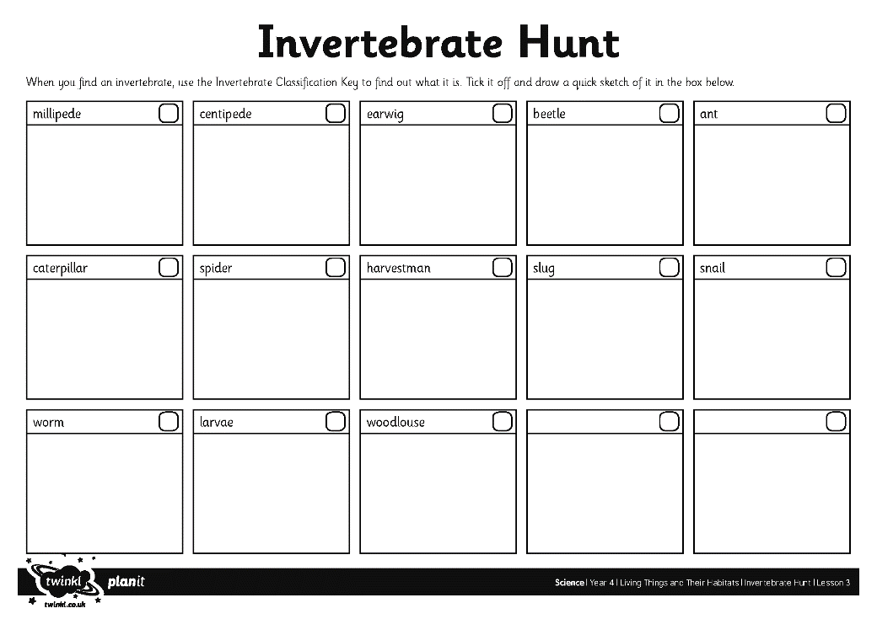
Find, identify and name and draw invertebrates, using your activity sheet below. .

Slide 18
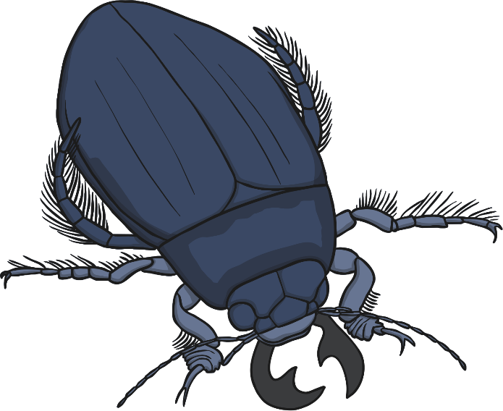
Identifying Invertebrates
Now it is time to identify your specimen!
Name of invertebrate: beetle
Habitat where it was found: leaf litter
Characteristics: this invertebrate has 6 legs, a body in 3 parts and a hard wing case. It has antenna. It does not have pincers on its tail.
Hint: to find out the characteristics of your specimen, look at the Invertebrates Classification Key to see the questions you have used to identify it.
wing case
abdomen
6 legs
thorax
head
antenna

Slide 19
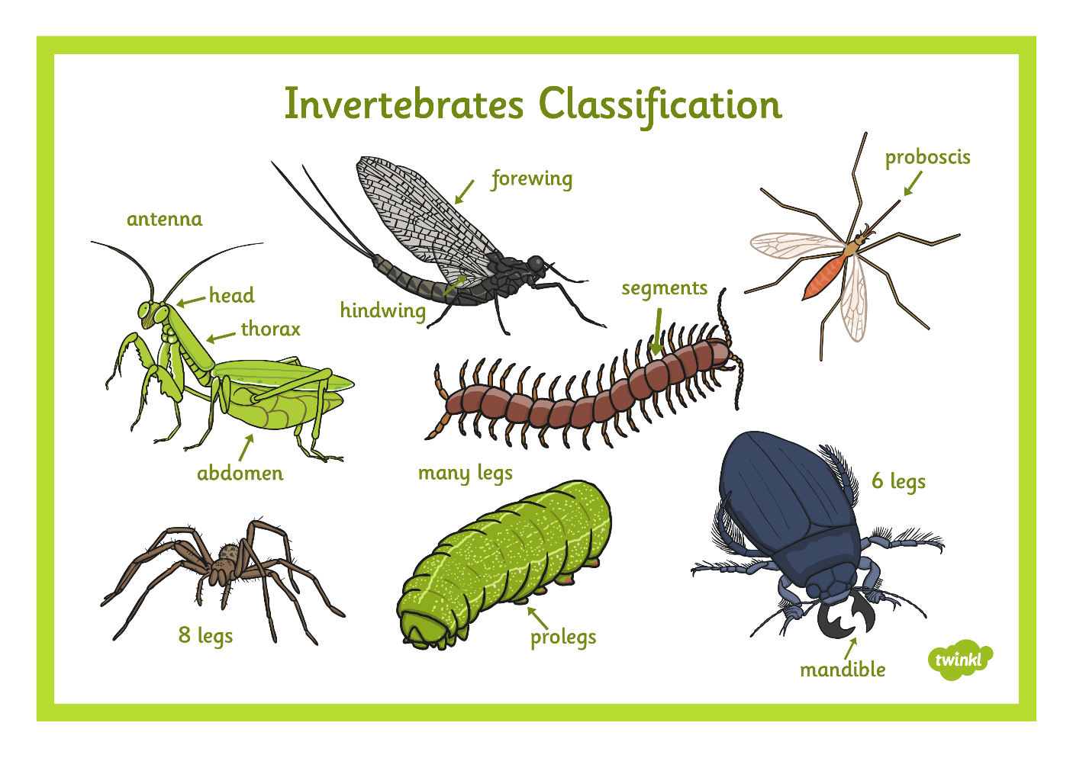
Identifying Invertebrates

Slide 20
Use the key to help you work out any invertabrates you do not know

Slide 21
How Do You Know?
How did you identify your specimen?
Use the Invertebrate Identification Key and the diagram of your specimen to show how you found out what your invertebrate is called.
wing case
abdomen
6 legs
thorax
head
antenna

