Slide 1
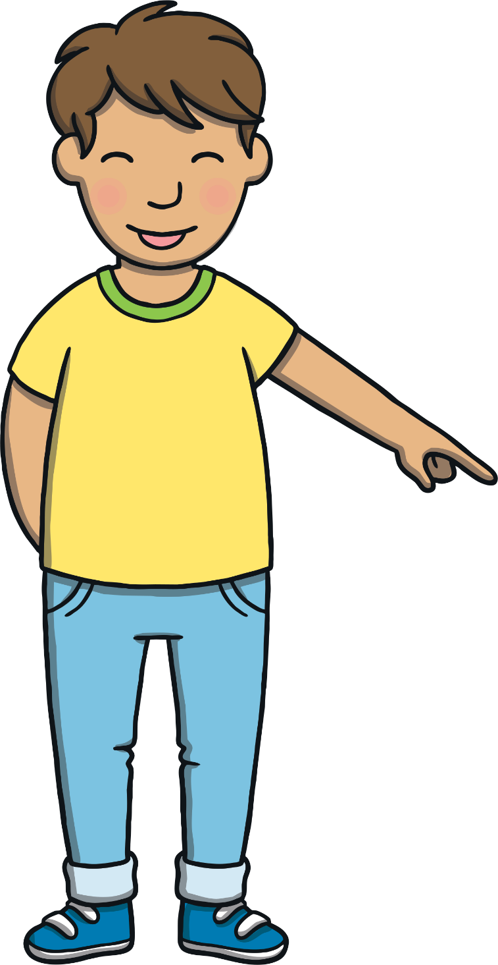
Today, we are learning…
ie
saying /igh/

Slide 2
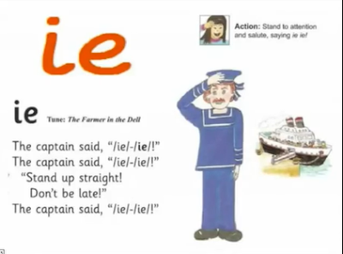
Jolly Phonics song and action for ie
https://vimeo.com/106231366
The song can be found at 10.44 / 12.14

Slide 3
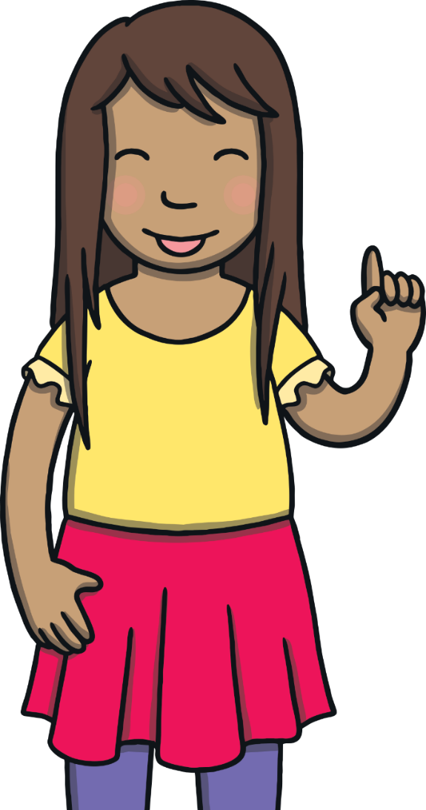
Teach
Today, we are learning to read and write words that contain ie for /igh/

Slide 4
Teach
Let’s practise reading some words with the ie sound.
pie
lie
tie
cried

Slide 5
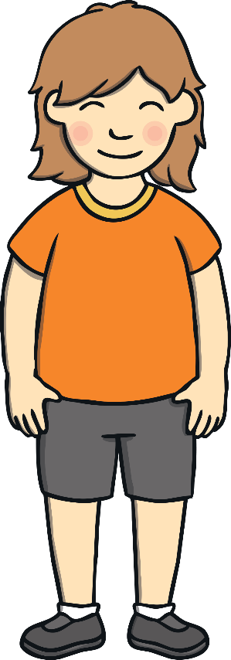
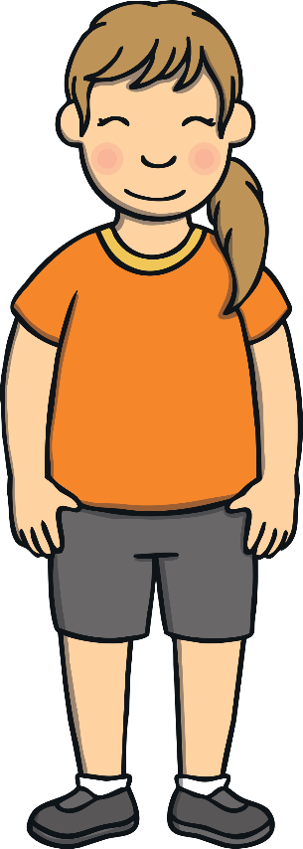
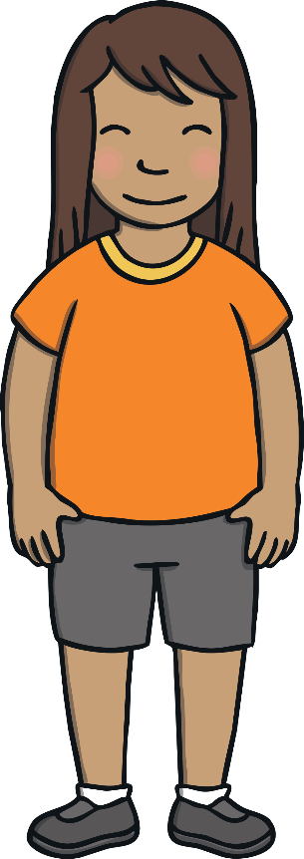
Practise
ie Letter Collect
The children are playing a game. They are racing to collect letters to make an ie word to match the picture. Can you help to find the right letters?

Slide 6
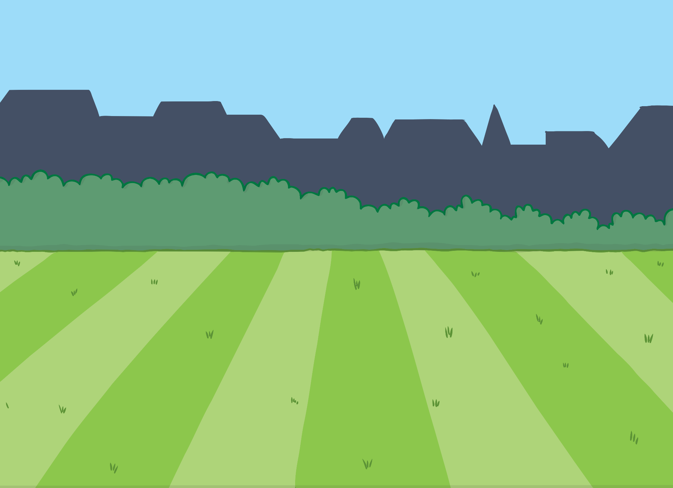
This is a great whiteboard activity! Children can write each word before clicking on the Check button below.
Teach
k
l
i
p
e
Check

Slide 7
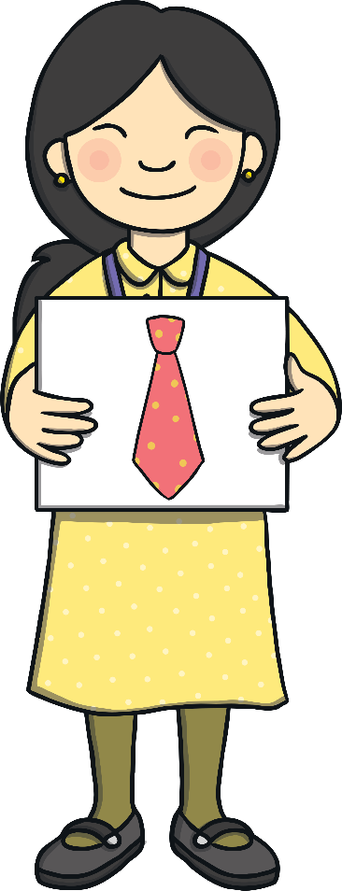
Practise
s
i
t
h
e
Check

Slide 8
Practise
s
i
r
t
m
e
f
Check

Slide 9
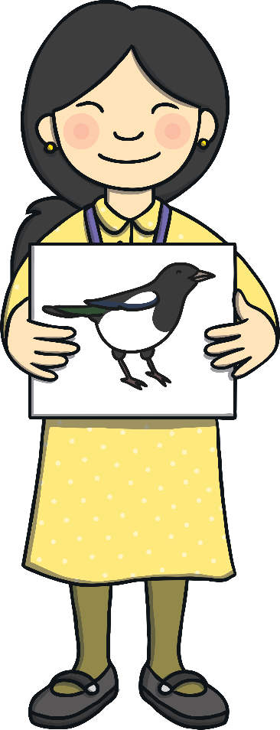
Practise
i
e
p
h
g
b
m
a
z
Check

Slide 10
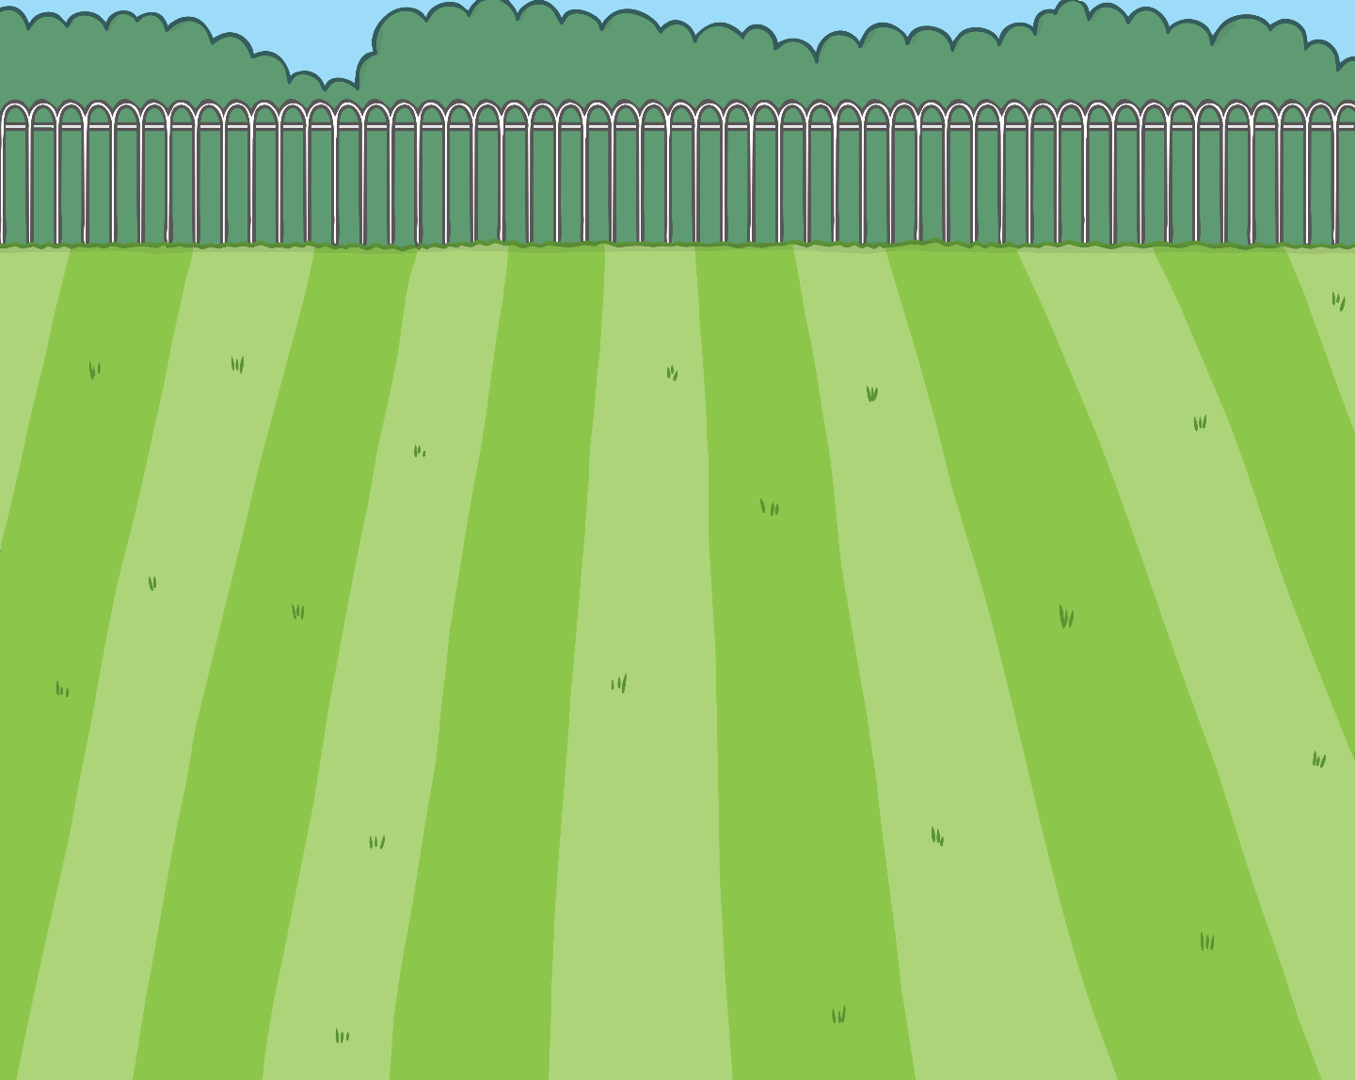
Can you find the digraph ie in the words below? Can you read the sentence to an adult?
Apply
“Come and have a lie down children!” she cried.

Slide 11
Today, we have learnt …
ie
saying /igh/

