Slide 1
Hello Unicorns! It’s been really lovely speaking to so many of you and your parents and also seeing your amazing photos and work. I don’t think that I’ve ever given out so many house points in one week! Remember our new class email address is: yeartwolearning@farnborough.bromley.sch.uk

Slide 2
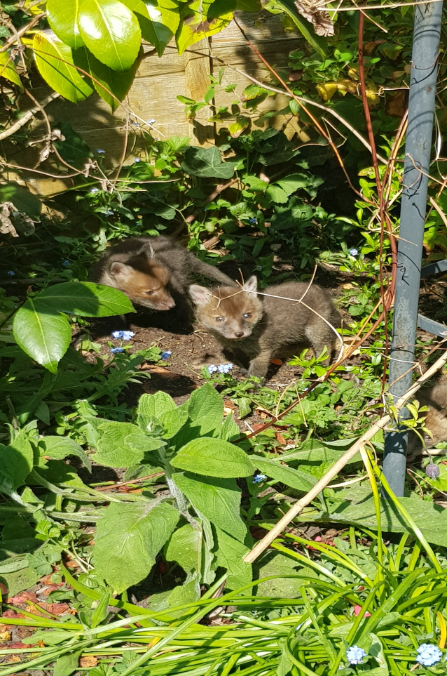
I’ve enjoyed hearing about what you’ve been doing in your spare time. Here’s what Miss McDonnell and I have been up to…
Hi Unicorns, Whilst we have been away I have turned into a bit of a wildlife watcher, watching the unusual birds and cats that enter my garden every day. Excitedly, we have a fox family that has moved in, a Mum fox (vixen) and her four cubs. It has been great watching from the house, the cubs love running around and are a little bit mischievous in the garden! Their favourite game at the moment is to jump up and down and squash all the plants in the flower bed! Here’s a photograph: I am looking forward to the day I see you all again and to see the work you have done. Love Miss McDonnell.

Slide 3
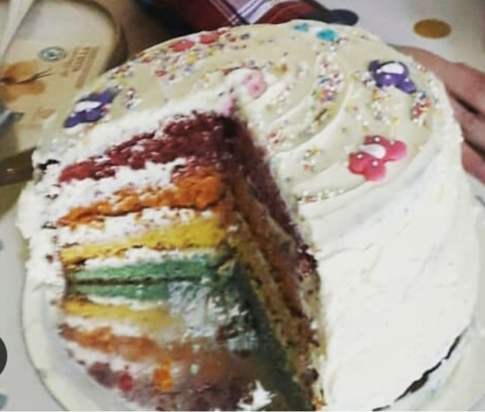
When I’ve had spare time in my day I’ve been busy baking which my husband is very happy about!
This is my first attempt at a rainbow cake… I think next time I’m going to work harder on getting the layers to look a bit neater. As you can see, my husband took just a small slice to try it out!
I’m missing seeing all your lovely smiles and am looking forward to hopefully seeing you soon. Love Mrs Matthews

Slide 4
Good morning Unicorns!
Here’s your work for today: Monday 4th May

Slide 5
Reading online
Please log on to Bug Club and read for at least 15 minutes
Make sure you answer your bug questions!

Slide 6
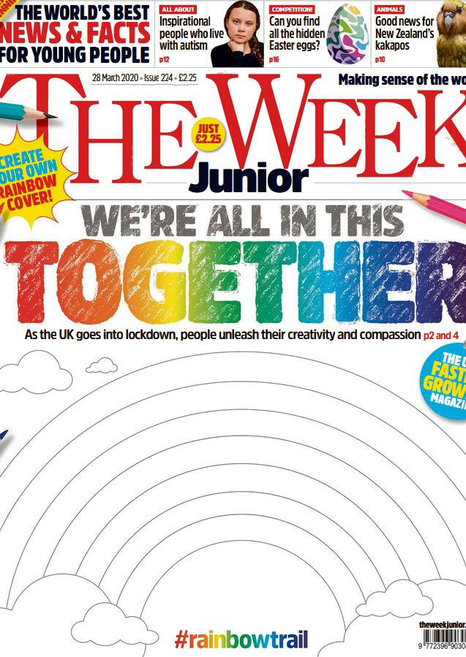
Reading online
You can also read ‘The Week Junior’ newspaper if you would like to:
https://www.yumpu.com/en/document/read/63174530/theweekjunior-224-2703-schools

Slide 7
Maths answers from last Friday:
Pages 47 and 48
Ali, 2 children
3 children
Imran is the oldest, Rob is the youngest
Saturday: 3 acorns, Sunday: 7 acorns
Blue 4
Pink 6
Red 2
6. 4 children, 21 children

Slide 8
Challenge
a): The most popular animal is the tiger – correct. 5 fewer children prefer the elephant to the tiger – incorrect. 8 more children prefer the monkey to the rhino – correct.

Slide 9
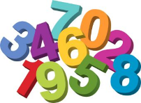
Maths
Today we are going to look at Tally Charts.

Slide 10
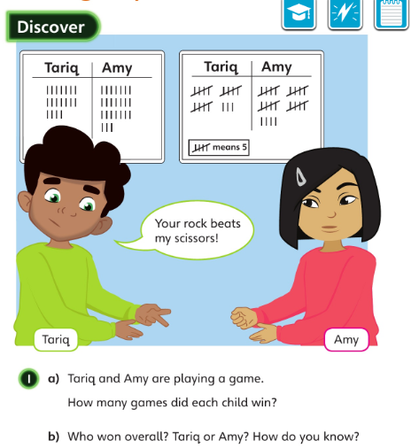
How is the first table different to the second table?
Whose tally is easier to count? Why?
Let’s look at the answers and how you could have worked them out on the next page…

Slide 11
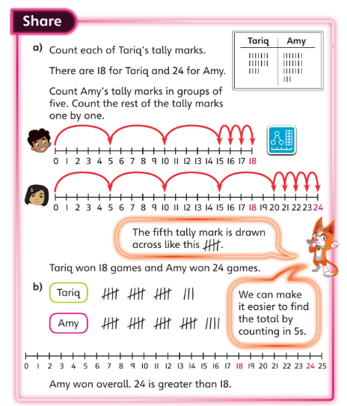
Which mathematical sign could you use to explain your answer?

Slide 12
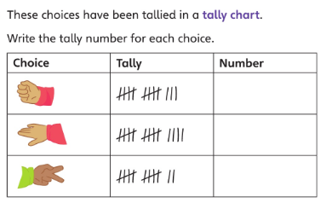
Don’t forget to use your five times tables to help you with this question!

Slide 13
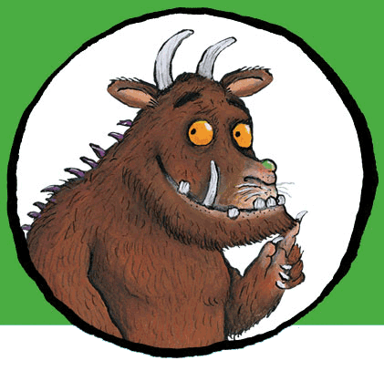
Now I would like you to have a go at completing work in your CGP Maths Reasoning workbook.
If you would like to try Gruffalo work, complete page 49
If you would like to try Horrid Henry work, complete pages 49 and 50
If you would like to try James and the Giant Peach work, complete pages 49, 50 and my Challenge question on the next slide.

Slide 14
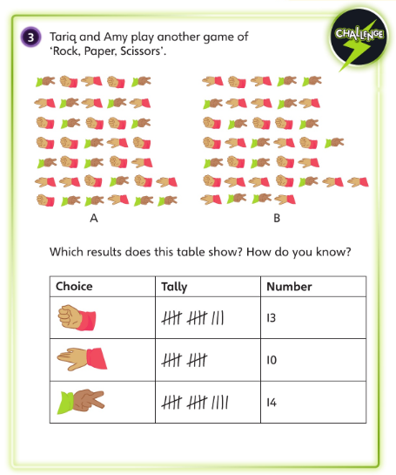

Slide 15
Handwriting
Please complete pages 26 and 27 in your CGP Handwriting Book.

Slide 16
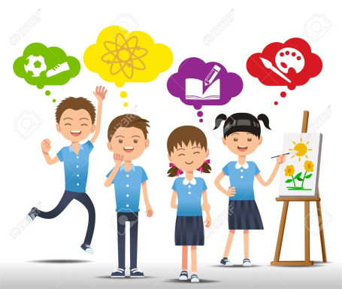
Independent Learning
If you could invent a new flavour for an ice-cream, what would it be?
Draw me a picture of your invention!

Slide 17
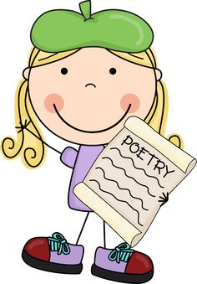
English
This week we are going to focus on a poem by someone called Kit Wright. It’s called ‘The Magic Box’…

Slide 18
The Magic Box
I will put into the box
the swish of a silk sari on a summer night,
fire from the nostrils of a Chinese dragon,
the tip of a tongue touching a tooth.

Slide 19
I will put into the box
a snowman with a rumbling belly
a sip of the bluest water from Lake Lucerene,
a leaping spark from an electric fish.

Slide 20
I will put into the box
three violet wishes spoken in Gujarati,
the last joke of an ancient uncle,
and the first smile of a baby.

Slide 21
I will put into the box
a fifth season and a black sun,
a cowboy on a broomstick
and a witch on a white horse.

Slide 22
My box is fashioned from ice and gold and steel,
With stars on the lid and secrets in the corners.
Its hinges are the toe joints of dinosaurs.
I shall surf in my box
on the great high-rolling breakers of the wild Atlantic
then wash ashore on a yellow beach
the colour of the sun.
Kit Wright

Slide 23
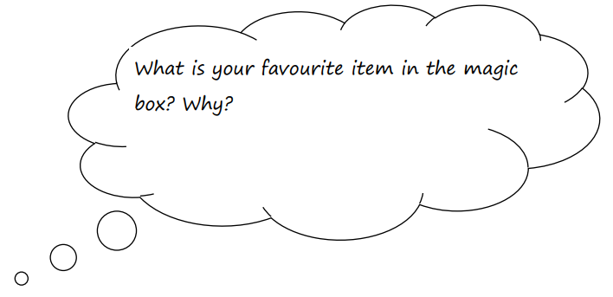
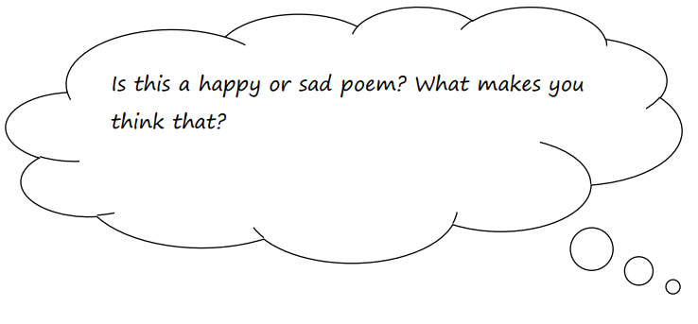
Write your responses in your exercise book.

Slide 24
Now it’s your turn. What are you going to put in the box?
This box is magic, which means you can put anything you like in it. Choose twelve of your favourite things, people or places.
Think about:
sounds feelings places tastes
thoughts beautiful things smells

Slide 25
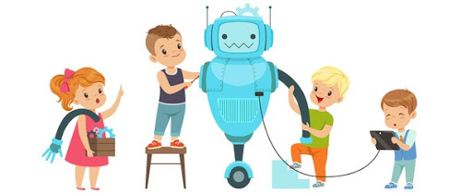
D.T
Today I would like you to carry out a creative activity linked to your English work.
I would like you to make a Magic Box!
You can:
Find a shoe box or small box and decorate it OR
Draw a box and decorate it.

Slide 26
Think about: • How you can make it magical? Perhaps it has eyes. Maybe it looks like a dragon or a witch’s cottage. • What is the theme? Perhaps it is magical creatures or places. Try to decorate it so that it fits your theme. • Is the lid attached to the box or does it lift off completely?

Slide 27
Enjoy, Unicorns!

