Slide 2
Good morning Unicorns!
Here’s your work for today: Monday 18th May

Slide 3
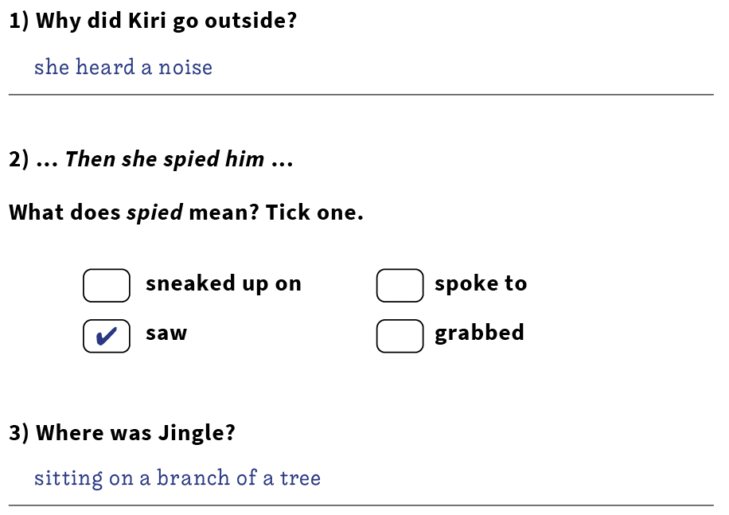
Reading answers from last Thursday:

Slide 4
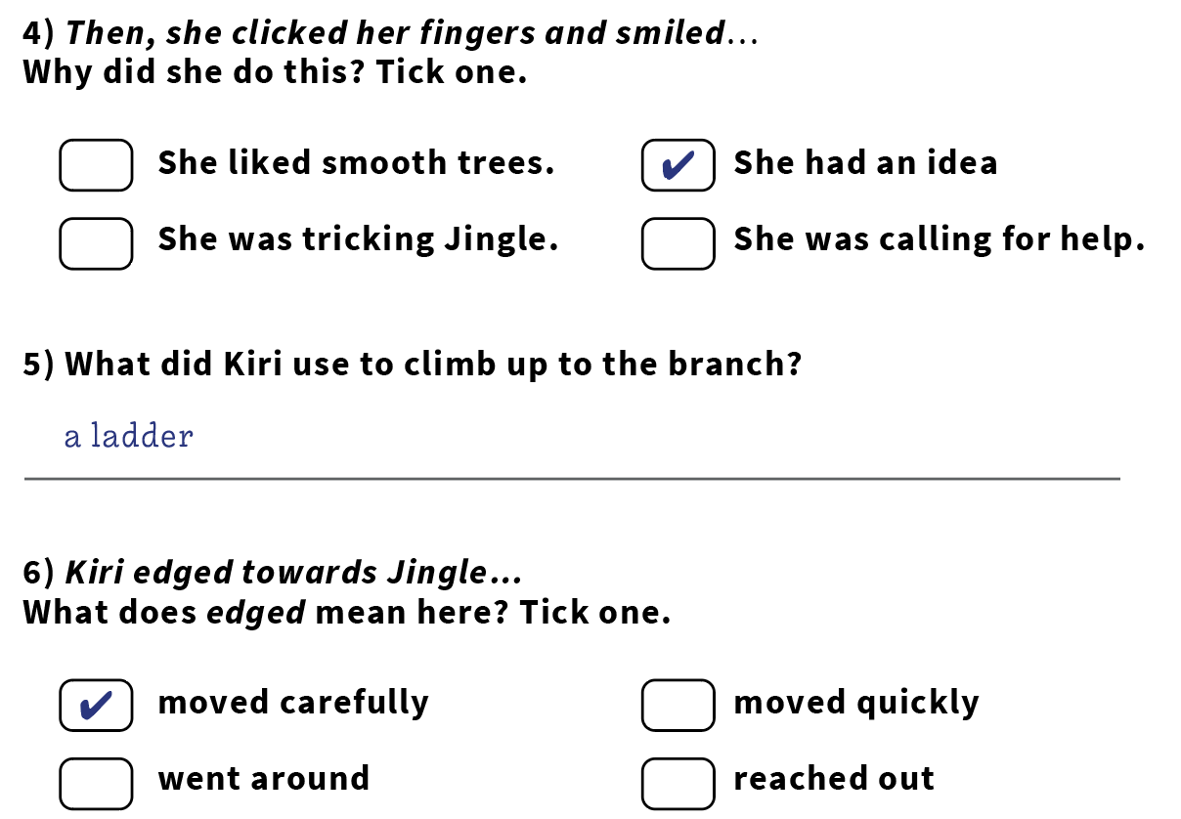

Slide 6
Reading online
Please log on to Bug Club and read for at least 15 minutes
Make sure you answer your bug questions!

Slide 7
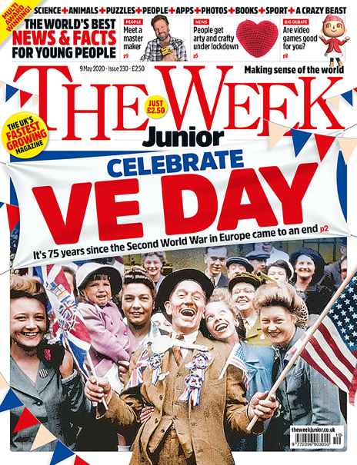
Reading online
Here’s a link to the latest issues of ‘The Week Junior’
https://magazine.theweekjunior.co.uk/

Slide 8
Maths answers from last Thursday:
C, A, B
c, a, b, d
a) 40 cm, 44 cm, 50 cm b) 27 m, 31 m, 55 m
Children could have changed the following numbers: a) The first number to a number less than 70 or the second number to a number between 80 and 90. b) The third number to a number greater than 26.

Slide 9
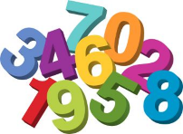
Maths
Today we are going to be focussing on money.

Slide 10
Click on this link:
kids.classroomsecrets.co.uk/resource/count-money-notes-and-coins-video-tutorial/

Slide 11
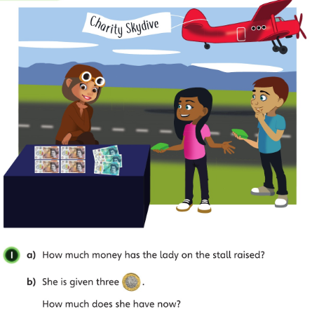
How many pounds does each note represent?
• Why do you use notes? Would it be a good idea to have 50 pound coins in your purse? Why not?
Let’s look at the answers and how you could have worked them out on the next page…

Slide 12
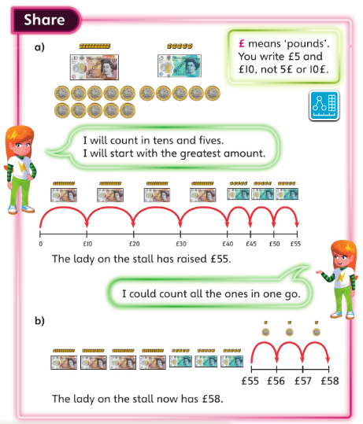
• Why does Astrid start with the greatest amount? • Which is correct: £58 or 58£? • How many £5 make £10? How many £5 make £20?

Slide 13
.

Slide 14
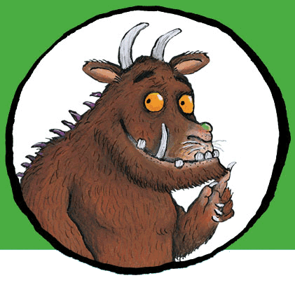
Now I would like you to have a go at completing the questions on the next slides. You can write your answers in your exercise books.
If you would like to try Gruffalo work, complete questions 1 and 2.
If you would like to try Horrid Henry work, complete questions 1, 2, 3 and 4
If you would like to try James and the Giant Peach work, complete questions 1, 2, 3 ,4 and the Challenge question on the following slide.

Slide 15
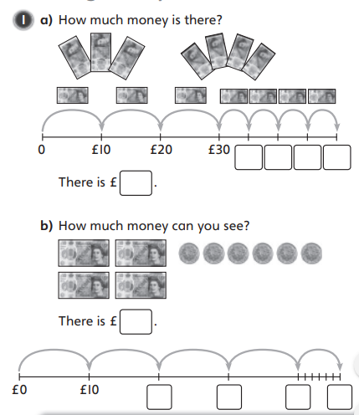

Slide 16
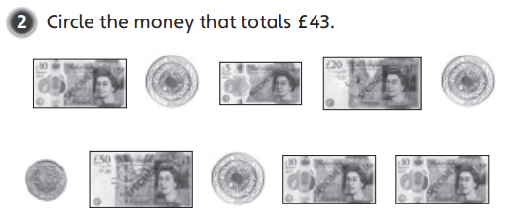

Slide 17
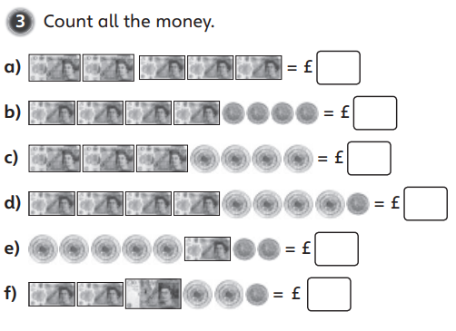

Slide 18
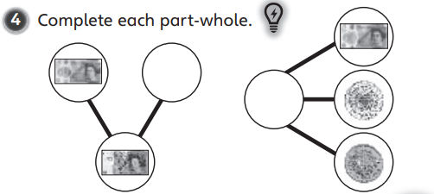

Slide 19
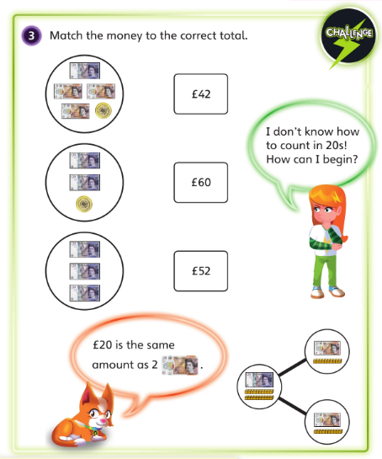

Slide 20
If you’d like an extra challenge, (or have some spare time) I have created a Maths Challenge PowerPoint which has an extra challenge for every day. You can have a go at that now.

Slide 21
Handwriting
Please look at the high frequency words on the next slide and copy them into your handwriting exercise book.

Slide 22
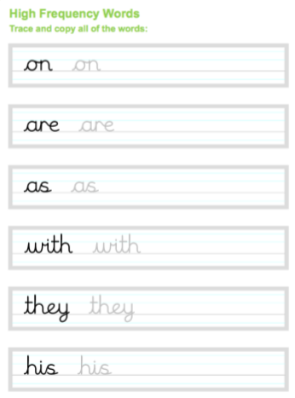

Slide 23
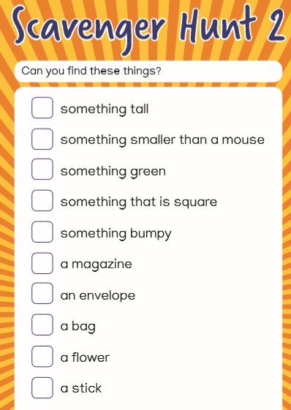
Independent Learning

Slide 24
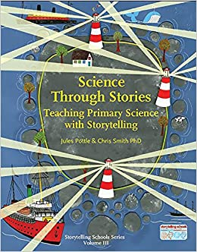
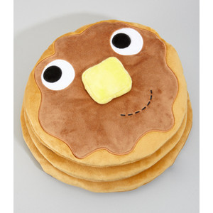
English
This week we are going to be carrying out work based around a funny story called ‘Death of a Pancake’. It is from a book called ‘Science through Stories’.

Slide 25
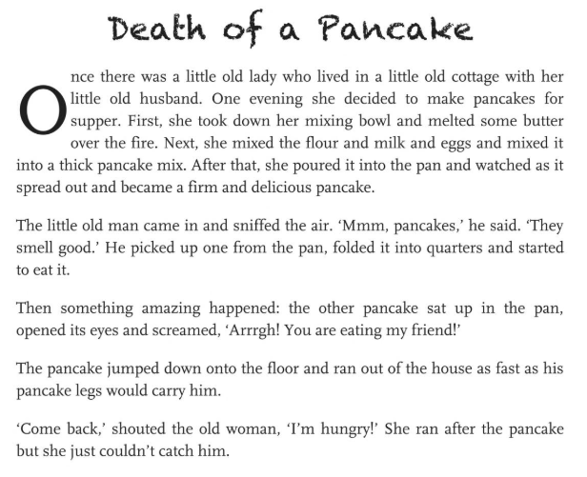
First, read the story on the next few slides:
Think about these questions:

Slide 26
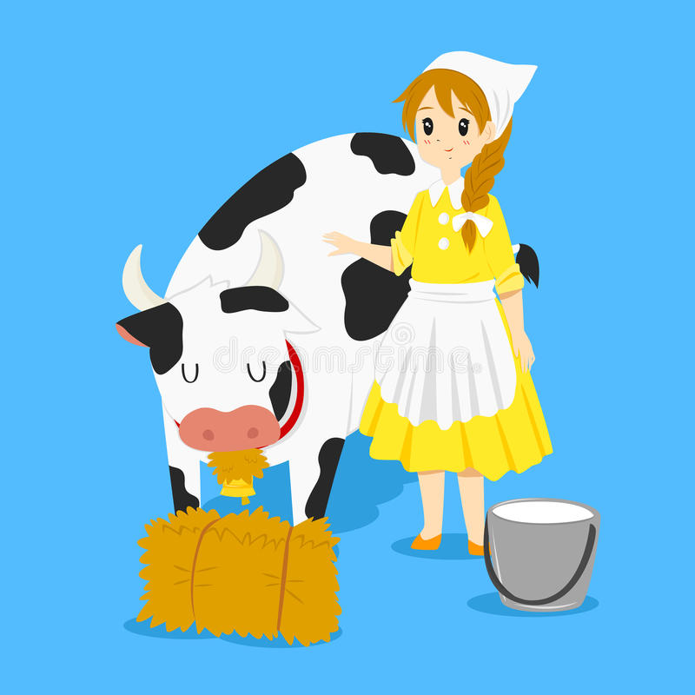

Slide 27
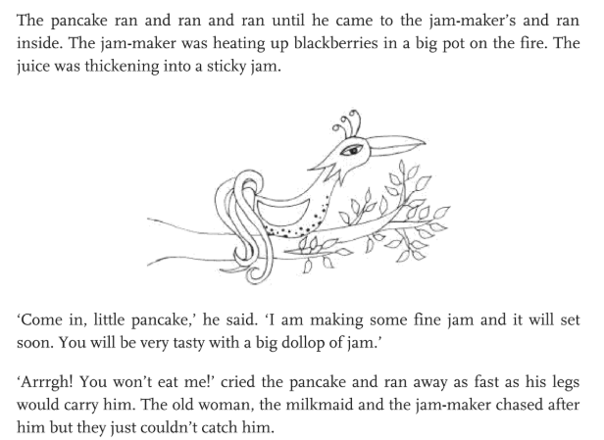

Slide 28
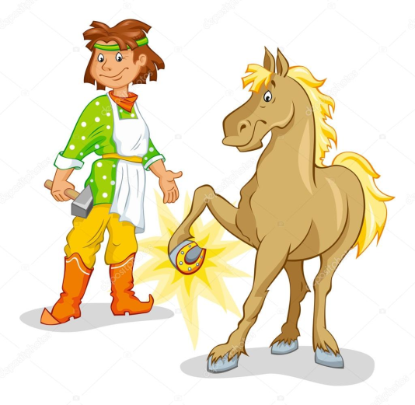

Slide 29
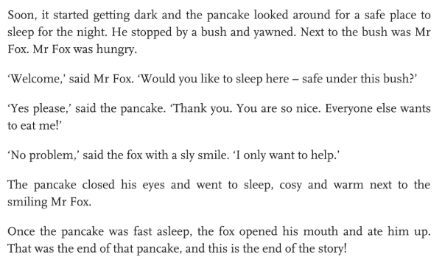

Slide 30
Today you are going to create a story map of the main events to help you to learn the story.
I have created one on the next slide as an example.

Slide 31
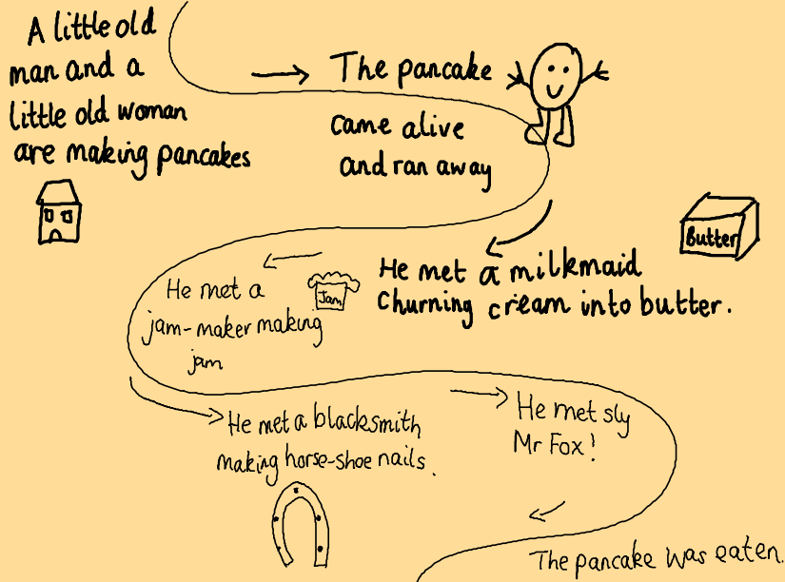

Slide 32
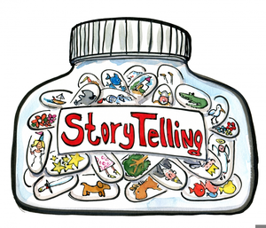
Now try to re-tell the story using your story map.
Enjoy!

Slide 33
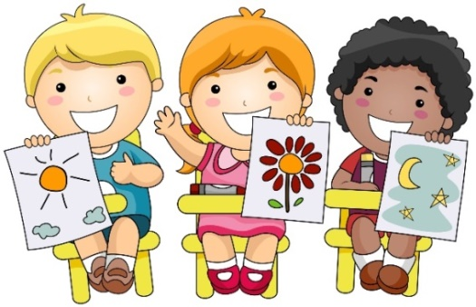
Art

Slide 34
What do you look forward to doing once Lockdown is lifted?
What do you look forward to doing once lockdown is lifted?
Local estate agents, Langford-Rae are running an Art competition. To enter they would like you to draw a picture or make a piece of art showing what you are most looking forward to doing once the lockdown is lifted. Entries should be on A4 size card/paper and in landscape format.
To submit your entry you will need to ask a parent/guardian to take a photo of your finished artwork and ask them to email it to chelsfield@langford-rae.co.uk with your name ,age and school. All entries need to be submitted before 5 pm, Sunday 24th May
The winning artwork will be published on their website and displayed at a later date in the Chelsfield Land-Rae office window. The overall winner will also receive a Hobbycraft gift voucher worth £25.00.
See full terms and conditions in separate pdf link
Art
Competition

Slide 35
Enjoy, Unicorns!

