Slide 1
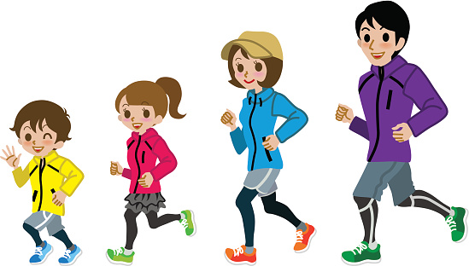
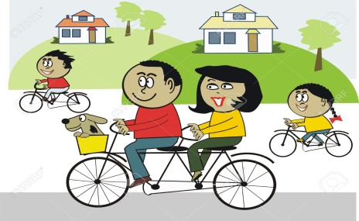
Our active challenge starts Thursday 14th May and ends Wednesday 20th May.
Farnborough gets Active
When going out for your daily exercise, measure how many kilometres you cover across 7 days (dates above).
All activities count - walking a dog, walking through the woods, running, cycling, scooting are all perfect.
Once you have completed the week, email your class teacher on the class email with the total of kilometres: receptionlearning@farnborough.bromley.sch.uk
The final day to supply teachers with your total is Friday 22nd May.
Which class will be crowned the most active?

Slide 2
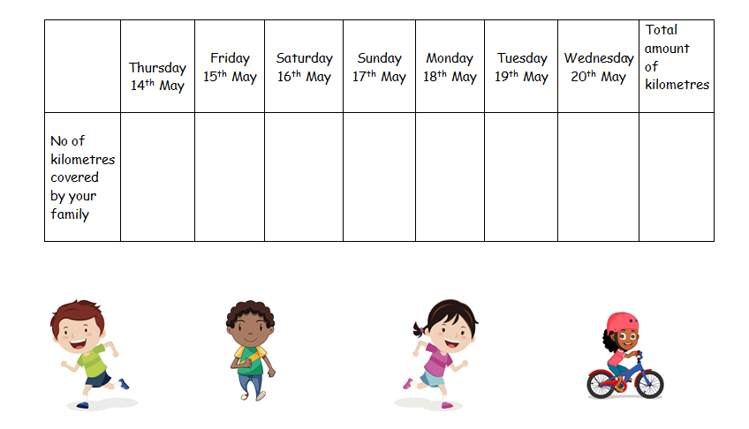
Here is a table your child can use to record your distances
Farnborough gets Active

