Slide 2
English
We are going to continue to use the Night Zookeeper for our English activities this week.

Slide 4
What do you think a Spying Giraffe is?
Describe one of the other magical creatures.
When was the last time you heard an alarm, how did it make you feel?
Make a mind map for all the reasons an alarm might be sounded.

Slide 5
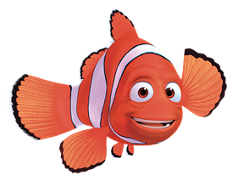
Active Learning

Slide 6
Guided Reading
Perfect picture!
Can you design a robot? Think about what it looks like, and what things it can do!

Slide 7
Reading Independently
Read for at least 15 minutes independently. You can read a book of your choice.
If you would like to read ‘The Week Junior’ follow this link.
If you would like to read an online book, follow this link.

Slide 8
Maths
Complete the coloured work you would normally do in class. If you want to try the other challenges, please feel free ☺
Purple group: challenge one
Blue group and green group: challenge two
(blue group, you can also finish off your maths workbook if you haven’t already, one page for each maths lesson instead of or as well as the challenge)
Orange group and red group: challenges two and three

Slide 9
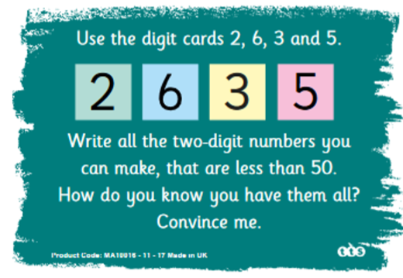
Challenge One
We are building our maths knowledge.

Slide 10
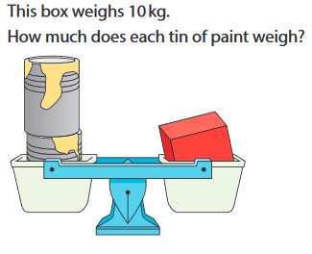
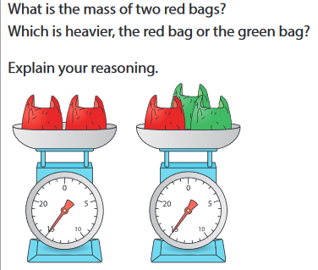
Challenge Two
We are improving our maths reasoning.

Slide 11
Challenge Three

Slide 12
Handwriting

Slide 13
Afternoon activity Use the ‘Art with Rob’ link on the Year 3 learning page to pick a picture to draw.

