Slide 2
English
We are going to be continuing to use ‘The Night Zoo keeper’ for our English activities this week.
You have a very special job, you have been recruited as a new Night Zoo Keeper at this magical zoo.

Slide 3
Let’s recap this part of the story.

Slide 4
You are going to complete you application form to become the Night Zookeeper. Remember to stay in character.

Slide 5
Guided Reading
Sick sentences!
These sentences are ‘sick’ and need help to get better. Can you help?
He was really big. People were scared. His big body walked down the street.
How can you make these sentences more exciting for the reader?

Slide 6
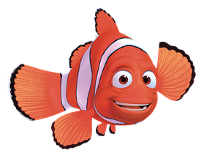
Active Learning

Slide 7
Maths
Complete the coloured work you would normally do in class. If you want to try the other challenges, please feel free ☺
Purple group: challenge one
Blue group and green group: challenge two
(blue group, you can also finish off your maths workbook if you haven’t already, one page for each maths lesson instead of or as well as the challenge)
Orange group and red group: challenges two and three

Slide 8
Challenge One
We are building our maths knowledge.

Slide 9
Challenge Two
We are improving our maths reasoning.

Slide 10
Challenge Three

Slide 11
Reading Independently
Read for at least 15 minutes independently. You can read a book of your choice.
If you would like to read ‘The Week Junior’ follow this link.
If you would like to read an online book, follow this link.

Slide 12
Handwriting

Slide 13
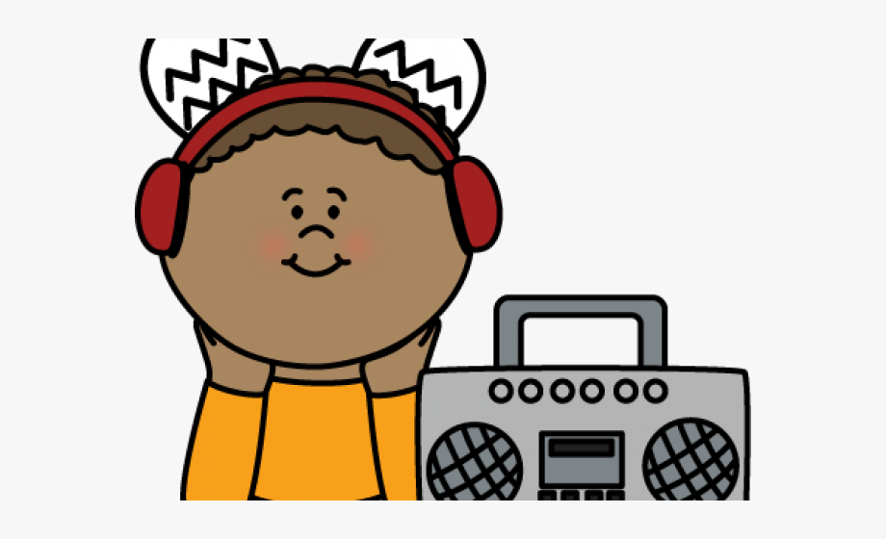
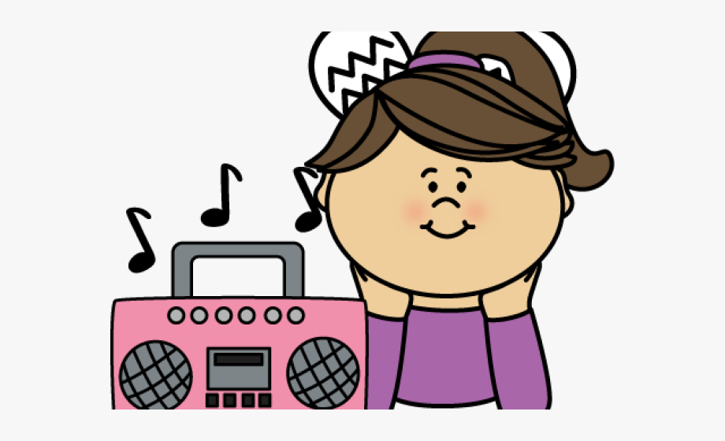
Music

Slide 14
Write down any pirate songs or films that you know. Write down the things you would you like to hear in a pirate song (e.g. finding treasure, walking the plank, sailing on the high seas)

Slide 15
Listen to the pirate song. If the video doesn't play, click this link
Sing the 1st verse of the song with the video
• Pause the video and practise clapping all the words in the chorus - make sure to clap every bit of the words (the syllables) e.g. “jolly” has 2 claps.
• At the end of the chorus (54 – 108) there is some instrumental music. Choose one of these phrases “Yo ho ho!” “Walk that plank!” “Hoist the Jolly Roger” or “Let’s set sail” to repeat over and over again in the instrumental section.
(Verse) We’re pirates sailing on our ship Will you come along? We’re pirates sailing on our ship We’re so brave and strong. We have a map of where our treasure is It’s hidden well But who will find this bottle? We can never, ever tell.
(Chorus) Yo, ho, ho! Walk that plank! Yo, ho, ho! Walk that plank! Hoist the Jolly Roger. Let’s set sail Hoist the Jolly Roger. Let’s set sail.

Slide 16
When you repeat a phrase or a rhythm over and over it’s called an ostinato. Ostinato rhymes with tomato!
You just did this at the end of the chorus!

Slide 17
Listen to the pirate song. If the video doesn't play, click this link
Learn the second verse
Pick a whole line either “Yo, ho, ho! Walk that plank!” or “Hoist the Jolly Roger. Let’s set sail.” and chant it over the music.
Repeat with the other phrase, add clapping and chant it over the music as an ostinato.
Sing the whole song through and choose what to add as an ostinato in the instrumental section, clapping, chanting or both.
Write down four of your favourite ostinato phrases.
Verse 2
The island is so dangerous With swamps and crocodiles Mines and caves and snakes as well You have to walk for miles. We have a map of where our treasure is It’s hidden well But who will find this bottle? We can never, ever tell.

