Slide 1

Guided Reading

Slide 2
Complete the coloured work labelled on your pack.
If you want a challenge, or have some extra time, please feel free to try another group’s work ☺

Slide 3
Hidden Temple
Purple Group
Sentence Challenge
Can you make a list of feelings to describe how you would be feeling before entering the temple?
Could you start a sentence with 1 or 2 of these emotions?
E.g. Nervously, I stepped through the doorway, preparing myself for the worst.
Remember to write in full sentences.

Slide 4
Hidden Temple
Blue Group
Sentence Challenge
Can you make a list of feelings to describe how you would be feeling before entering the temple?
Could you start a sentence with 1,2 or 3 of these emotions?
E.g. Nervous and shaking, I stepped through the doorway, preparing myself for the worst.
Remember to write in full sentences.

Slide 5
Green Group
Sick sentences!
These sentences are ‘sick’ and need help to get better. Can you help? Could you add an adverb?
It was really hot in the jungle. I was sweating. I saw a temple it front of me. It was big and it was covered with green stuff.
Sentence challenge!
Can you make a list of feelings to describe how you would be feeling before entering the temple?
Could you start a sentence with 1,2 or 3 of these emotions?
E.g. Nervous and shaking, I stepped through the doorway, preparing myself for the worst.
Hidden Temple
Remember to write in full sentences.

Slide 6
Orange Group
The humidity was unbearable. Perhaps when the entered the temple it would be cooler?
The group had been travelling together for days, fighting their way through the jungle. They had exhausted themselves wrestling with vines and branches, drenched in sweat as the heat attacked them.
All around them the air was heavy; each breath was a gasp. The jungle climate was oppressive, and they were in need of rest.
As the group hacked their way through the dense foliage with their machetes, they had glimpsed the hidden temple. Approaching the door with a sense of growing trepidation, they knew they had to go inside; curiosity and desperation had got the better of them…
Hidden Temple
Question time!
What does ‘trepidation’ mean? Why might they be feeling it?
Who are ‘the group’? Why are they in the jungle?
What does ‘curiosity and desperation got the better of them’ mean?
Remember to write in full sentences.

Slide 7

Handwriting
Complete page 14 in your handwriting book.

Slide 8
English
This week we are going to use poetry by R L Stevenson to inspire our own rhyming poetry.

Slide 9
What pattern do you notice about the rhyme in this poem?
What do you think the poem is about?

Slide 10
This type of rhyming pattern is called a rhyming couplet.
What could you see from a train window as you were going along?

Slide 11
cars
Trees
Now, try to add at least 3 more ideas of your own.
From the train window
people
Buildings

Slide 12
cars
Trees
Now, try to rhyming words to your spider diagram.
From the train window
people
Buildings
We will use this to help us write our own verse tomorrow.

Slide 13

Maths
Year 3
Complete the coloured work you would normally do in class.
If you want a challenge, or have some extra time, please feel free to try another group’s work ☺
Red Group follow this link https://DUKEMUG.exampro.net

Slide 14
Purple group – complete page 18 of your workbook
We are recapping our knowledge of division.
Write down all your division facts for the 2 times table. Can you explain how to use the times table to help find the division facts?

Slide 15
Blue group - complete pages 18 and 19 of your workbook
We are recapping our knowledge of multiplication and division.
Write down division facts for the 2, 5 and 10 times tables to warm up.

Slide 16
WALT: add a 3-digit number and 1s.
We are going to consolidate our knowledge of addition and
subtraction, which we looked at in Autumn Term.
Look at the yellow pages to help you, then complete the work
for your group.
Green group – green background
Orange group – orange background

Slide 17
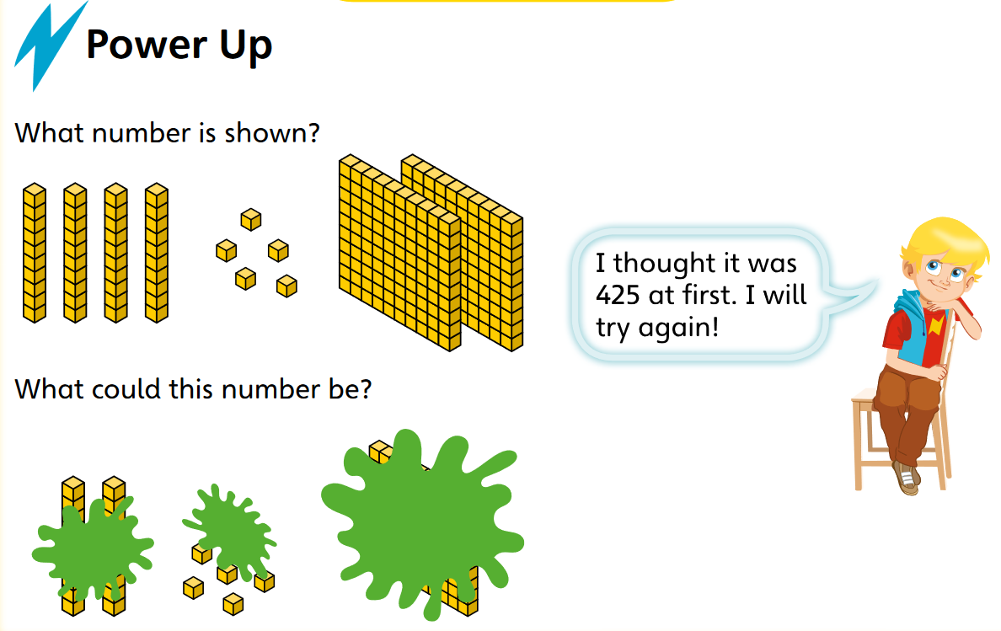
Green and orange warm-up

Slide 18
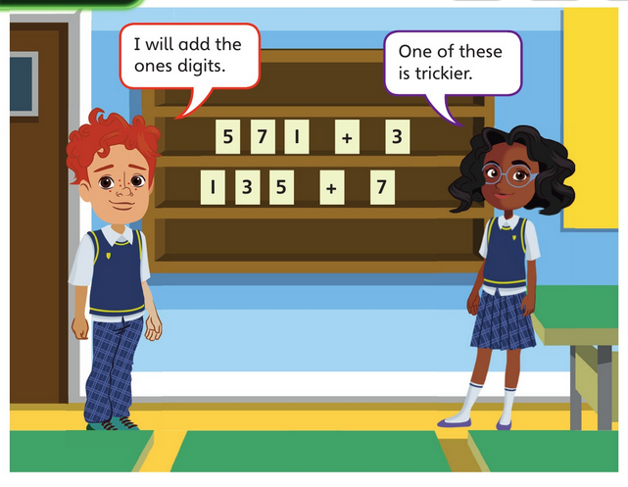
Solve these additions.
Explain which one is harder and why.

Slide 19
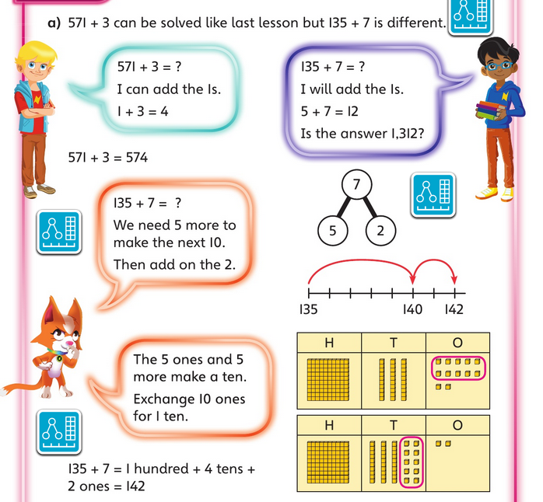

Slide 20
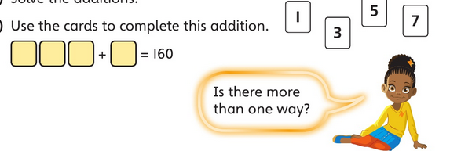

Slide 21


Slide 22
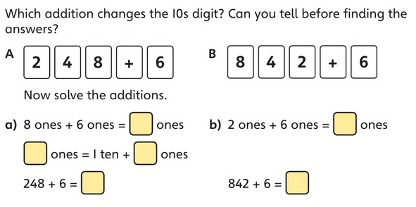

Slide 23
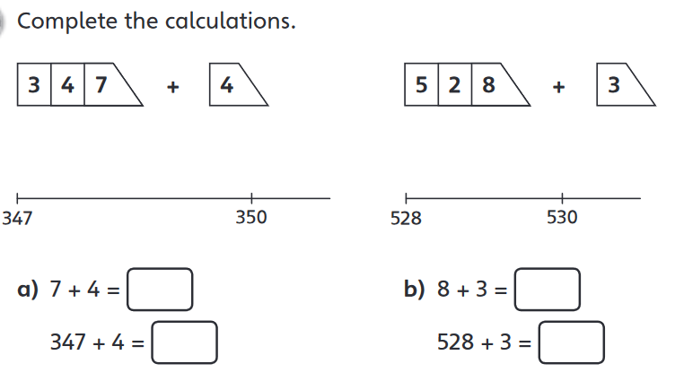

Slide 24
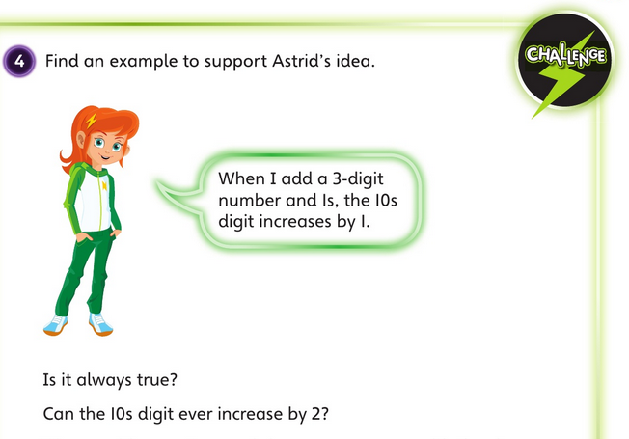

Slide 25
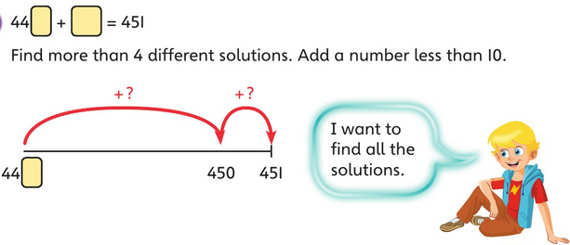

Slide 26
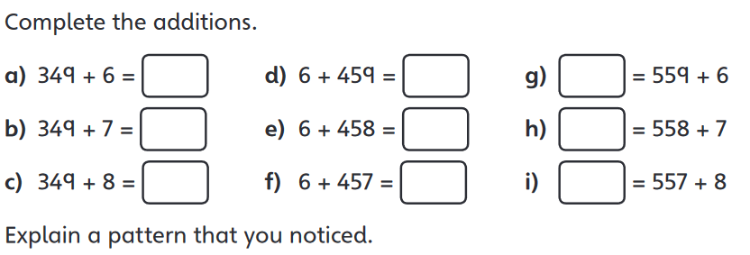

Slide 27
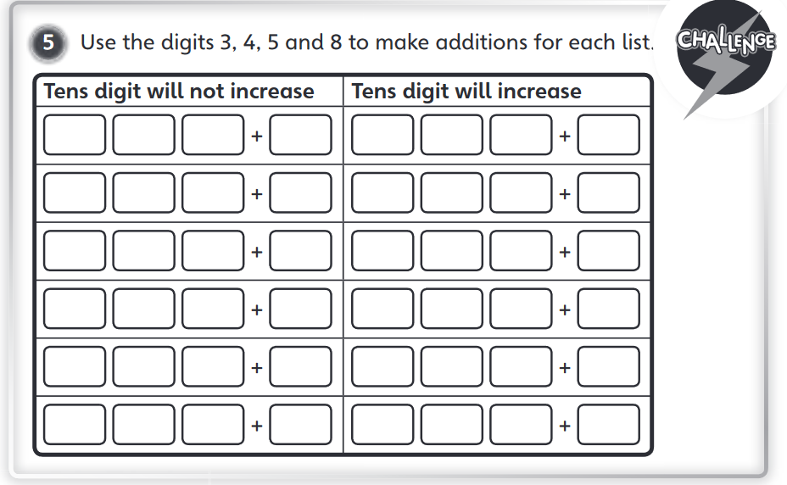

Slide 28
Art
Patterns are all around us.
Have a look around your house or in your garden, if you can and draw 3 patterns that you can find.

Slide 29
Art
Write down three things you can tell me about the patterns you have found.
E.g. what shapes can you see? Does the pattern repeat multiple times? What colours and textures can you see?

Slide 30
Physical activity – minimum 30 minutes each day | Link to resource
5 a day User Name: FPS53 / Password: JFz4XqG7 | https://player.5-a-day.tv/
Joe Wicks – PE sessions | https://www.youtube.com/channel/UCAxW1XT0iEJo0TYlRfn6rYQ
Cosmic Kids Yoga | https://www.youtube.com/user/CosmicKidsYoga
PE Hub Parents Portal | https://pehubportal.co.uk/
Go Noodle | https://www.gonoodle.com/good-energy-at-home-kids-games-and-videos/
Go for a walk/run. You must go with an adult from your home and make sure you stay 2 metres away from other people.

