Slide 1
Good Morning Unicorns!
Here’s your work for today:
Tuesday 21st April

Slide 2
Reading Comprehension
Today you are going to read a text and then answer questions about it.

Slide 3
First…
…read the text ‘Bees’ on page 21 in your CGP Reading workbook.

Slide 4
Now take a look at the questions…
R
Remember to be detectives- the answers will be hidden somewhere in the text.

Slide 5
Please complete the questions on pages 22-26 of your CGP Reading workbook.

Slide 6
Grammar
Today you will be focussing on:
Punctuation for sentences (Full stops, question marks and exclamation marks)
Watch this link and enjoy the song and dance:
Sentences

Slide 7
Grammar
Please complete pages 10 and 11 in your Nelson Grammar workbook.

Slide 8
Maths answers from yesterday:
Pages 28 and 29
13cm
Morning: 10°C , Afternoon: 24 °C
Height: 4cm, Length: 12cm
18 grams
Coloured up to the third line from the bottom, Coloured two lines up from 150.
Arrow to the first line ( in-between 0 and 100), arrow to the line between 200 and 300
Challenge
Thermometer A is in the shade.
Thermometer B is broken.
Thermometer C is in the sun.

Slide 9
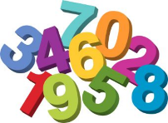
Maths
Today we are going to look at comparing measurements.

Slide 10
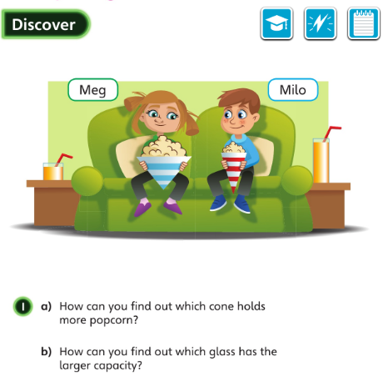
Let’s look at the answers and how you could have worked them out on the next slide…

Slide 11
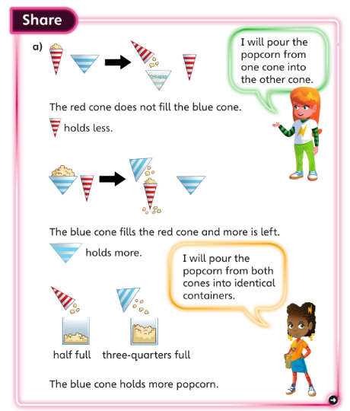
• Could you use the < and > signs to make a statement about the cones?
• Is there another way you could compare the amount of popcorn each cone holds?

Slide 12
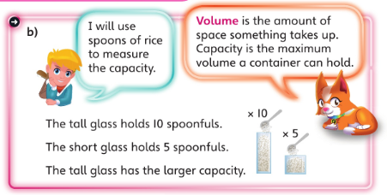
How could you compare the capacity of the different glasses?
If the tall glass holds 10 spoons of rice, and the short glass holds 5 spoons of rice, which has the larger capacity?

Slide 13
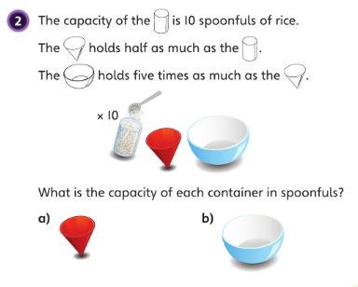
a): A capacity of 5 spoonfuls.
b): A capacity of 25 spoonfuls.

Slide 14
Now I would like you to have a go at completing work in your CGP Maths Reasoning workbook.
If you would like to try Gruffalo work, complete page 30.
If you would like to try Horrid Henry work, complete pages 30 and 31
If you would like to try James and the Giant Peach work, complete pages 30, 31 and my Challenge question on the next slide.

Slide 16
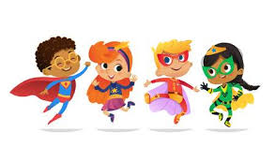
English
Today you are going to write your introduction and first subheading.
Look back at your poster from yesterday.
Write your first paragraph, making sure you think about these things:
Introduction:
What is your superhero called? What will the reader learn about them in this information text?
Look on the next slide for an example of what your introduction may look like …

Slide 17
Introduction
Have you ever heard about the Super Tutor? The Super Tutor is an extraordinary modern day superhero. Read on to find out about what she looks like, what her superpowers are and how she became a superhero. How impressed you will be!

Slide 18
Now you are going to write your first subheading.Think about these things:
What do they look like?
What do they look like? What do they wear? What is special about their outfit? What special features does their outfit have?
Look on the next slide for an example of what your first subheading may look like …

Slide 19
What do they look like?
The Super Tutor has long brown hair that she always ties up in a ponytail and eyes that are as blue as the ocean. She wears bright red gloves and a long flowing blue cape. On her top you will see a capital ‘T’, which stands for Tutor. The Super Tutor never goes on her superhero missions without her cape and special green boots because they help her fly. They work by pulling an activation chord that allows her to zoom through space to help people who need it.

Slide 20
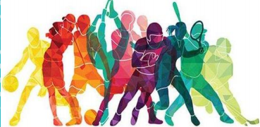
Active Learning
Creating a new Olympic Sport
The Olympics have been postponed.
Which new sport would you want to have in the Olympics?

Slide 21
Decide what kind of sport you want: Is it played in water? On a field? Is it about accuracy or speed? Is it an individual sport or a team sport?
Pick a name for your sport.
Decide on some rules: How many players, the aim of the sport, how to score/gain points…
Decide on the specific jobs for all the players, making sure that each one contributes to the game.
Draw the ball/racket/uniforms needed to play your sport

Slide 22
Have fun, Unicorns!

