Slide 1
Good Morning Unicorns!
Here’s your work for today:
Thursday 23rd April

Slide 2
Reading Comprehension
Today you are going to read a text and then answer questions about it.

Slide 3
First…
…read the text ‘Guide Dogs’ on page 27 in your CGP Reading workbook.

Slide 4
Now take a look at the questions…
R
Remember to be detectives- the answers will be hidden somewhere in the text.

Slide 5
Please complete the questions on pages 28-32 of your CGP Reading workbook.

Slide 6
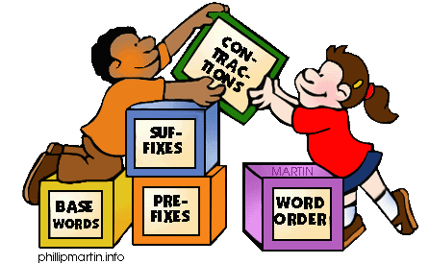
Grammar
Today you will be focussing on:
Describing Words (Adjectives)
Watch this link and enjoy the song and dance:
Adjectives

Slide 7
Grammar
Please complete pages 12 and 13 in your Nelson Grammar workbook.

Slide 8
Maths answers from yesterday:
Pages 32-34
1p- 2p- 10p, 50p, £1.00, £2.00
20p, 10p, £1.00
20p + 20p = 40p, 20p + 10p + 5p = 35p, 50p + 50p + £1.00= £2.00
5p
Any answer with circles around the 50p and a 10p and squares around two 20p’s and two 10p’s.
60p
Apple, banana
30p
17p
50p – 34p = 16p
20p
Challenge
£3 and 50p – £2 and 20p = £1 and 30p.
Lesley spent £1 and 30p more than her brother.

Slide 9
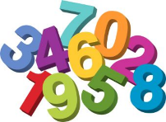
Maths
Today we are going to look at days and months.

Slide 10
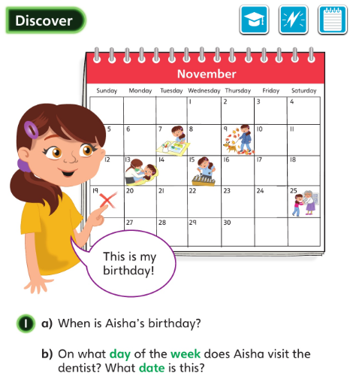
Let’s look at the answers and how you could have worked them out on the next page…

Slide 11
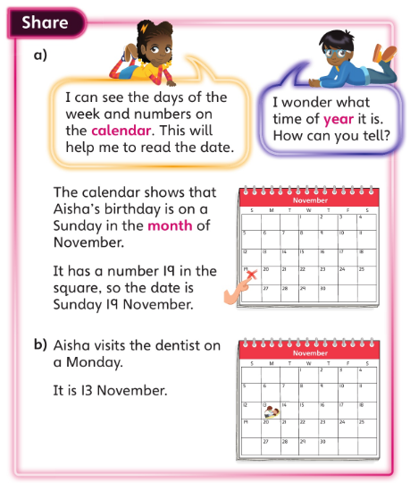
• Where would you look on a calendar to find out what month is shown?
• Once you have found the date that you are looking for, how do you find out what day of the week it is?

Slide 12
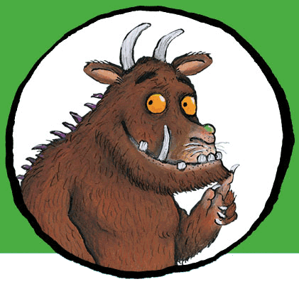
Now I would like you to have a go at completing work in your CGP Maths Reasoning workbook.
If you would like to try Gruffalo work, complete page 35.
If you would like to try Horrid Henry work, complete pages 35 and 36
If you would like to try James and the Giant Peach work, complete pages 35, 36 and my ‘Deepen Activity’ question on the next slide.

Slide 13
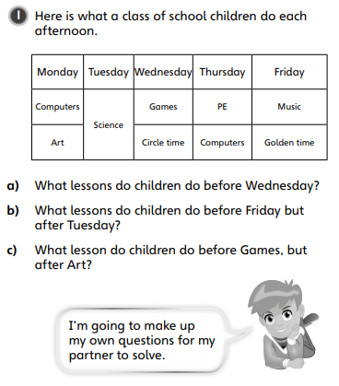

Slide 14
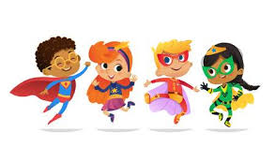
English
Today you are going to write your third subheading.
Think about these things when you are writing:
How did they become a superhero?
How did they become a superhero? How old were they when they discovered their powers? How did they get their powers? Do they have any enemies? Do they have any other superhero friends?
Look on the next slide for an example of what your third subheading may look like …

Slide 15
How did they become a superhero?
When she was seven years old, the Super Tutor was forced to stay indoors by a nightmare superpower that roamed the lands, called Coronamare. She didn’t let Coronamare stop her from learning. The Super Tutor worked night and day to learn as much as possible until her brain became full to the brim with facts and knowledge. There was no question she could not answer. From that day onwards, she could fly to help others with their learning. With the help of her friends, the Super Learners, the Flying Doctors, the Never-ending Shelf stackers and Patient Parents all the children could learn and the evil superpower Coronamare was defeated.

Slide 16
I would like you to log on to Busy Things: https://www.busythings.co.uk/ Click on this icon: Username: home16000 Password: CHILD Then: Key stage 1, Year 2, Computing, Busy Code Code Disco
Computing

Slide 17
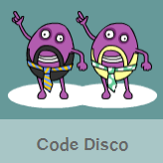
Have a go at the tutorial:

Slide 18
Have fun, Unicorns!

