Slide 1
Day Four

Slide 4
Lesson 19 – WALT: Problem solve using addition and subtraction.
Which model would you use?
Would a bar model represent the problem well?

Slide 5
What does ‘part’ mean?
What does ‘whole’ mean?

Slide 6
How do you know that this is an addition problem?
What does the bar model need to show?

Slide 7
Practice Questions

Slide 10
Food Chains
What is a food chain?
Now watch the following video clip and see if we can add to or refine our ideas.

Slide 11
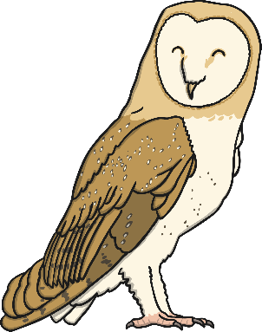
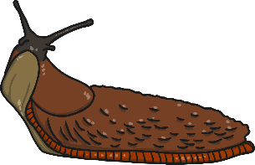
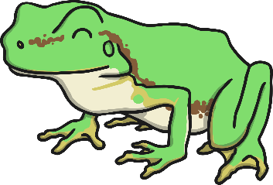
Interpreting Food Chains
How is this food chain constructed?
What do the arrows represent?
How should we label the different parts of the food chain?

Slide 12
Labelling Food Chains 1
Producer/Autotroph
Consumer
Consumer
Consumer
Primary Consumer
Secondary Consumer
Tertiary Consumer
Prey
Predator/Prey
Predator
Detritivore
Omnivore
Carnivore

Slide 13
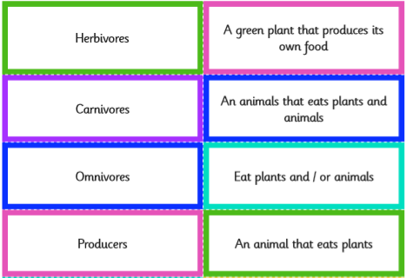
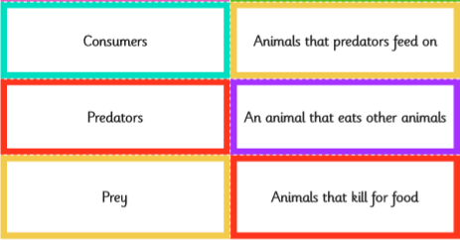
Get familiar with the vocabulary
Match up the word with the meaning.
These words would be found in a glossary if they appeared in a book on food chains.

Slide 14
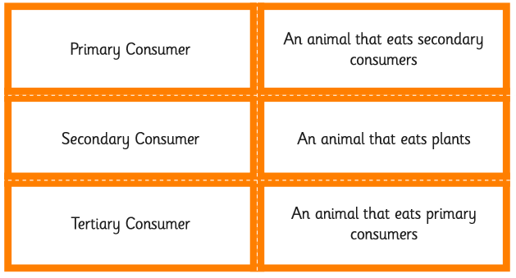
Get familiar with the vocabulary
These words may be unfamiliar, but have a go, you can do it!

Slide 15
Interpreting Food Chains
Write out the words with their meanings. Extra Challenge: Three new words on this list, can you write a meaning for each one?
Words | Meanings
Herbivores | An animal that eats plants.
Carnivores | An animal that eats other animals.
Omnivores | An animal that eats plants and animals.
Detritivores | An animal that eats decomposing plants and animals.
Producers/Autotrophs | Plants that produced their own food.
Consumers | Animals that eat plant or other animals.
Primary Consumer | An animal that eats plants.
Secondary Consumer | An animal that eats the primary consumer.
Tertiary Consumer | An animal that eats the secondary consumer.
Prey | An animal that is hunted for food.
Scavenger | An animal that eats dead animals.
Predators | An animal that kills for food.
Decomposer | An organism or bacteria that breaks down dead plants and animals into liquid for food.

Slide 16
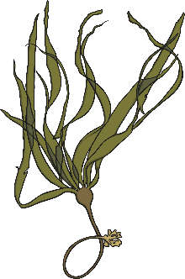
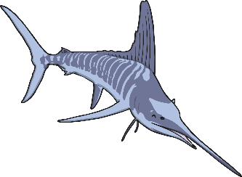
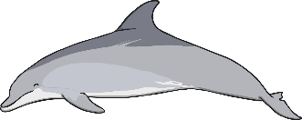
Labelling Food Chains 2
Here is a more complex example:
Producer/
Atrotroph
Consumer
Consumer
Consumer
Consumer
Primary Consumer
Secondary Consumer
Tertiary Consumer
Quaternary Consumer
Prey
Predator/Prey
Predator/Prey
Predator/
Scavenger
Herbivore
Carnivore
Carnivore
Carnivore

Slide 17
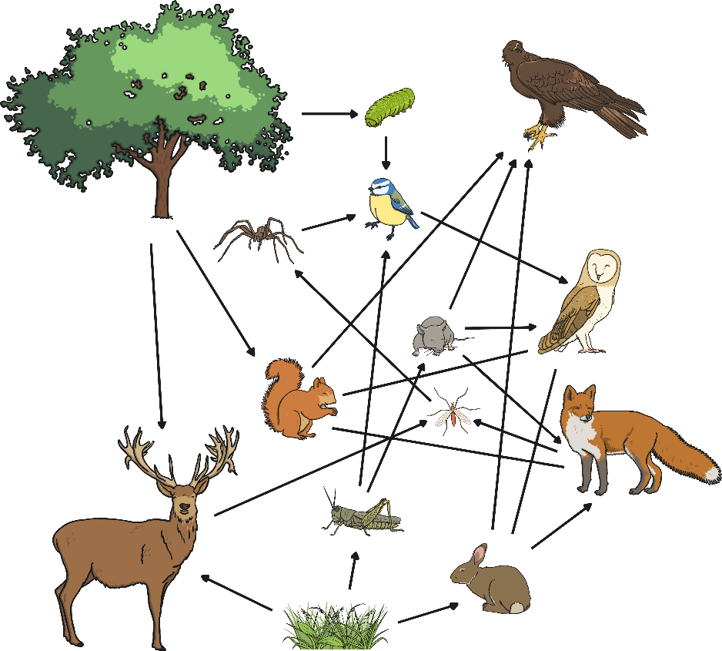
Interpreting Food Webs
How are food webs similar/different to food chains?
When would it be better to use a food chain?
When would a food web be better?

Slide 18
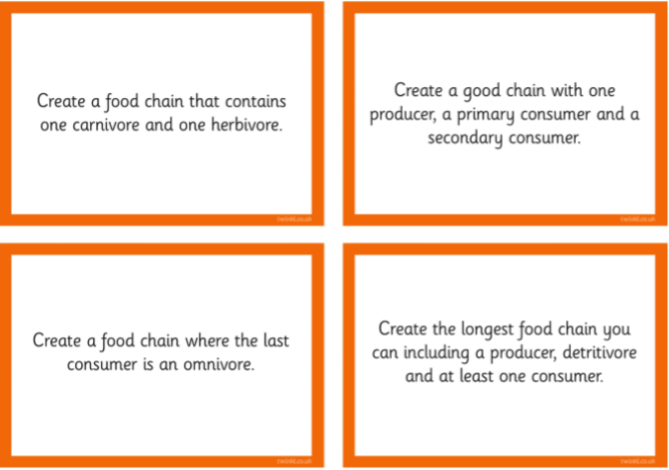
Research and draw some food chains in your books. Remember to label the chain with the correct vocabulary. Try to do as many as you can and if you get stuck look at the Food Chain Animal suggestions to help you. Good Luck!

Slide 19
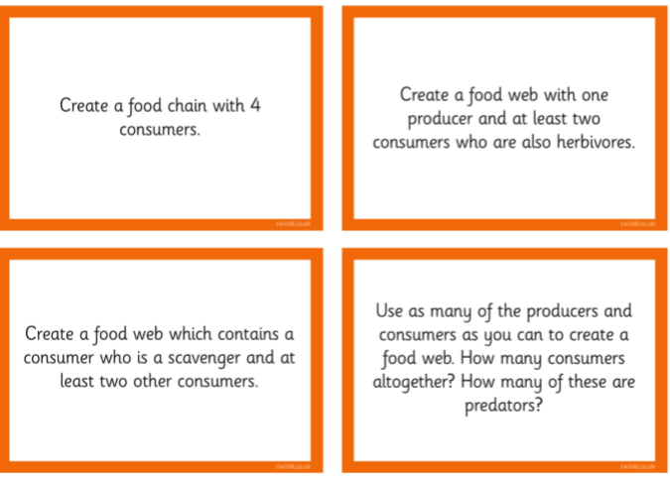
An extra challenge if you want it! These are more tricky, but go for it!

Slide 20
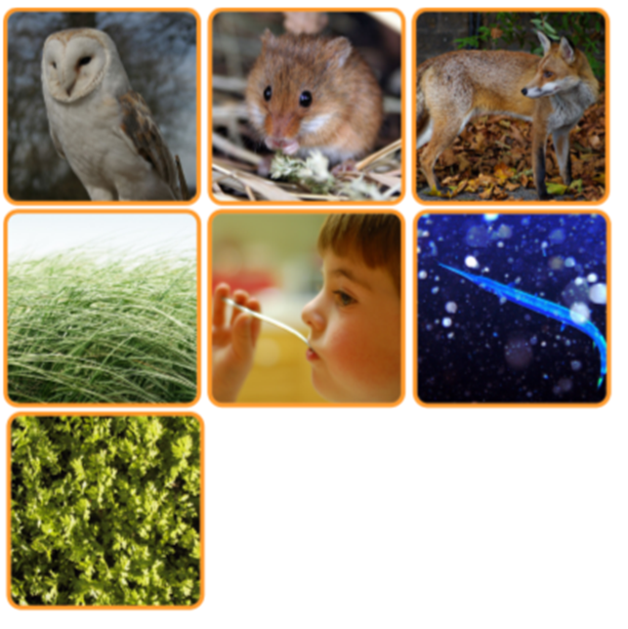
Food Chains Sorting Cards If you need some help to get started

Slide 21
