Slide 1
Welcome to the writing tasks for week 3
Over the next two weeks, you will have a virtual teacher, Jo, who will guide you through the activities.
The focus is on a story called, ‘The King of Fishes’, which is a wishing tale.
Read the instructions carefully to help you complete the tasks.

Slide 2
Day Two

Slide 7
Notes for Maths
Discovery – Children to work independently.
Share – This page shows you different ways the discovery question could have been answered.
Think Together – Complete and then discuss with an adult to consolidate and deepen understanding.
Practice – children practice the skills they have learnt. Please complete 2 of the 3 slides of practice. (Pick the 2 pages you think will challenge you the most!)

Slide 8
Lesson 12 – WALT: Add 2 4-digit numbers.
What method could you use to solve 1a?
How can you show you are correct?

Slide 9
What do we call this method of addition?
Why do we not start with the thousands column when adding?

Slide 10
How can you check your answer? Have you double-checked?

Slide 11
What could you use to work out the missing numbers?

Slide 12
Practice Questions

Slide 15
Guided Reading/Topic: Read the text and the answer the questions and complete the activities.
Use the glossary link if you are unsure of the vocabulary. Words listed in the glossary appear in a different colour to the rest of the text, such as afterlife above.

Slide 18
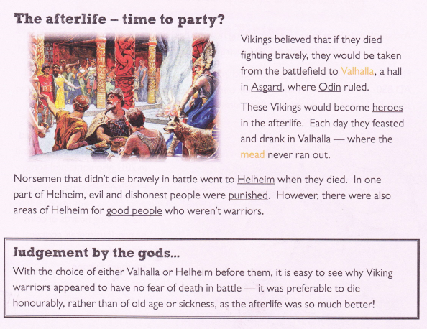
Now use this information to answer the questions and complete the questions. Remember to use the glossary if you need to.

Slide 19
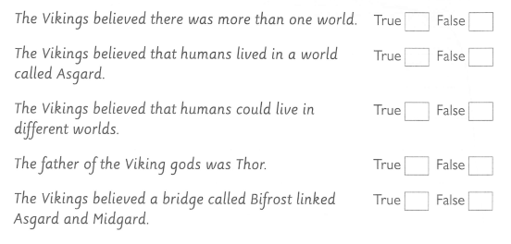

Slide 20
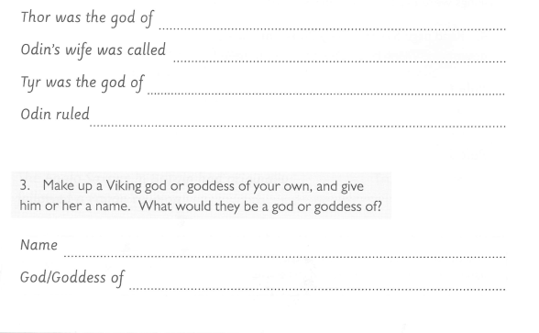

Slide 21
