Slide 1
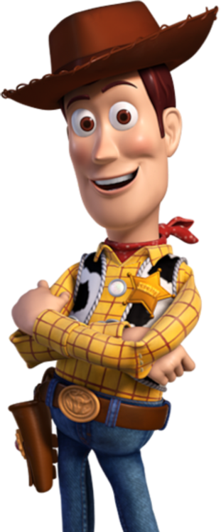
Good morning Elves !
Here’s your work for today…

Slide 2
Reading online
Please log on to Bug Club and read for at least
15 minutes.
Make sure you answer your bug questions!
Read the key words inside the front cover first.
Click on the bug questions.
Elves, make sure you note down the book and/ or pages
you have read in your reading record book so I can
read all about your amazing reading when I see you
next.

Slide 3
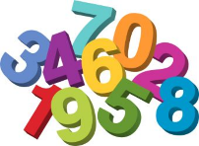
Maths
Today we are going to practise
our measuring skills.

Slide 4
Green group
Maths

Slide 5
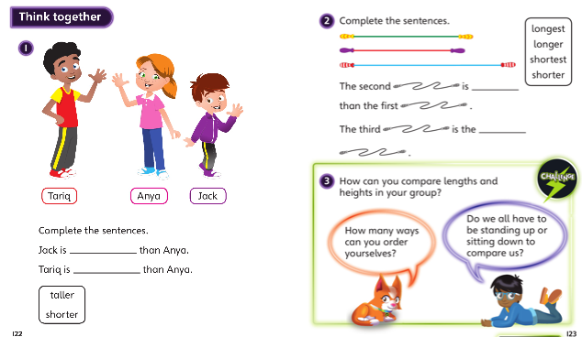
Green group
Maths

Slide 6
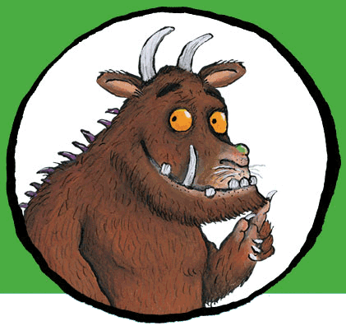
Now I would like you to have a go at completing work in your CGP Maths workbook.
If you would like to try Gruffalo work, complete page 24 and 25
If you would like to try Horrid Henry work, complete pages 24, 25 and 26
If you would like to try James and the Giant Peach work, complete pages
24,25, 26 and 27

Slide 7
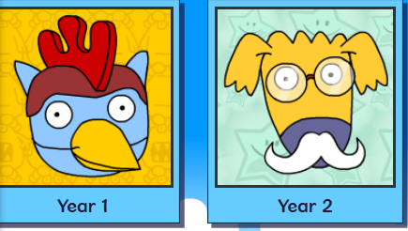
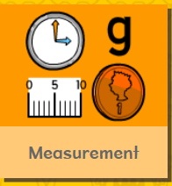
Green group
Maths
Logon on to Busy Things. Play one or all the games, practising your measuring skills

Slide 8
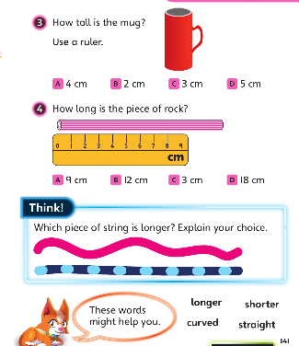
If you’ve completed the CGP Maths booklet and have time for the Maths Challenge below. Have a go at the following questions. Write the answers in your blue book.

Slide 9
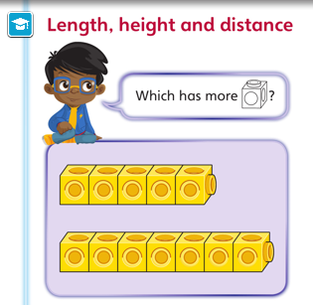
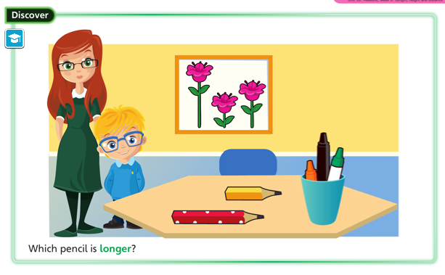
Yellow group
Maths

Slide 10
Yellow group
Maths

Slide 11
Yellow group
Maths

Slide 12
Now I would like you to have a go at completing work in your CGP Maths workbook.
If you would like to try Horrid Henry work, complete pages 22
If you would like to try James and the Giant Peach work, complete pages 22 and 23

Slide 13
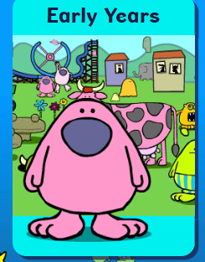
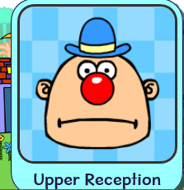
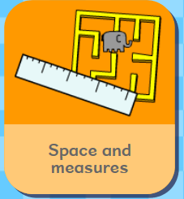
Logon on to Busy Things. Play one or all the games, practising your measuring skills

Slide 14
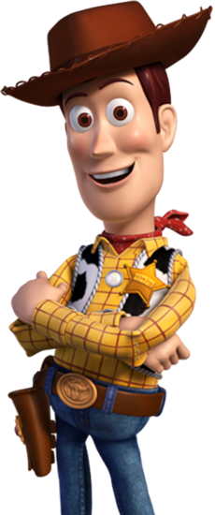
Handwriting
Please complete pages 10 and 11 in
your CGP Handwriting Book
.

Slide 15
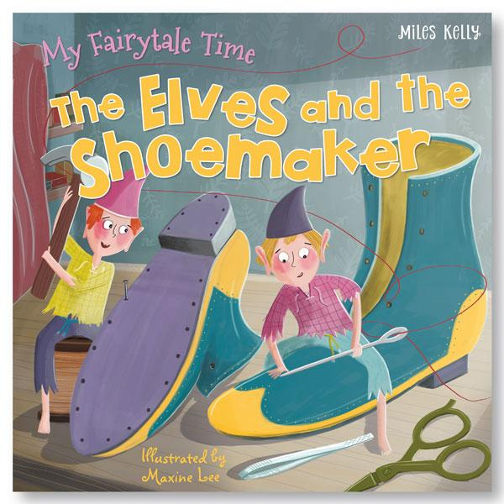
English
Click on the link and listen the story of the Elves and the
Shoemaker. https://www.youtube.com/watch?v=huPNTanetW4
Imagine you are the Shoemaker. Write a letter to
the Elves for working so hard and making the shoes.

Slide 16
Phonics
Green group
Phonics
Take a look at page 10 ,11, 12 and 13 in your Phonics booklet and
complete the pages.
I hear you’re a great designer. Can you
design and make a tie which says something
about yourself.

Slide 17
Phonics
Yellow group
Phonics
-How about working through pages 24
and 25 in your Phonics booklet 1.
-Go on a sound hunt around
your home. How many items can
you find with the t sound.

Slide 18
Active Learning
Have a tea party with your favourite teddy.
Bake your favourite cookie or cake with an adult or decorate a biscuit with icing.
An idea for a biscuit is on the next page.

Slide 19
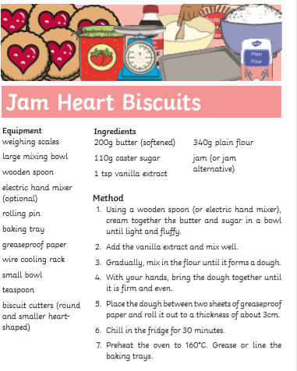

Slide 20
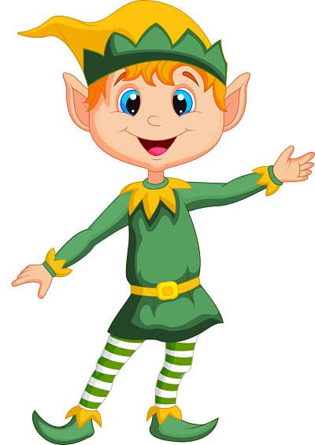
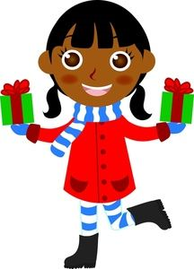
You’ve been Brilliant this week Elves.

