Slide 1
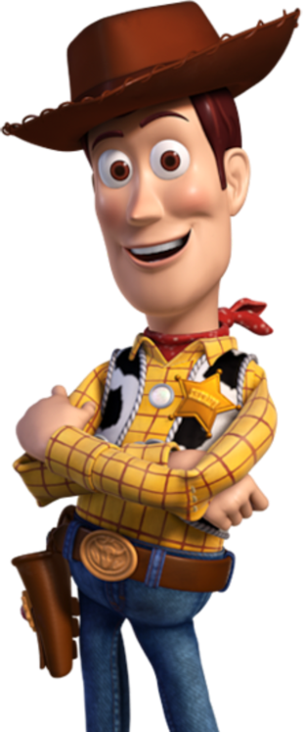
Good morning Elves !
Here’s your work for today…

Slide 2
Reading online
Please log on to Bug Club and read for at least
15 minutes.
Read the key words inside the front cover first.
Click on the bug questions.
Elves, make sure you note down the book and/ or pages
you have read in your reading record book so I can
read all about your amazing reading when I see you
next.

Slide 3
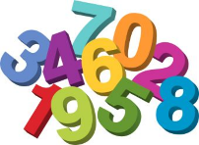
Maths
Today we are going to recap on our knowledge of adding.

Slide 4
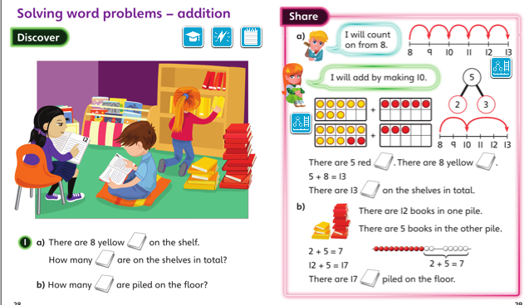
Green group
Maths

Slide 5
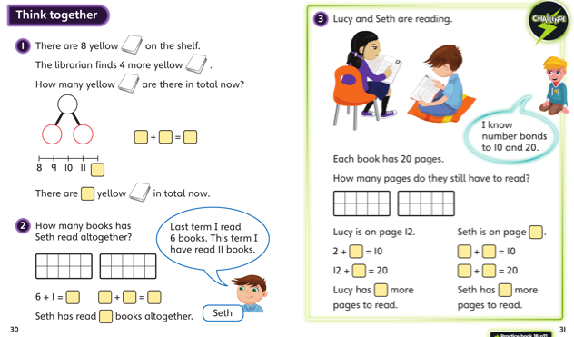
Green group
Maths

Slide 6
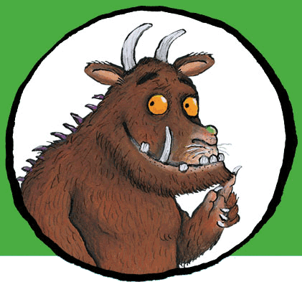
Now I would like you to have a go at completing work in your CGP Maths workbook.
If you would like to try Gruffalo work, complete page 9
If you would like to try Horrid Henry work, complete pages 9 and 10
If you would like to try James and the Giant Peach work, complete pages 9, 10 and 11

Slide 7
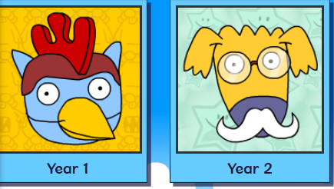
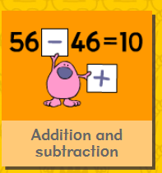
Logon on to Busy Things. Can you challenge yourself today? Play one or all the games to practise your addition skills.
.

Slide 8
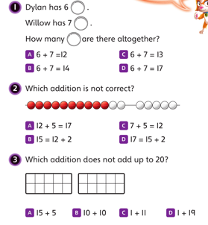
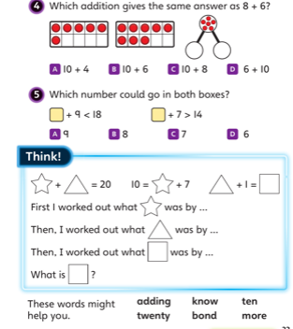
If you’ve completed you Maths book and have time for the Maths Challenge below. Have a go at the following questions.
Write the answers in your blue book.
Green group
Maths

Slide 9
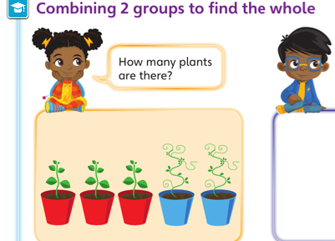
Yellow group
Maths

Slide 10
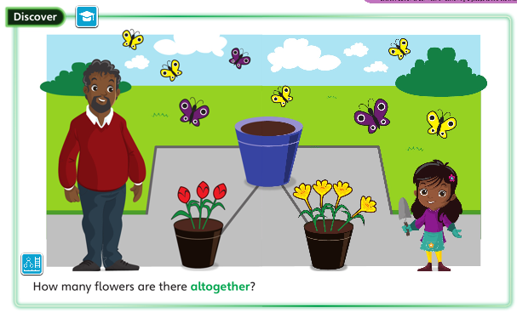
Yellow group
Maths

Slide 11
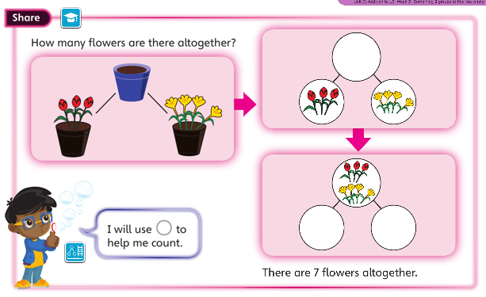
Yellow group
Maths

Slide 12
Yellow group
Maths

Slide 13
Now I would like you to have a go at completing work in your CGP Maths workbook.
If you would like to try Gruffalo work, complete page 9 and 10
If you would like to try Horrid Henry work, complete pages 9, 10 and 11
If you would like to try James and the Giant Peach work, complete pages 9,10,11 and 12

Slide 14
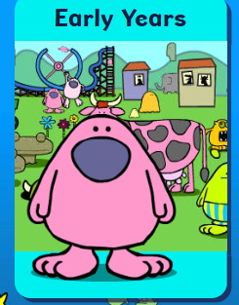
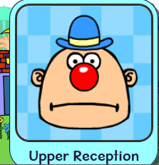
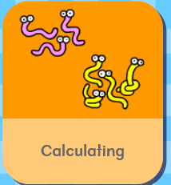
Logon on to Busy Things. Can you challenge yourself today?
Play one or all the games to practise your
calculating skills.

Slide 15
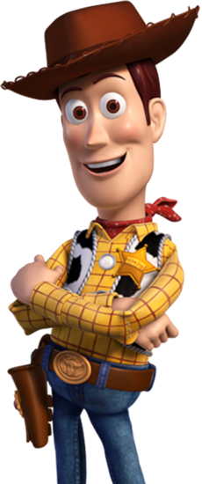
Handwriting
Please complete pages 6 and 7 in
your CGP Handwriting Book
.

Slide 16
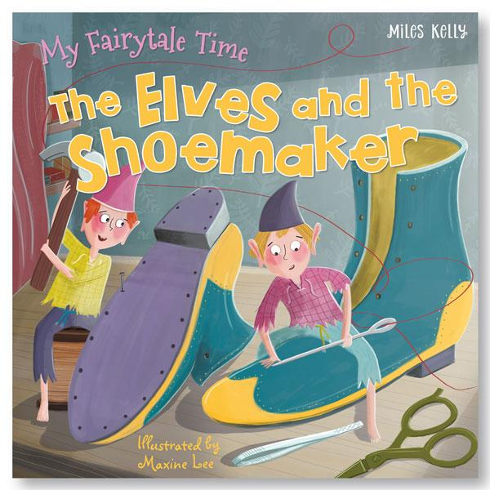
English
Click on the link and listen the story of the Elves and the
Shoemaker. https://www.youtube.com/watch?v=huPNTanetW4
As you’ve listened to the Elves and the Shoemaker a few times
now. Have a go at retelling the story to a member of your
Family.
Can you draw a story map to help retell the story?

Slide 17
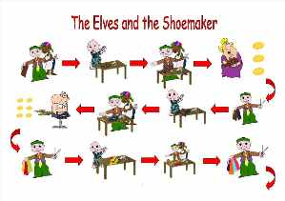
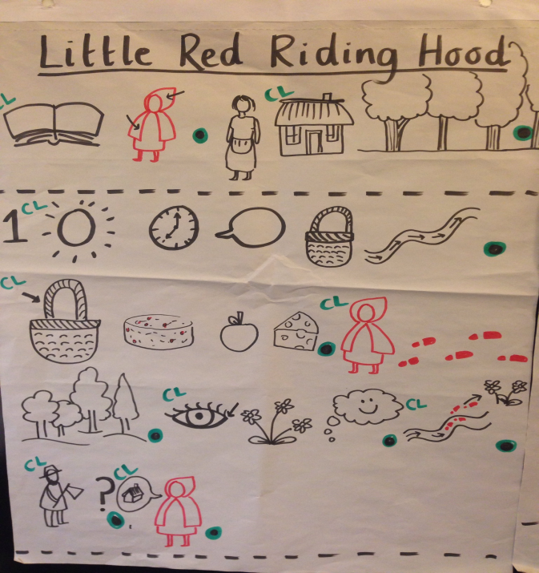
English

Slide 18
Phonics
Green group
Phonics
Take a look at page 6 and 7 in your Phonics booklet and
complete the pages.
Have a go at thinking and writing some
Nonsense with the ‘oy’ sound in your blue
Book. I’ve got a few to get you started….
soy broy croyer. What can you come
up with?

Slide 19
Phonics
Yellow group
Phonics
How about working through pages 6
and 7 in your Phonics booklet 1.
Can you make up your own sound
pattern with a member of your family?

Slide 20
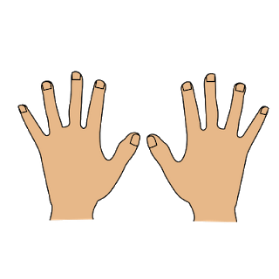
Active Learning
Can you make a tower using
a material you have at home
i.e. lego, newspapers, cardboard.
How tall can you make it?
Have a go at measuring it with
an adult. Measure using hands, shoe or a book maybe.

Slide 21
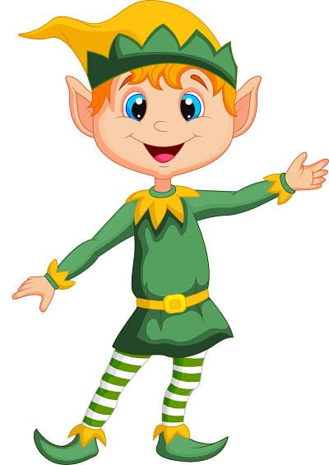
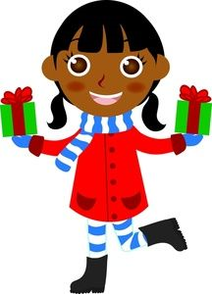
Have fun, Elves!
I will speak to you tomorrow.

