Slide 1
Day 3 - Writing

Slide 2
Day 3: WALT: recognise and use personification
Jimmy visits the setting in slide 6. He looks around and realises this place makes him feel happy and cheerful.
This time he is going to use personification (where objects are given a human quality) to help create his atmosphere.
See if you can do the same as Jimmy by following this format:
Write a list of nouns in the picture (clouds, flowers, mountains, scenery etc)
Write a list of adjectives to go with the nouns, e.g. colourful flowers, wispy clouds, majestic mountains.
Now think of some verbs that the nouns can do which will create the personification, e.g. the colourful flowers laughed in the golden sunshine, the wispy clouds danced through the blue sky.
Remember, the focus is to create a cheerful and happy atmosphere.

Slide 3
Notes for Maths
Discovery – Children to work independently.
Share – This page shows you different ways the discovery question could have been answered.
Think Together – Complete and then discuss with an adult to consolidate and deepen understanding.
Practice – children practice the skills they have learnt. Please complete 2 of the 3 slides of practice. (Pick the 2 pages you think will challenge you the most!)

Slide 4
Lesson 8 – WALT: Use a number line to 10,000 continued.
Can you see how this image is a number line? What does it measure?
What is the scale on the number line? What unit is it measured in?
How did you work out where to put 1,950m on the number line? What numbers does it lie between?

Slide 5
Can you remember the scale used on this number line? What units is it measuring?
What is the halfway point between 1,000 and 1,100? Has Sofia run more than this?
Can you find the 1,900 mark on the number line? How far between 1,900 and 2,000 is 1,950?

Slide 6
What does the dial go up in? How do you know? How can you work it out?
Look at the scales on the number lines. What is the same about them?

Slide 7
Practice Questions

Slide 10
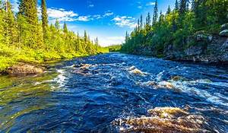
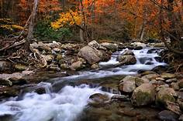
The River by Valerie Bloom
The River's a wanderer.
A nomad, a tramp,
He doesn't choose one place
To set up his camp.
The River's a winder,
Through valley and hill
He twists and he turns,
He just cannot be still.
The River's a hoarder,
And he buries down deep
Those little treasures
That he wants to keep.

Slide 11
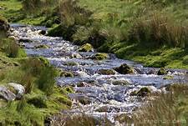
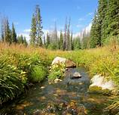
The River by Valerie Bloom
The River's a baby,
He gurgles and hums,
And sounds like he's happily
Sucking his thumbs.
The River's a singer,
As he dances along,
The countryside echoes
The notes of his song.
The River's a monster
Hungry and vexed,
He's gobbled up trees
And he'll swallow you next.

Slide 12
Reading Day 3 WALT: learn and perform a poem
Learn ‘The River’ poem off by heart.
Spend some time practising its words, rhythm and thinking about the expression you could use.
Perform to a member of your household. Ask for feedback which should consist of 2 ‘what went wells’ and an ‘even better if’.
Revise and perform again. Have fun!

Slide 13
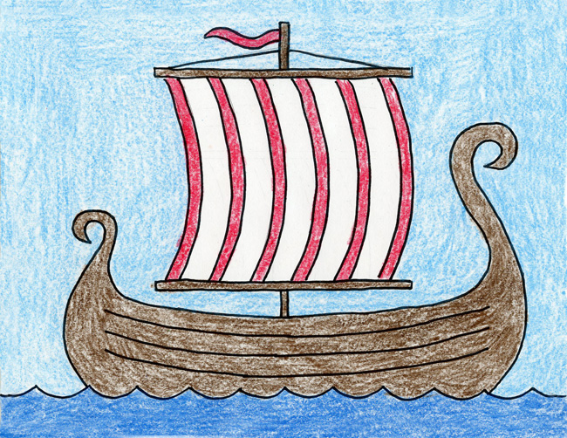
How to draw a Viking Longship
https://artprojectsforkids.org/how-to-draw-a-viking-ship/

Slide 14
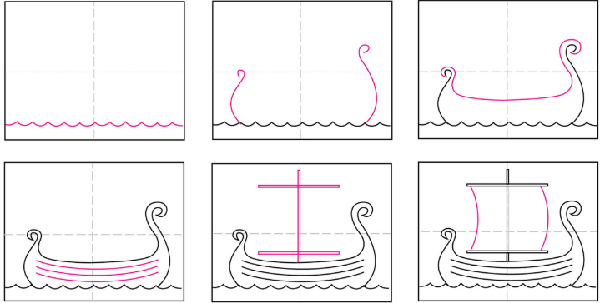

Slide 15
See the next slide if you want to draw Vikings rowing, remember the Vikings did not really wear helmets with horns so up to you if you want to add!

Slide 16
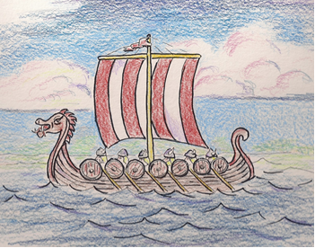
https://drawinglessonsfortheyoungartist.blogspot.com/2011/11/how-to-draw-viking-ship-lesson-for.html

Slide 17
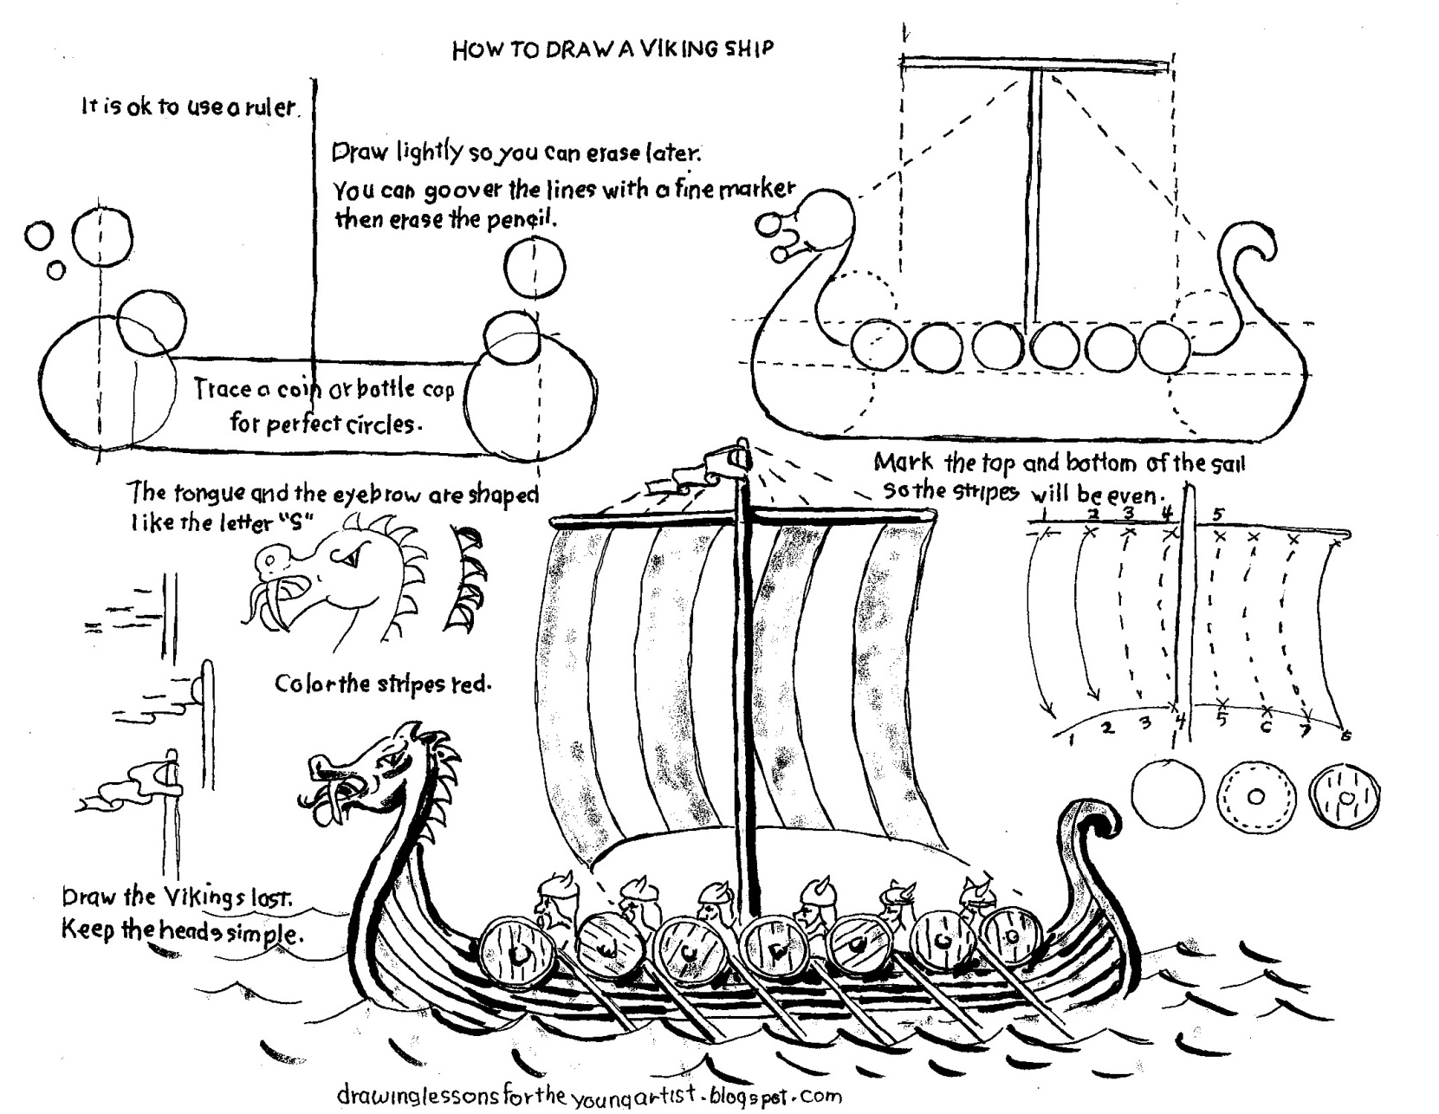
If you want more detail use this worksheet.
Good luck and stay well.

