Slide 1
Day 3: WALT – recognise adjectives within sentences

Slide 2
Use the description you thought of yesterday to write some sentences for this setting, e.g. The candy floss clouds loomed over the tiny island. Underline the adjectives in your sentences. The clear turquoise water lapped gently onto the golden sand. Make sure you don’t over do them but use them effectively.

Slide 3
Notes for Maths
Discovery – Children to work independently.
Share – This page shows you different ways the discovery question could have been answered.
Think Together – Complete and then discuss with an adult to consolidate and deepen understanding.
Practice – children practice the skills they have learnt. Please complete 2 of the 3 slides of practice. (Pick the 2 pages you think will challenge you the most!)

Slide 4
Lesson 3 – WALT: Round to the Nearest 100.
What is Danny’s number? What 100s are either side of this number?
Which 100 is Danny’s number nearer to?
How far away is Alex’s number from the 100s either side of it?

Slide 5
Which 100s does 578 lie between?
Which hundred is 568 closest to? How does subtracting 568 from 600 help you?
How could you round 856 to the nearest 100 without drawing a number line?

Slide 6
What other numbers could you make with the dice?
How do you know which 100 the number is closest to?
Where will you place the number on the number line? How will this help you?

Slide 7
Practice Questions

Slide 10
Reading
This week we will be reading through the text, ‘Here be Dragons’ by Pie Corbett which is an instructional text.
There will be various activities to complete from it during the week.

Slide 11
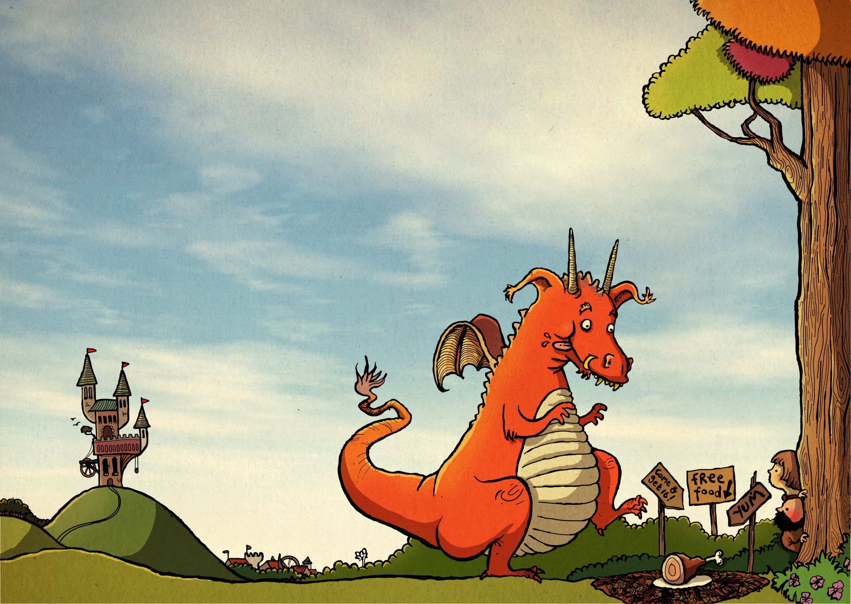
Day 3 – WALT: retrieve information from a text
Answer the following questions below.:
State 3 things you will need for looking after a pet dragon.
What happens if your dragon has flown into a distant valley
and you blow a whistle?
3) What food do dragons eat?
4) Why do you need to keep your dragon outdoors when it grows larger?
5) Why should you hide anything that glitters from a dragon?

Slide 12
Digestive System
Humans digest food. They have a digestive system that allows them to do this.
What do you think digest/digestive system mean?
https://www.bbc.co.uk/bitesize/topics/z27kng8/articles/z9wk7p3
Digest
Break down food so it can be used by the body.
Digestive System
System of organs that get food in and out of the body and which make use of the food to keep the body healthy.
Click here for a definition of digest
Click here for a definition of digestive system

Slide 13
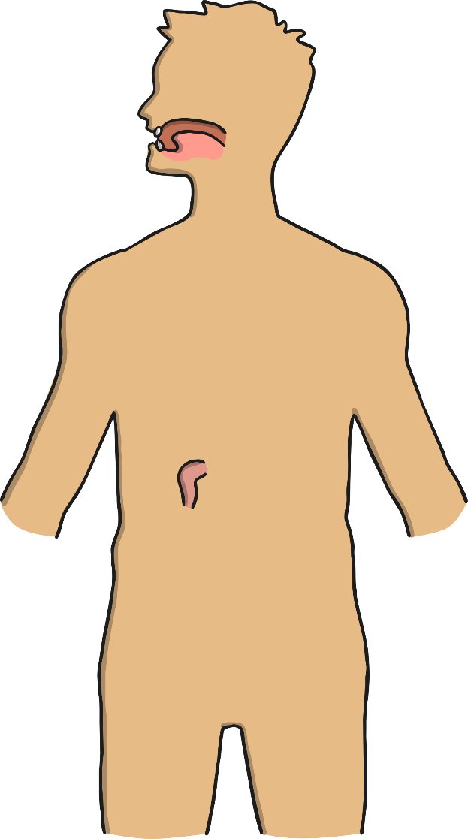
What do you already know? Digestive System Parts
Think about which parts you know of the digestive system. Where would the parts be in the body? Think about the following to help you:
How do humans digest food?
How does food travel through the body?
What parts of the body are involved?
https://www.bbc.co.uk/bitesize/topics/z27kng8/articles/z9wk7p3
(Hint: it’s not just the ones on the outside that you can see!)

Slide 14
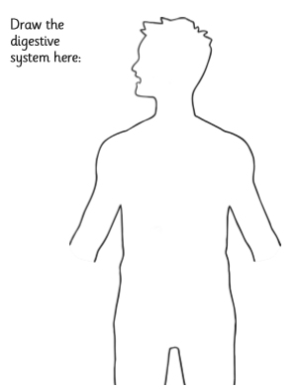

Slide 15
Naming Parts of the Digestive System
Can you research and label the names of all the parts of the digestive system? Print or draw out the next slide.

Slide 16
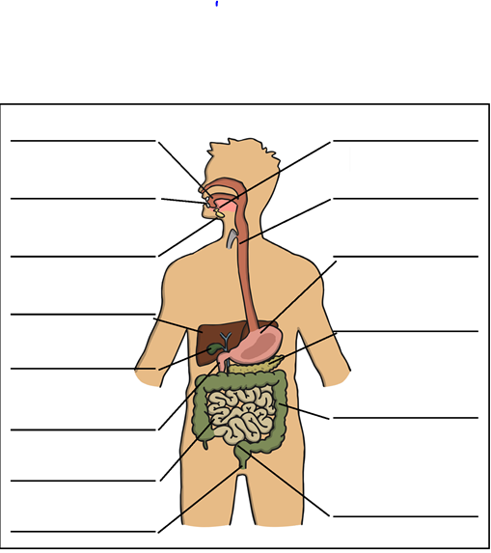
Key words:
Mouth
Tongue
Teeth
Salivary glands
Oesophagus
Stomach
Duodenum
Small intestine Large intestine
Gallbladder
Pancreas
Liver
Rectum
Anus.

Slide 17
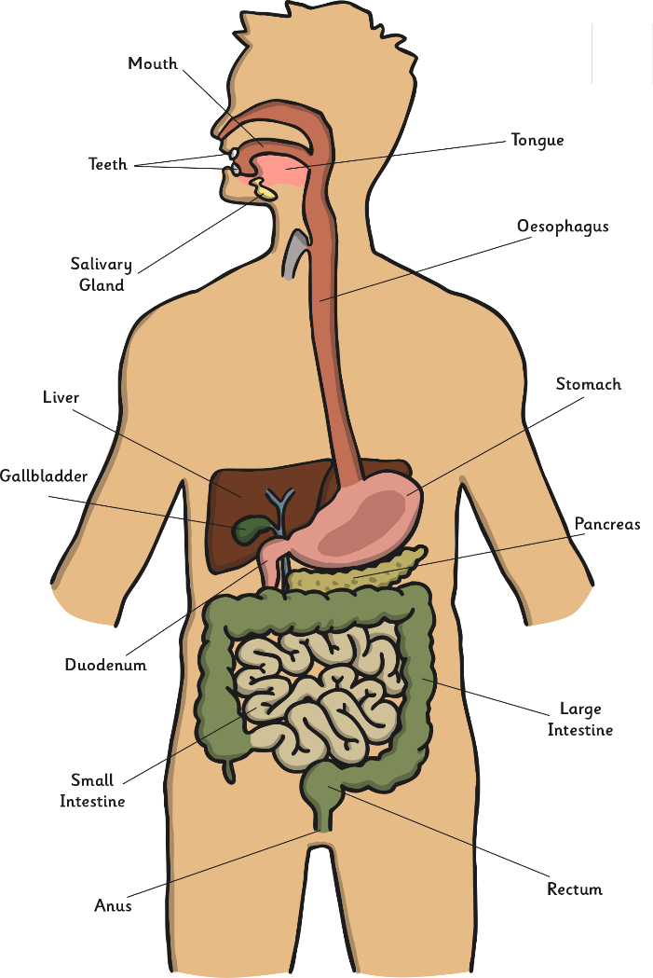
Digestive System Parts
Tick any body parts that were correct and correct any that were incorrect.
Were there any obvious body parts you missed out?
Were there any body parts that you were surprised by?

