Slide 1
Good morning Unicorns!
Here’s your work for today: Friday 3rd April

Slide 2
Reading answers from yesterday:
Pages 17-18
Evening
Caravans
A tent
Sawdust
Page 19
Glaring
Sparkle
Page 20
Because it is dangerous
So that they don’t fall

Slide 3
Reading online
Please log on to Bug Club and read for at least 15 minutes.
Make sure you answer your bug questions!

Slide 4
Maths answers from yesterday:
Page 24
Chair
Any answer where a longer fish has been drawn
full- empty
quick- slow
short-tall
A quarter full = 1 part shaded
Half full = 2 parts shaded
Full = 4 parts shaded

Slide 5
Maths answers from yesterday:
Page 25
Joe arrives earlier than Lucy.
Mike arrives later than Lucy.
Quicker than a race car = aeroplane
Slower than a race car = bicycle
7. The top train, the second bookcase
Deepen Activity
A, D, B, C

Slide 6
Maths
Today we are going to look at units of measurement.

Slide 7
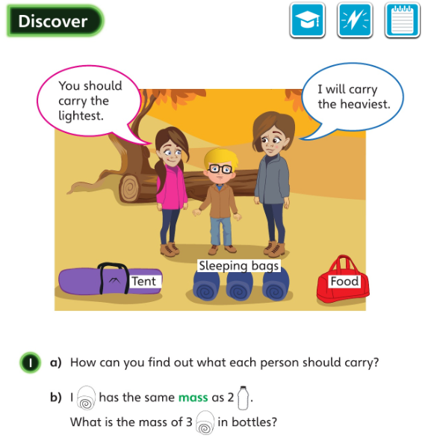
Let’s look at the answers and how you could have worked them out on the next page…

Slide 8
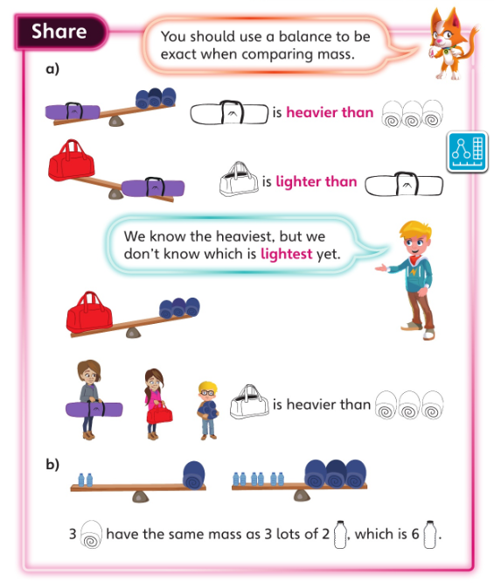
How did you work out how many bottles have the same mass as 3 sleeping bags?
What information did you use to help you?

Slide 9
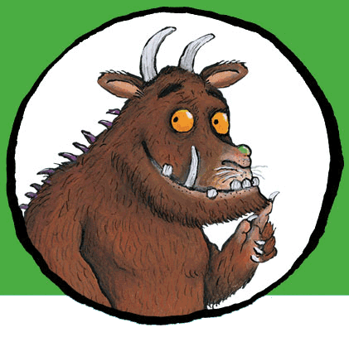
Now I would like you to have a go at completing work in your CGP Maths Reasoning workbook.
If you would like to try Gruffalo work, complete page 26
If you would like to try Horrid Henry work, complete pages 26 and 27
If you would like to try James and the Giant Peach work, complete pages 17, 18 and 19 and my Challenge question on the next slide.

Slide 10
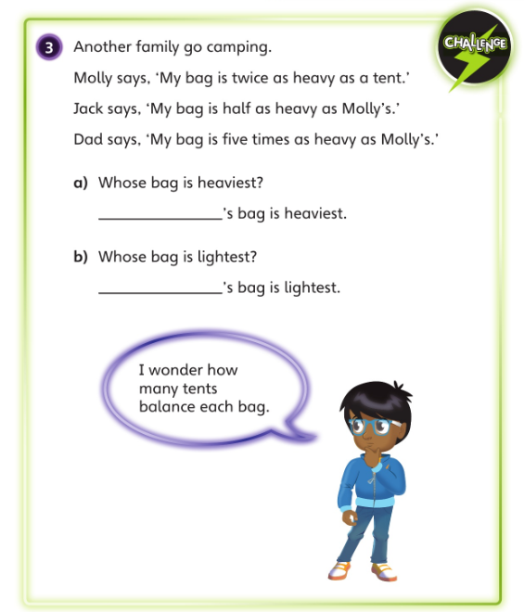

Slide 11
Handwriting
Please complete pages 12 and 13 in your CGP Handwriting Book

Slide 12
English
Today you are going to write instructions on how to be the naughtiest pet.
You could use ideas from our work on ‘The Diary of a Killer Cat’ that we carried out in class a few weeks ago – Imagine Tuffy has had a kitten and he wants to teach her all his tricks so she can become as naughty as he is!

Slide 13
These are what you will need to include:
A title and introduction.
A ‘you will need’ list. Remember to include quantities (how much).
Numbered instructions.
Imperative verbs.
Adverbs telling you how to do things.

Slide 14
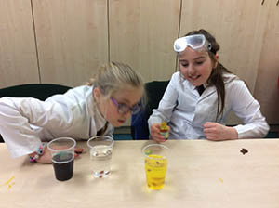
‘Find Out Friday’ Science!
Today I would like you to carry out another practical activity that our Young Science Ambassadors carried out last year.

Slide 15
Dancing Sultanas
This is an activity to explore the effects of carbon dioxide and make sultanas dance!
First, add sultanas to both a glass of tap water and a glass of fizzy water. ( You could put a few drops of food colouring in one glass if you have any so that you can see the difference between the two glasses)
Next, watch the sultanas in the glass of tap water …they will sink to the bottom.
After that, compare the sultanas in the fizzy water… they should keep floating to the surface and then sinking to the bottom- just like they are dancing!
Don’t forget to wash your hands.

Slide 16
What’s the Science behind it? Fizzy water contains a large amount of dissolved carbon dioxide. The carbon dioxide bubbles are less dense than the fizzy water, so they rise to the surface. The sultanas initially sink to the bottom as they are heavier than water, but as the bubbles start to rise to the surface, they attach themselves to the sultanas, causing them to rise too. Once the sultanas reach the surface, the bubbles supporting them pop, causing them to sink again. But they rise again as new bubbles lift them up.
Have a look at this link to see what the Young Science Ambassadors did:
Young Science Ambassadors

Slide 17
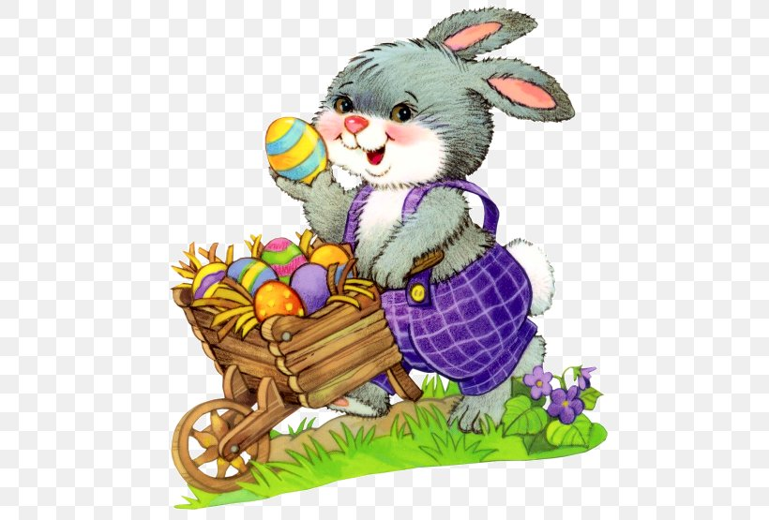
I hope that you all have a lovely Easter break.
There will be no online work for the next two weeks.
Take good care of yourselves and your families.
Happy Easter,
love from Mrs Matthews
xxx

