Slide 1
Good morning Unicorns!
Here’s your work for today: Friday 27th March

Slide 2
Reading answers from yesterday:
Pages 6-7
Cara’s sister
Blue
Shut her eyes
At the top of the wheel
Their house
Disappointed
Page 8
Walked
Moved suddenly
Gigantic
Tom’s sister

Slide 3
Reading answers from yesterday:
Page 9
She was scared of going on the ride
Happy
The people on the ground looked very small.
Page 10
2, 1, 3, 5, 4
1a) Yes
1b) Cara was disappointed when the ride was over

Slide 4
Reading online
Please log on to Bug Club and read for at least 15 minutes.
Make sure you answer your bug questions!

Slide 5
Maths answers from yesterday:
Page 15
13 biscuits
31 sandcastles
76 puddings
Page 16
23 + 3
76 – 60 = 16; 76 – 16 = 60
27 + 66; 93 - 27
Deepen Activity
1 + 5 + 9 = 15 1 + 6 + 8 = 15 2 + 4 + 9 = 15 2 + 5 + 8 = 15 2 + 6 + 7 = 15 3 + 4 + 8 = 15 3 + 5 + 7 = 15 4 + 5 + 6 = 15
b) 9 + 8 – 2 = 15; 9 + 7 – 1 = 15

Slide 6
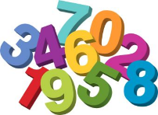
Maths
Today we are going to look at multiplication and division.

Slide 7
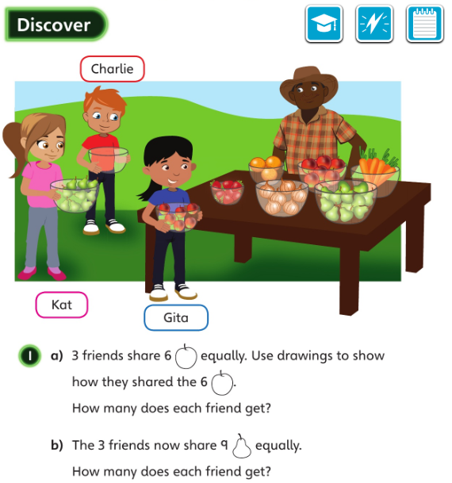
• What does ‘share equally’ mean?
• Does every child have to have the same number at the end?

Slide 8
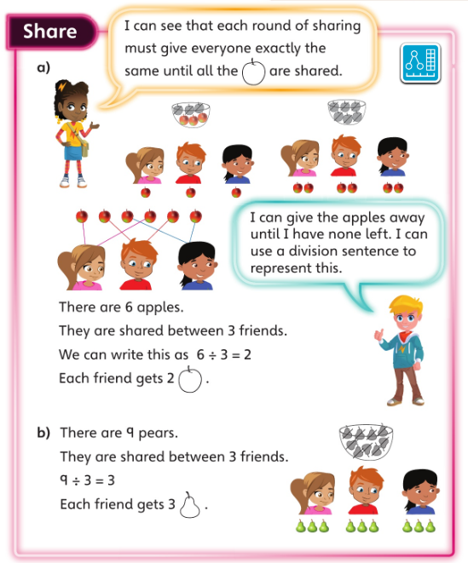
Let’s look at the answers and how you could have worked them out …

Slide 9
What could you use to represent what you are sharing in your drawings and workings out?

Slide 10
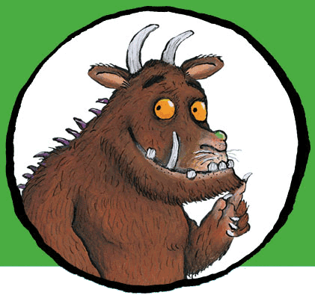
Now I would like you to have a go at completing work in your CGP Maths Reasoning workbook.
If you would like to try Gruffalo work, complete page 17 and 18
If you would like to try Horrid Henry work, complete pages 17, 18 and 19
If you would like to try James and the Giant Peach work, complete pages 17, 18 and 19 and my ‘Deepen Activity’ question on the next slide.

Slide 11
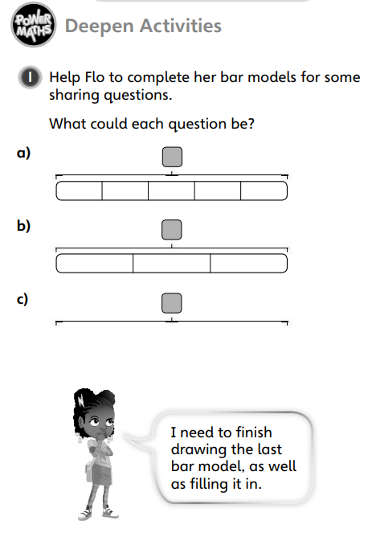

Slide 12
Handwriting
Please complete pages 6 and 7 in your CGP Handwriting Book

Slide 13
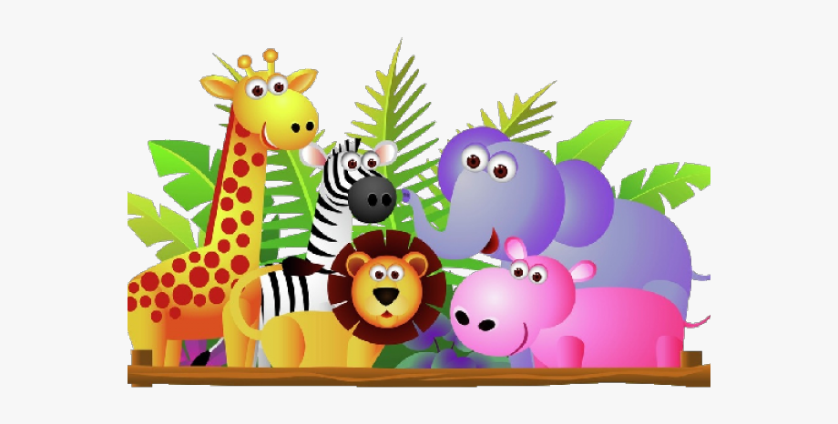
English
Today you are going to write your own ending to your animal story.
Read my ending on the next slide…

Slide 14
No longer did the other wallabies laugh at Thud. Really, they wanted to be just like him.
What happened to Daisy? Well that’s another story!

Slide 15
If you look carefully, you will see that my ending explains these things:
The mean animals at the start of the story weren’t mean anymore.
They wanted to be just like Thud.
An ending sentence

Slide 16
Today I would like you to write your own ending to your story. Include:
The mean animals at the start of the story not being mean anymore.
The others wanting to be just like your character.
An ending sentence.

Slide 17
Then I would like you to read through your whole story and check for missing words, capital letters and full stops.
Then, if you would like, you can write the story in your best handwriting on a new piece of paper as a whole story. Once you have finished, you can read it to someone in your home.
Well done! I’m sure that you have written a fantastic animal story!

Slide 18
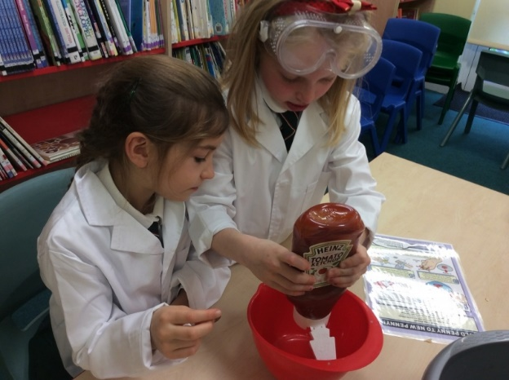
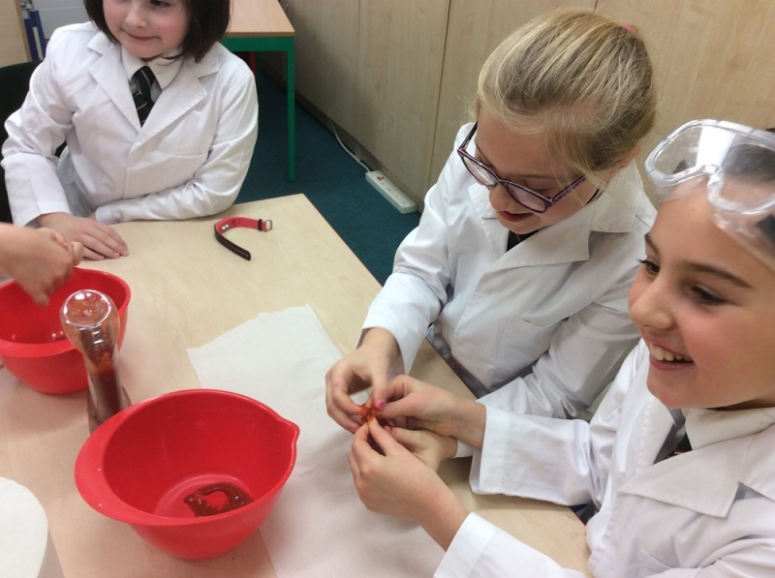
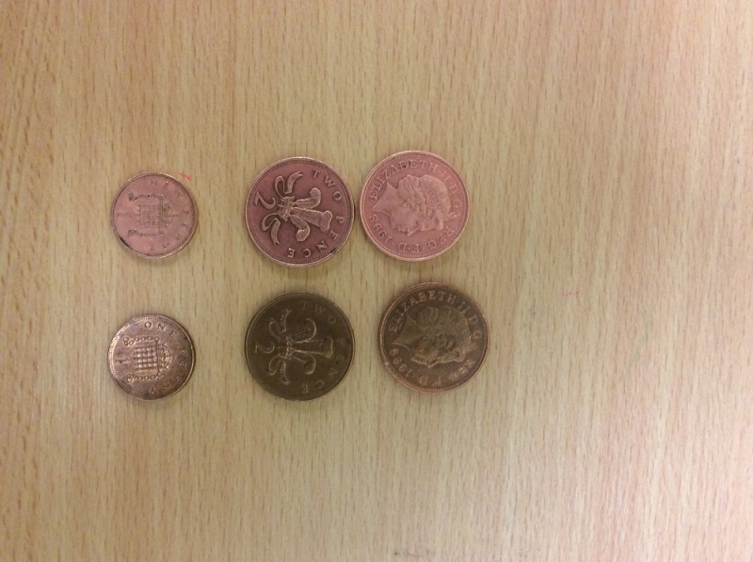
‘Find Out Friday’ Science!
Today I would like you to carry out a practical activity that our Young Science Ambassadors carried out last year.

Slide 19
This is an activity for transforming old dull-looking pennies into pennies that become bright and shiny!
First put a penny into a bowl of tomato ketchup (making sure it is completely covered) and leave it for three minutes.
Then have fun getting messy fingers by rubbing the sauce into the coins for another thirty seconds.
After that, use water to rinse and clean all of the ketchup from the penny.
Finally, dry the penny with a tissue.
Instead of dull-looking coins, you should have money that is so shiny you may be able to see your reflection in them!
Don’t forget to wash your hands.

Slide 20
What’s the Science behind it? The salt plus the acid in the tomato sauce formed hydrochloric acid and this reacts with the copper.
Have a look at this link to see what the Young Science Ambassadors did:
Young Science Ambassadors
( scroll down to the bottom of the page)

Slide 21
Well done for all your hard work, Unicorns!
From Mrs Matthews
x

