Slide 1
Good Morning Unicorns!
Here’s your work for today:
Thursday 26th March

Slide 2
Reading Comprehension
Today you are going to read a text and then answer questions about it.

Slide 3
First…
…read the text ‘The Ferris Wheel’ on page 5 in your CGP Reading workbook

Slide 4
Now take a look at the questions…
R
Remember to be detectives- the answers will be hidden somewhere in the text.

Slide 5
Please complete the questions on pages 6-10 of your CGP Reading workbook.

Slide 6
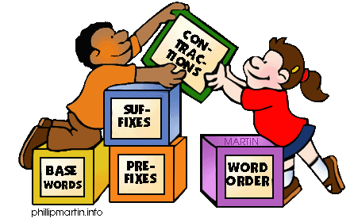
Grammar
Today you will be focussing on:
Sentences
Watch this link to recap:
sentences

Slide 7
Grammar
Please complete pages 4 and 5 in your Nelson Grammar workbook.

Slide 8
Maths answers from yesterday:
Pages 12, 13 and 14
21 medals
26 yellow flowers
38 books
65 – 40; 35 -10
77 bricks
21 animals
13 + 28 and 28 + 13
36 apples
55 people
12 cards
Deepen Activity
Circle = 9, Square = 1, Star = 7
Circle Star – Star Circle = 18

Slide 9
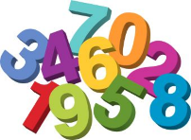
Maths
Today we are going to recap on our knowledge of solving word problems.

Slide 10
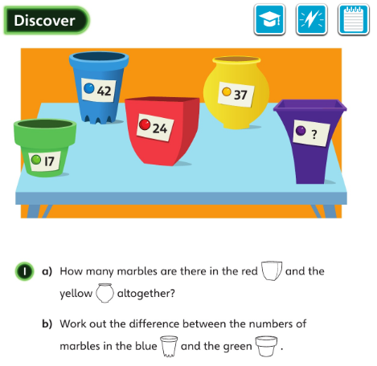
a): What do you think you need to do to find the solution?
b): How could you represent difference using bar models?
• What additional questions could you ask about this picture?

Slide 11
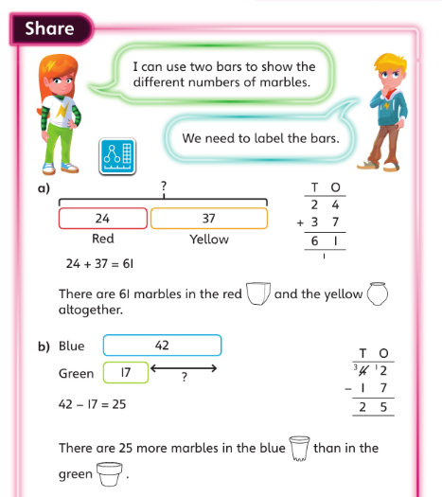
Let’s look at the answers and how you could have worked them out …

Slide 12
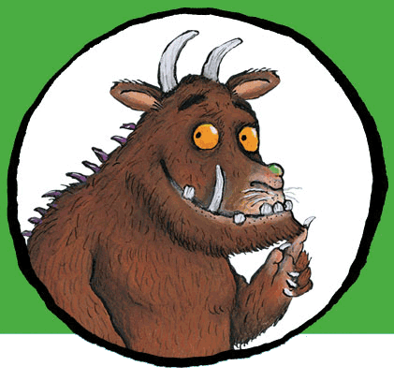
Now I would like you to have a go at completing work in your CGP Maths Reasoning workbook.
If you would like to try Gruffalo work, complete page 15.
If you would like to try Horrid Henry work, complete pages 15 and 16
If you would like to try James and the Giant Peach work, complete pages 15 and 16 and my ‘Deepen Activity’ question on the next slide.

Slide 13
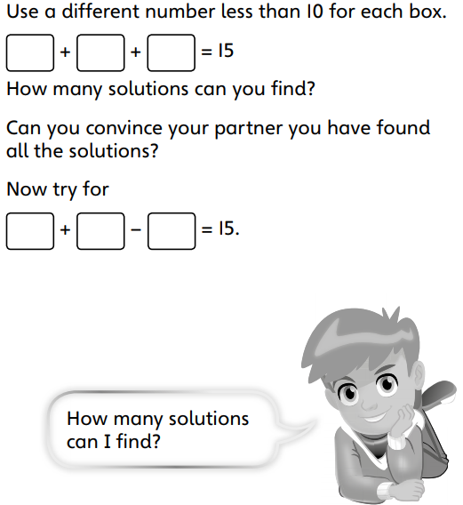

Slide 14
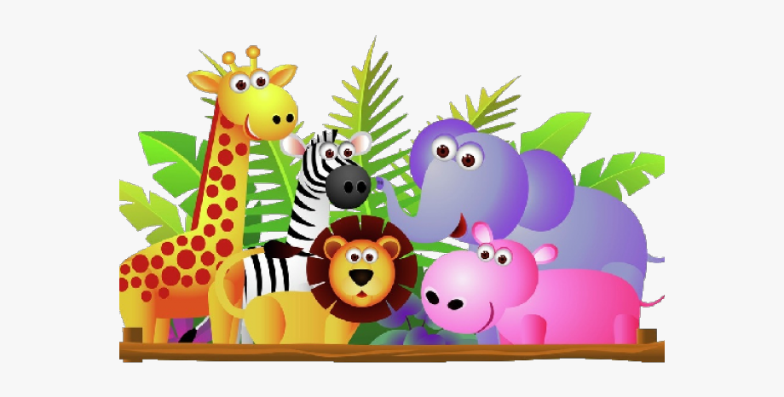
English
Today you are going to write your own problem and resolution in your story.
Read the problem and resolution to my story on the next slide…

Slide 15
Daisy wanted to try again but then they both heard a noise in the distance. It was a pack of angry looking dingoes. Now the thing you need to know is that dingoes eat wallabies.
This time, Thud was terrified. He took one hop. THUD. He took another. THUD.THUD. He took another. THUD. THUD. THUD. Without realising, Thud began to hop quickly like all the other wallabies. In fact, he could hop even faster than all of the others.

Slide 16
If you look carefully, you will see that the problem and resolution explains these things:
Daisy wanted to try again but something scared them.
I explained why this was so serious.
How Thud learned to hop.
How great he was at hopping.

Slide 17
Today I would like you to write your own problem and resolution to your story.
-Your animal friend wants to try again but something happens.
-Explain why this was so important.
-How your character learned to do a new thing.
-How great they were at that new thing.
Read through your sentences and check for capital letters and full stops.

Slide 18
Art
Rob Biddulph has set up a #DrawWithRob activity, in which he is posting draw-along videos that you can follow.
Click on this link to watch Rob create a Gregosaurus and have a go yourself!
http://www.robbiddulph.com/draw-with-rob

Slide 19
Have fun, Unicorns!

