Slide 1
Guided Reading

Slide 2
Complete the coloured work labelled on your pack.
If you want a challenge, or have some extra time, please feel free to try another group’s work ☺
Purple Group complete page 6 in your work book.
Blue Group complete pages 6 & 7 in your work book.

Slide 3
2 Sides

Slide 4
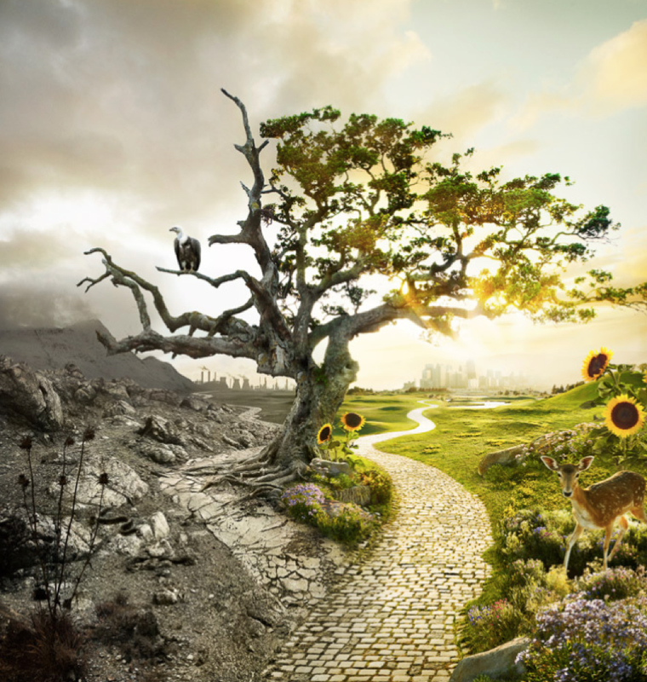
Questions Orange and Green Groups
Why are the two sides of this picture different?
What do you think it would feel like in either place?
Would it like possible for the grey side to become like the colourful side again?
Remember to answer the questions in full sentences.

Slide 5
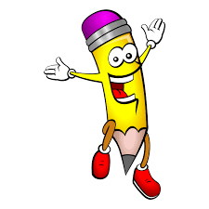
Handwriting Complete page 3 in your handwriting book.

Slide 6
English
This week we will write our own poems using poetic techniques

Slide 7
Its raining pigs and noodles by Jack Prelutsky
It’s raining pigs and noodles,
It’s pouring frogs and hats,
Chrysanthemums and poodles,
Bananas, brooms, and cats.
Assorted prunes and parrots
Are dropping from the sky,
Here come a bunch of carrots,
Some hippopotami.
It’s raining pens and pickles,
And eggs and silverware.
A flood of figs and nickels
Are falling through the air.
I see a swan, a sweater,
A clock, a model train-
I like it so much better
Than when its raining rain.

Slide 8
Day 2: Alliteration
It’s raining pigs and noodles,
It’s pouring frogs and hats,
Chrysanthemums and poodles,
Bananas, brooms, and cats.
Assorted prunes and parrots
Are dropping from the sky,
Here come a bunch of carrots,
Some hippopotami.
It’s raining pens and pickles,
And eggs and silverware.
A flood of figs and nickels
Are falling through the air.
I see a swan, a sweater,
A clock, a model train-
I like it so much better
Than when its raining rain.
Write down examples of alliteration you can find in the poem.
Remember: what is alliteration?
Answer: words which start with the same sound, e.g. pigs, pasta, peas.

Slide 9
Day 2: Alliteration
Now, look at your list of nouns. Can you find pairs of nouns which are alliterative? Below are some ideas to get you started.
pigs and pasta
perfume and peas
bananas and babies
burgers and beans
figs and fingers
steam and sticks
grass and grouse

Slide 10
Maths
Year 3
Complete the coloured work you would normally do in class.
If you want a challenge, or have some extra time, please feel free to try another group’s work ☺
Red Group follow this link https://HIUIDIV.exampro.net

Slide 11
Purple group – complete pages 3 and 4 of your workbook
Blue group - complete pages 3 and 4 of your workbook
We are recapping our knowledge of place value.
Which is bigger and why? Use place value to explain:
34 or 43

Slide 12
WALT: identify 100s, 10s and 1s.
We are going to consolidate our knowledge of place value,
which we looked at in Autumn Term.
Look at the yellow pages to help you, then complete the work for your group.
Green group – green background
Orange group – orange background

Slide 13
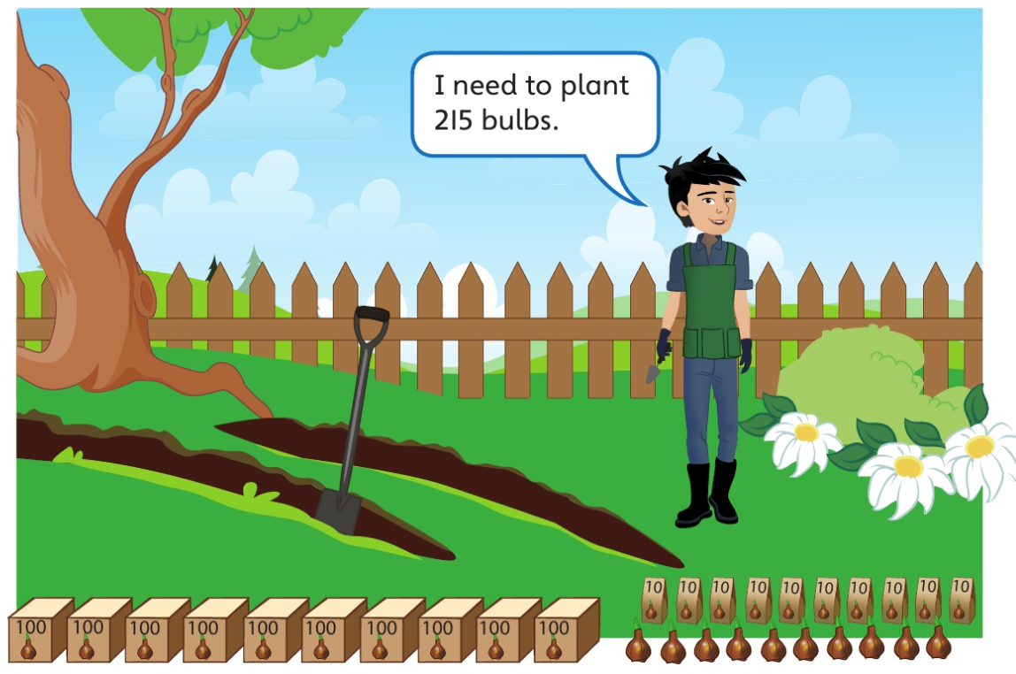
How many boxes of 100, packs of 10 and single bulbs will he need?
Show this on a place value grid in your book.

Slide 14
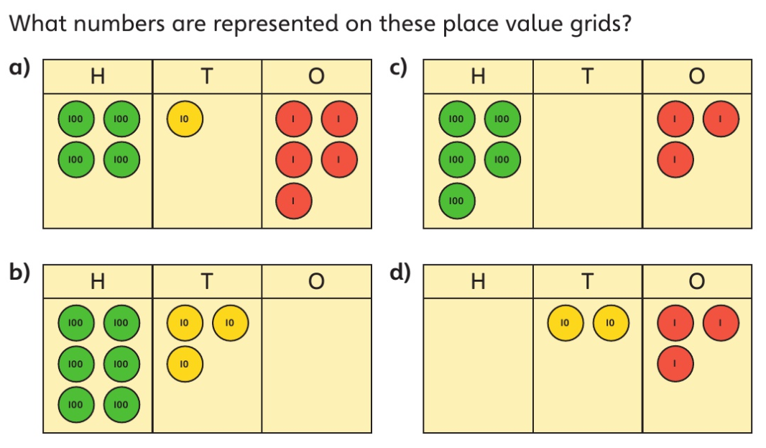

Slide 15
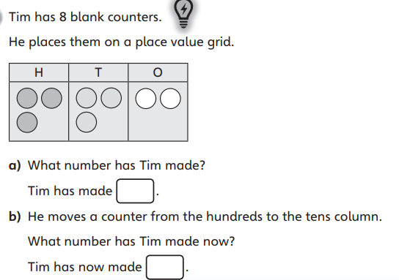

Slide 16
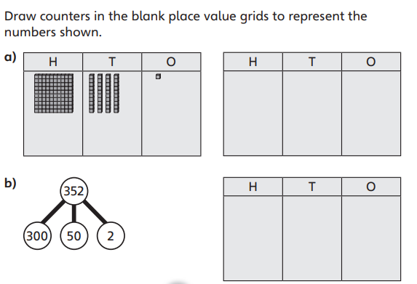

Slide 17
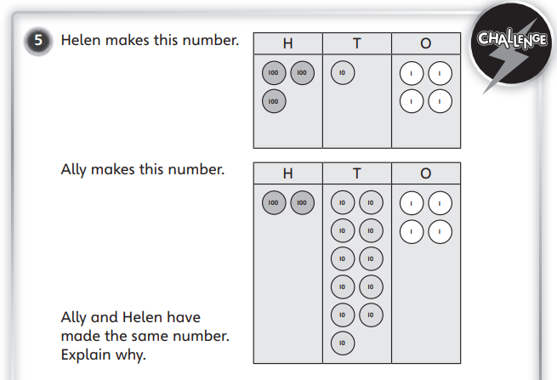

Slide 18
Rocks and Soils How are fossils made?

Slide 19
We are looking at fossils and finding out how they are made.
First of all, look at these pictures and see what fossils you can find.

Slide 20
Watch the video in the link below, and read the rest of the web page underneath.
How are fossils made video
Make notes in your book to explain how a fossil is made.
You could use the sequencer on the website to help you if you are unsure.

