Slide 1
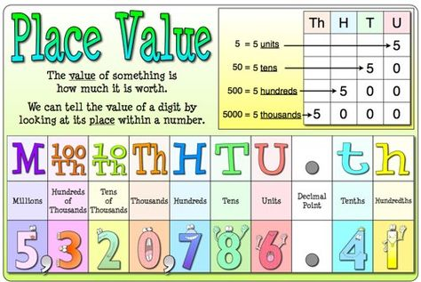

Slide 2
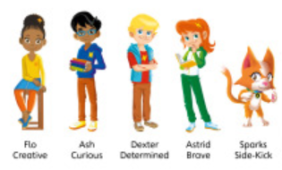
Day 1
WALT: order and compare numbers to at least 1,000,000

Slide 3
Daily Maths
Discovery –Look at a question independently
Share – Show different methods of how a question could be answered
Thinking Together – Discuss method shared, use information to answer questions
Challenge – Plato only
Practice – Children to work independently on tasks.

Slide 4
What you need to do?
Discovery – Plato, Aristotle, Pythagoras
Share – Plato, Aristotle, Pythagoras
Thinking Together – Aristotle, Pythagoras
Challenge - Plato
Practice – Pythagoras Qu 1 and 2
        Aristotle Qu 1 – 4
        Plato Qu 3 - Reflection

Slide 5
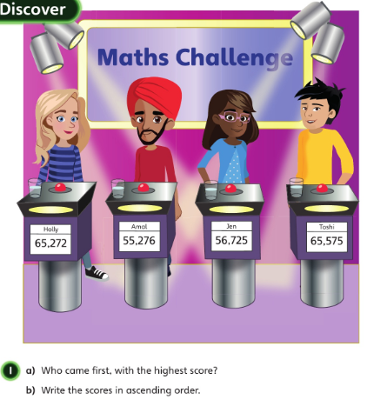
Discovery – Look at a question independently
What do you notice about the digits in all of the scores?
Can you find some digits that have the same value in different scores?
How do you know immediately that Amal was not the winner?
How do you know that Holly was not last?
Which digit in the number tells you this?

Slide 6
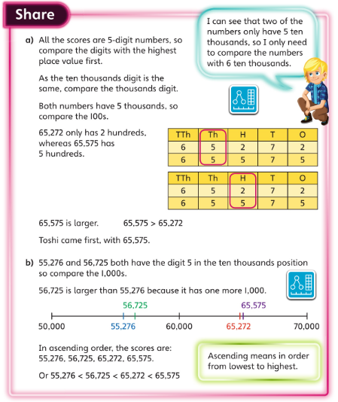
Share – Show methods of how a question could be answered
Question a)
Why is it important to check how many digits each number has before comparing digits?
Can you suggest a pair of 5-digit numbers where you need to check the 1,000s but not the 100s?
What would you do if the number of 100s in the two scores had also been the same?

Slide 7
Question b)
Why do you only need to compare the numbers 55,276 and 56,725 now?
How does representing the two numbers with place value counters help you compare them?
How do the signs between the numbers tell you that they are in ascending order?
What does descending mean? How could you write the numbers in descending order?

Slide 8
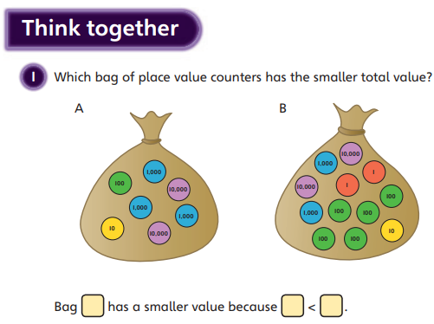
Bag B has more counters, but why might it not have the larger value?
Which counters have the largest value?
Why do you need to compare the numbers of 1,000s next?

Slide 9
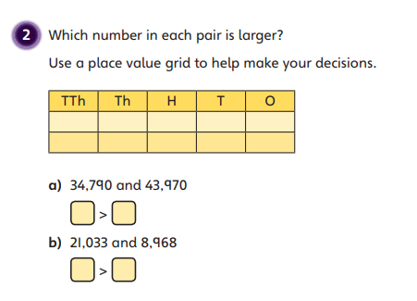
Thinking Together – Discuss method shared, use information to answer questions
How do you know that you need to write the larger number in the
first box each time?
One of the numbers starts with a larger digit. Does this mean that it must be the larger number? Why?

Slide 10
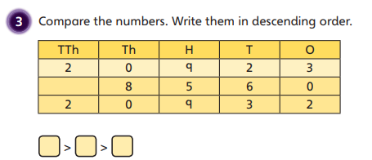
How do you immediately know that the second number on the grid is the smallest?

Slide 11
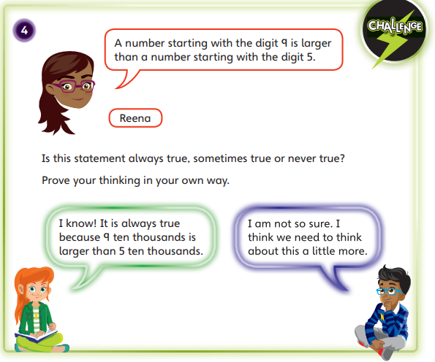

Slide 12
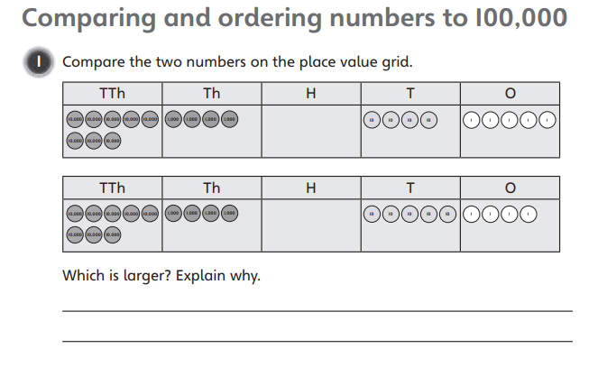

Slide 13
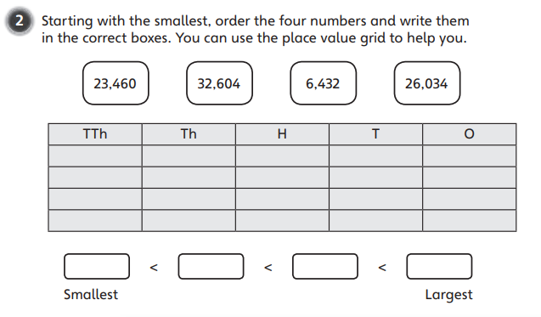

Slide 14
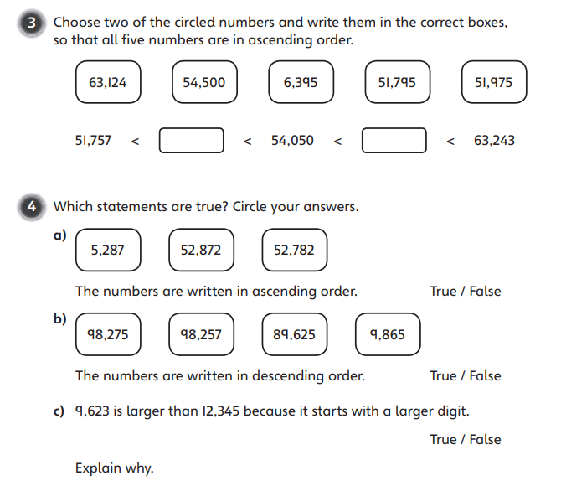

Slide 15
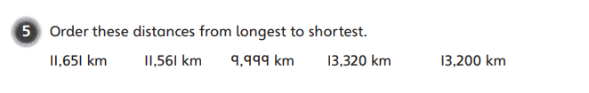
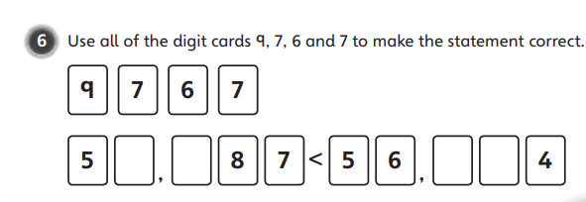

Slide 16
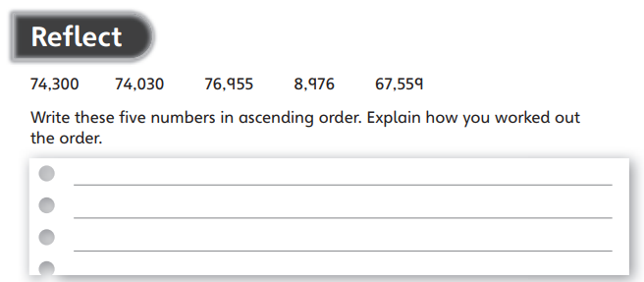

Slide 17

Day 1
Guided Reading

Slide 18

Inference and Deduction Skills
WALT: use our skills in inference and deduction to gather information about a text.
That sounds very complicated
but it just means searching
for clues and reading between the lines
to work out what’s going on!
Notes:
Opportunity to update vocabulary bank

Slide 19
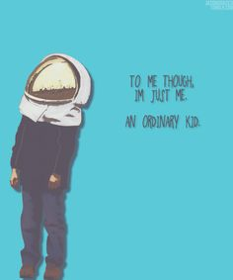
. What do you notice about the book covers?
‘You can’t blend in when you were born to stand out’
‘To me, though, I’m just an ordinary kid.
Notes:
Direct students to think about colour, images, the eye, why the face might not be shown. They may need a lot of scaffolding for deep thinking and encouragement to explain their ideas.

Slide 20
What is a Blurb?
Is this an effective blurb?
Why?
Why not?
My name is August.
I won’t describe what I look like.
Whatever you’re thinking, it’s probably worse.
Notes:
If students aren’t confident, record definitions in vocabulary bank.

Slide 21
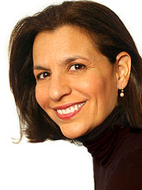
So to sum up…
R.J. Palacio wrote the children’s novel
‘Wonder’, a fictional story about trying to fit
in when you stand out.
The idea for the book came from a real incident!
The author was at an ice-cream shop with her two sons when they saw a little girl with a facial difference (this is kinder than the word deformity).
Palacio’s 3-year-old son started to cry. Her 10-year-old son looked alarmed. She quickly pulled the boys away. Palacio never saw the girl again, but she did not forget about her.
“I started thinking about what life must be like for that family, for that little girl. Imagine having to face a world that couldn’t face you back. That is how I came up with the idea for August Pullman, the main character in Wonder.”

Slide 22
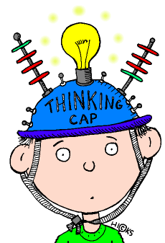
The main character in ‘Wonder’ was born with Treacher-Collins syndrome.
This means his face is very
different to other
children’s.
Why might someone write
a book about a boy with
Treacher-Collins syndrome
going to school for the
first time?
Notes:
Lead students towards encouraging people to be understanding and kind.

Slide 23

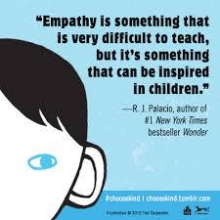
If every person in this room made it a rule that wherever you are, whenever you can, you will try to act a little kinder than is necessary - the world really would be a better place. And if you do this, if you act just a little kinder than is necessary, someone else, somewhere, someday, may recognize in you, in every single one of you, the face of God
Notes:
The author wanted to encourage people to be kind
Pledge to choose kind – charity campaigns began to encourage people to be understanding of people with TCS

Slide 24

Thinking Time
What kind of places do you think there will be in the story?
What kind of dilemmas might the main character face?
What kind of characters might we meet?
Do you think there will be a moral of the story or that it will teach us something?

Slide 25
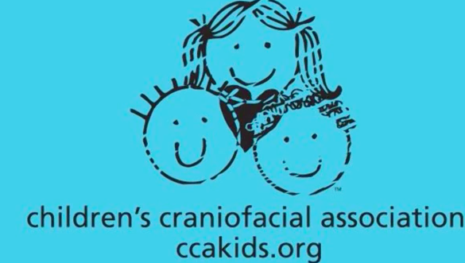
Treacher-Collins syndrome is more common than you might think so RJ Palacio’s message is so important. As we read her book, you will hear about a character called Auggie Pullman who has quite a tough time at school.
As we read, remember that there are many Auggie Pullman’s in the world!
Notes:
Watch a few then skip to the message at the end.
https://www.youtube.com/watch?v=mKDRo5DLTwQ

Slide 26
Exit Pass
Complete these sentences:
I think the book will be about…
The writer wrote the book because…
I think the writer wants the reader to…

Slide 27
Day 1
English

Slide 28

WALT:
use showing and telling when exploring a character description.
It makes the story much more interesting and allows the reader to fully understand how a character feels.

Slide 29

Show, don’t tell!
One way of making your writing more interesting is to SHOW rather than TELL.
Example: David was in a furious temper.
David stomped to his desk spilling coffee as he went. Pushing past a group of people, he threw himself into his chair. With one sweep of his hand, he cleared his desk and growled at the nearest secretary.
Write down the words or phrases, in your book, that show you that David was furious. How did he move? What sounds did he make? What did he do?

Slide 30
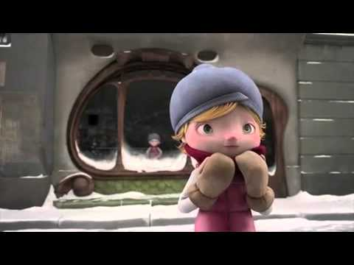
Peacefully, the crisp, white snowflakes tumbled towards the earth, above the sleepy Barcelona suburb, blown by a blustery wind, which whistled through the labyrinth of dark alleys and huddled houses. Alma tried her best to dart and dodge in between each flake, causing her to bounce all over the cobbled path. Her pale pink gilet was the colour of her rosy cheeks and her small button nose, which had been exposed to the chilly weather for just a few minutes too long. Rested on her head, sat a grey bobble hat – warm and snug. This young girl had not a care in the world as her arms waved about playfully and she continued to skip through the cascading snow.
Read the text. Can you pick out where ‘show not tell’ has been used? Write it in your book. Then explain what feeling it is showing.

Slide 31
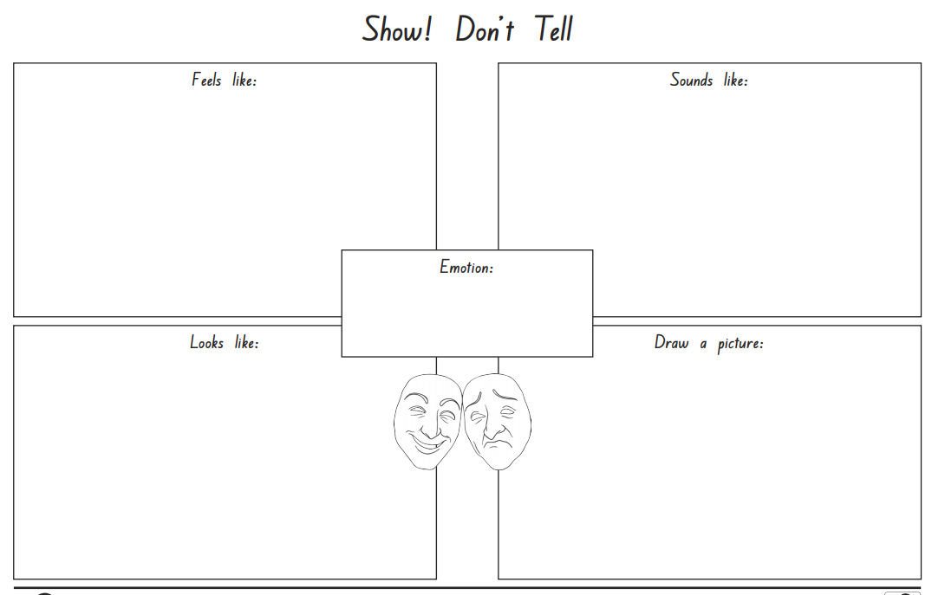
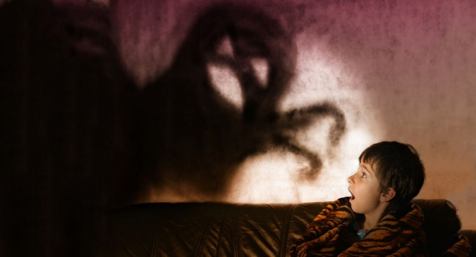
Look at the grid. Look at the different examples of ‘show not tell’ for the word scared.
e.g
heart beating like a drum
Butterflies in stomach
e.g
Stomach rumbling
Pulse racing
scared
e.g
Break out in a sweat
Hands clasped over mouth
Eyes wide open

Slide 32
Choose an emotion from… scared, happy, shy, angry etc. Place it in the box in the middle. Then describe what it feels like, sounds like, looks like and draw a picture to illustrate it!

Slide 33
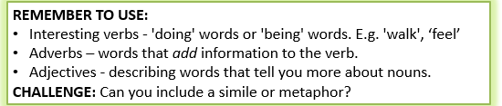
Show, don’t tell!
One way of making your writing more interesting is to SHOW rather than TELL.
Task: Re-write the statements below so that you are showing, not telling, the reader how these characters are feeling.
She was frightened.
He was unhappy.
She was happy.
He was surprised.
She was excited.
This link will help you remember what similes and metaphors are.
https://www.youtube.com/watch?v=uoSBVNUO2LU

Slide 34

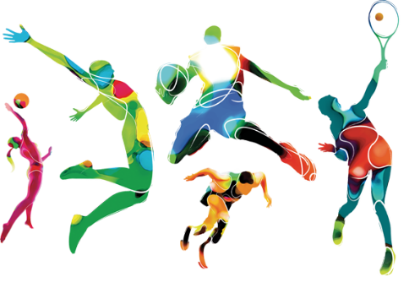
PE
Use this link to access 5 a day
https://player.5-a-day.tv/
User Name: FPS53
Password: JFz4XqG7​

