Slide 1
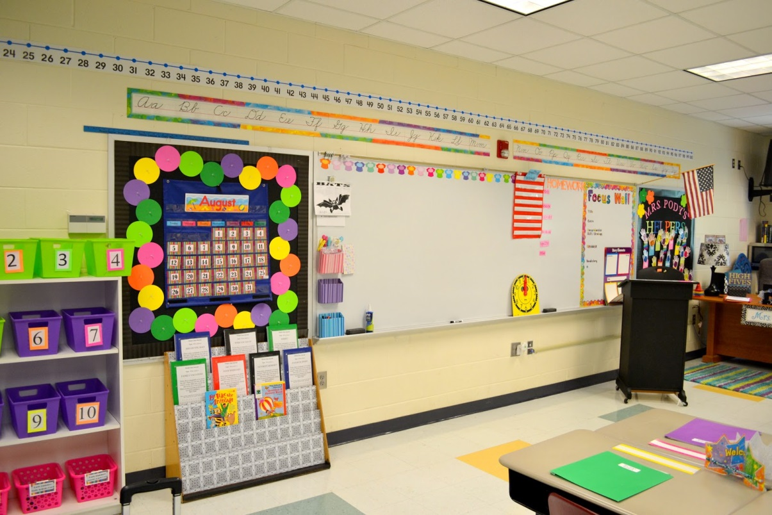
Phonics and ReadingWorkshop
Farnborough Primary School

Slide 2
Session Aims
What does phonics mean?
Understanding the 44 sounds of the English Language
How to support blending skills for reading
What are tricky words?
The Year 1 phonics screening test
Supporting reading at home

Slide 3
What does phonics mean?
Phonics means the sounds that letters make in words
There are 26 letters
There are 44 sounds
There are over 140 ways to combine the 26 letters to make 44 sounds
We blend sounds together to help us read (build words up)
We segment words into sounds to help us spell (break words down)

Slide 4
The Alphabet
We need to learn
Letter sounds (phonemes)
Letter names
Letter shapes A a a (graphemes)
Letter pattern when writing

Slide 5

Letter sounds

Slide 6
Letter sounds
How to learn the letters and sounds of the Alphabet - YouTube
How did you get on?
Which sounds are most tricky?
c and k make the same sound
q is made of two sounds (kw)
x is made of two sounds (ks)
Remember to avoid making a ‘schwa’ at the end of each sound; this is where it is over emphasised

Slide 7
Blending
We blend sounds together to help us read.
Blending involves saying the individual sounds in a word and running them together to make the word.
For example, sounding out d-o-g and making dog. It is a technique that every child needs to learn and practice.
To start with you should sound out the word and see if your child can hear it, giving the answer if needed.
Some children take longer than others to hear this. The sounds must be said quickly to hear the word. It is easier if the first sound is said slightly louder

Slide 8
Your turn
Have a go at blending some words using the sounds that we have learnt so far. Use your alphabet arc to help you.
pog tabsug zenlap
Slitenpod brenpigas

Slide 9
Blending
When supporting your child with blending skills you also need to remember that some sounds are represented by two letters, such as sh. These are known as digraphs
Children should sound out the digraph (sh), not the individual letters (s-h)
With practice they will be able to blend the digraph as one sound in a word. A word like rain should be sounded out as r-ai-n and feet as
f-ee-t.
This is difficult to begin with and takes practice

Slide 10
Now have a go at saying these sounds. They represent the remaining sounds that make up the 44 sounds of the English language
Which is the odd one out?
sh
ch
th
th
ng
zh
ai
ee
igh
oa
oo
OO
ar
or
ur
ow
oi
ear
air
ure
er

Slide 11
Blending
How would we read these nonsense words?
chail pightfoy dairang
chail pightfoy dairang

Slide 12
Blending
One letter can represent a sound as in ‘t a p’
Two letters can represent a sound as in ‘p i ck’
Three letters can represent sound as in ‘l igh t’
Four letters can represent a sound as in ‘th r ough’

Slide 13
Blending
Use your full rainbow of sounds to have another go at blending these words.
Try underlining or highlighting each word into the sounds that you can see on the rainbow.
sart tighfear poajing
yaireecher

Slide 14
How do we teach phonics in reception and Key Stage 1?
Using the Letters and sounds programme
Introduced in phases, grouping sounds together that can then form words e.g.
s a t p i n
Using your whiteboards –how many words can you make from these sounds? You have a minute to win it!
at in tap sat tip nip tan pat an pan sit

Slide 15
How do we teach phonics in reception and Key Stage 1?
The letters b and d are introduced in different groups to avoid confusion
Sounds that have more than one way of being written are initially taught in one form only
For example: the sound ai (rain) is taught first and the alternatives a-e (gate) and ay (day) follow later

Slide 16


Multi-sensory teaching
Each sound is taught in a multisensory way to enable to children to recognise:
Sound
Letter name
Shape
Formation
Jolly Phonics song for children in order - YouTube

Slide 17
Tricky words
Alongside each phase of the letters and sounds programme we teach tricky words
Tricky words cannot be read or spelt using our knowledge of sounds as they do not follow the rules
They have to be learnt as sight vocabulary
As with the 44 sounds, tricky words are also taught in phases

Slide 18
Tricky words
the to I no go
he she we me be was my you her they all are
some one said come do so were when have there out like little what
By the end of year one, the majority of children should be able to read and spell the above tricky words

Slide 19
Phonics Screening Check
The phonics screening check is a short simple assessment to make sure that all pupils have learned phonic decoding (reading) to an appropriate standard by the age of 6.
All year 1 pupils in maintained schools, academies and free schools must complete the check
This check takes place in the Summer term

Slide 20
How does the check work?
Your child will sit with a teacher he or she knows and be asked to read 40 words aloud
Your child may have read some of the words before, while others will be completely new
The check will contain a mixture of real words and ‘non-words’ (or nonsense words)
The check normally takes a few minutes to complete and there is no time limit. If your child is struggling your teacher will stop the check. The check is designed not to be stressful for your child
(DFE 2013)

Slide 21
Supporting Reading
Using Phonics
When your child meets a word they don’t know ask them to:
Sound out the word from left to right – try to avoid guesses based on the initial sound
Concentrate on the part of the word that may not have been sounded out correctly e.g igh
Tell them the correct sound that the letter/s make

Slide 22
Sound out the word from left to right again using the correct sounds
Blend the sounds together faster and say the word
In some cases you may need to tell them what the word is

Slide 23
Supporting Reading
At Home
Find a quiet place away from interruptions
Sit somewhere comfortable where you can both see the book. A table is useful to prevent the book from moving around. Try to avoid the book being ‘flat’ if possible.
Let your child take control of the book –turning pages, following the words with a finger etc.
Spend a few minutes discussing the ‘blurb’ and front cover before you even open the book-what do you think this book is about?

Slide 24
Help and support your child if they get stuck on any words. DO NOT simply tell them the words, encourage them to work it out by:
-sounding out and blending
-using any picture clues
-using the context of the sentence to work out the word.
-re-reading to check for meaning

Slide 25
Isolate a difficult word – cover the rest of the text
Break up a word into chunks (syllables)
Warm the text before you start reading –pick out tricky words or challenging vocabulary and help your child become familiar with the words first. Always have a whiteboard to hand or try using magnetic letters

Slide 26
When your child is reading more independently –use the 3Ps
Pause (before you tell them the word)
Prompt (if they needs a little help)
Praise

Slide 27
Ask your child questions to check their understanding of the text e.g.
What was your favourite part?
How did you feel about the main character?
Which words show you that the character is happy?
What might happen next?
Don’t forget that they can ask the questions too!

Slide 28
Give your child lots of praise and encouragement
Do not worry if your child does not remember a word that they have read easily before. Stay positive and simply encourage and help them work it out again

Slide 29

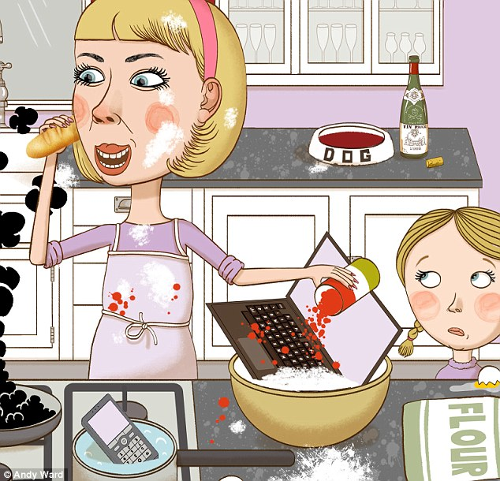
Try not to read with your child whilst you are helping their siblings or completing other tasks

Slide 30




Don’t make your child read there and then if they are really not in the mood. Suggest another time and walk away
Have fun reading together

Slide 31
Fiction Books Fact Books
Comics Newspapers Instructions
Recipes Shopping lists Labels
Advertisements Signs Road Names

Slide 32
Even when your child becomes an independent reader sharing bedtime stories will enable your child to enjoy literature, extending their vocabulary and comprehension of stories.
The more stories and books your child hears, the more they will want to read
Often shared stories are memories that children carry with them for life

Slide 33
F.A.Qs.
1. Are there any other reading strategies that my child can use as well as phonics?
The current government guidance places the emphasis on phonics. However, at Farnborough we are aware that children’s learning styles vary. Other strategies that we use include learning and recalling ‘whole words’ and gaining a good understanding of word families and rhyming skills (light, fight, might). We also look at words in context, prediction skills and reading around the word etc.
2. How often does my child read to an adult at school?
Children in Reception, Year 1 and Year 2 are heard at least once a week. This is sometimes as part of a small guided reading group and sometimes as individuals.
3. Who listens to them read in class?
The class teacher, teaching assistants or a trained volunteer. The children are rotated in order to ensure that they are heard by their class teacher on a regular basis.

Slide 34
4. How many books are provided by the school?
The children receive three books a week, one printed book and two from the Bug Club reading scheme which is computer based. They also have the chance to choose a book from the school library on a weekly basis. Additionally, we encourage parents to visit the local libraries with their children. As well as decoding the words, it is vital that the children understand what they are reading. To encourage this, we suggest that you talk about the book with your child and ask questions to secure their understanding. Shared reading together is a great way of reading a book, as well as children reading by themselves.
5. What books are involved in the reading scheme?
The core books are part of the Oxford Reading Tree and the Bug Club scheme. The Bug Club includes some Oxford Tree books.
6. What happens when my child completes the last stage of the reading scheme?
Your child will become known as a free reader and will have the opportunity to choose their own books. They will be encouraged to continue to choose books available at school as well as those they have at home.

Slide 35
7. How long should I read with my child and how often?
Every day would be great in an ideal world; each session on average lasting between 10 and 20 minutes.
8. Does my child have to read the whole book in one sitting?
Your child should not feel pressured to read a story from beginning to end. You may cover a couple of pages in detail. You may have discussed the title and what is happening in the pictures. You may have used some time to predict what happens next.

Slide 36
9. My child is a reluctant reader. What can I do to motivate them and make reading enjoyable?
Be a good role model – read regularly with your child and be seen as a reader yourself.
Team reading – take it in turns to read, reading in unison, echo reading, parent reading to child, be the teacher.
Playing games within the books – who can find the word ‘was’, how many ‘sh’ sounds can you spot? Can you find a word that rhymes with ‘cat’? Can you find another word that starts with the ‘j’?

Slide 37
Offering alternative books/reading materials that engage your child’s interest e.g. trains, princesses, pirates, dragons, fairies, fun information etc. Please ensure that you avoid referring to the school books as ‘homework’ and the other books as ‘fun’.
PRAISE PRAISE PRAISE!
Reading is a crucial skill in life. Let’s make it as enjoyable as we can in any way that works for you and your family.

Slide 38
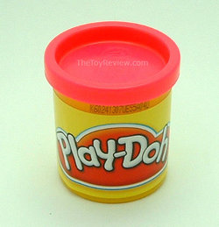
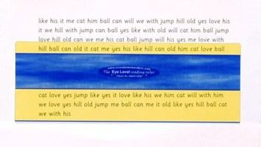


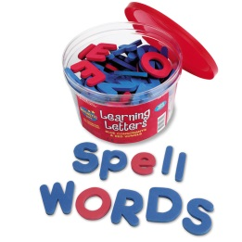
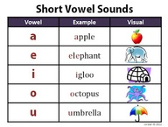



Support pack

Slide 39

The five finger rule
Is your child’s book too difficult to read? How can you tell?
Use the five finger rule.
Get children to read one page from the book. For each word they cannot read get them to hold up a finger.
If they hold up five fingers before the end of the page then the book is more than likely to be too challenging
Showing the children how to do this will help themselves when choosing a book

